Slide 1
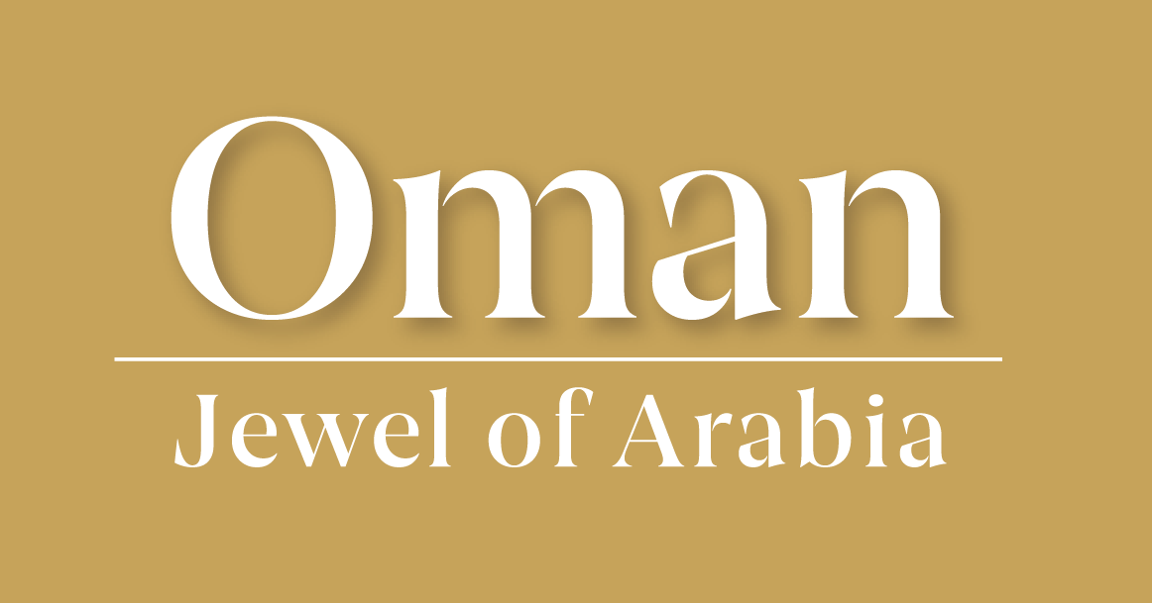
The Land of Frankincense
Learning Goals
Know what frankincense is and why it is sought after.
Describe the location of the Land of Frankincense, predicted climate change and its impacts.
Understand the alternative possible futures for the local population of the Dhofar region.

Slide 2
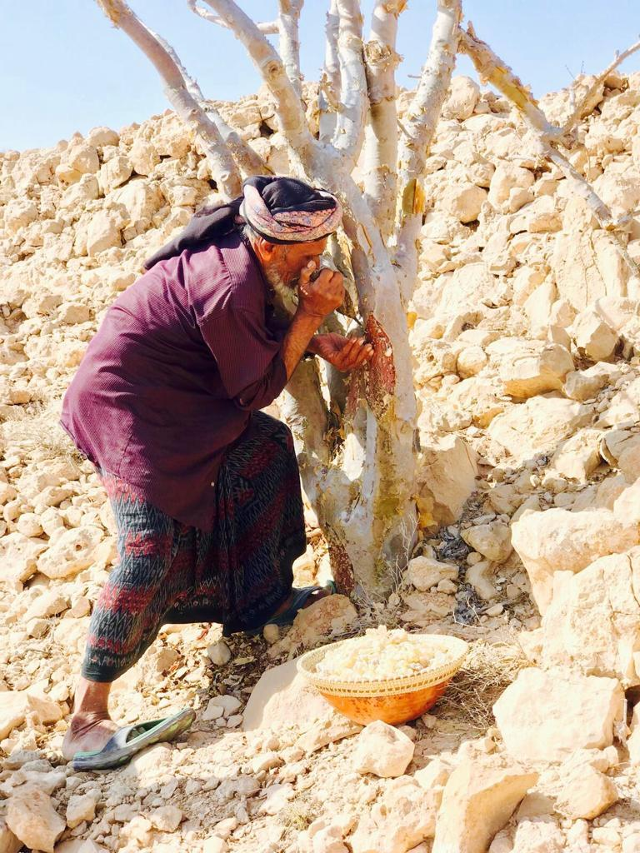
Starter
Discuss the picture on the next slide. What does it show? What are its uses around the world?
Answer the questions about the image on your sheet.
Need a clue?
I'm a fragrant treasure from ancient lands, used in ceremonies and worship by many hands
In the story of Christmas, I was a gift, treasured in Oman for the spirits I lift
Image source: © ayublab

Slide 3
Card sort
You have been given 15 cards on frankincense. Follow the steps below to complete the activity.
Step 1: What did you already know about frankincense? Sort the cards into two piles, one for ‘I did not know that’ and the other for ‘I knew it’.
Step 2: Next, sort the cards into two groups, under the headings: description (6), and uses (9).

Slide 4
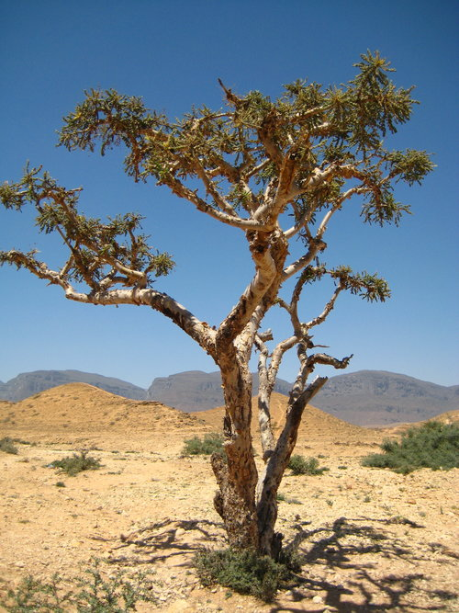
The frankincense tree
Use the next few slides to annotate your copy of the frankincense tree adding information about location, climate, adaptions and characteristics.
Image source: Boswellia Sacra Tree @ ayublab

Slide 5
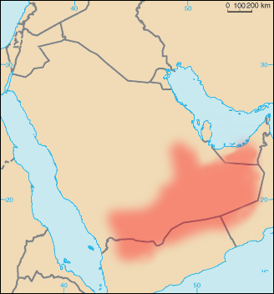
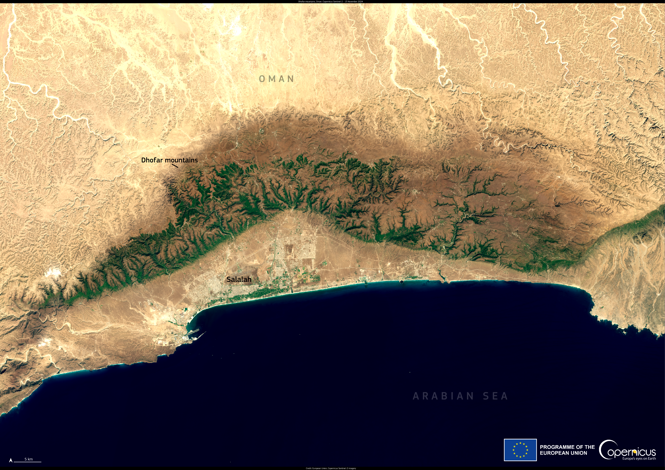
Location
The region of Dhofar is in the south of Oman. It benefits from the almost clockwork arrival of monsoon rain, called the Khareef.
The coastal Dhofar mountains are famous and are home to the desert cloud forest, a unique ecosystem supporting a rich diversity of wildlife.
Behind these mountains is semi-desert and the Rub' al Khali, otherwise known as the Empty Quarter. This is a large expanse of desert covering over 650,000 km².
Image sources: Rub’ al Khali © Thomas Pusch, CC BY-SA 4.0 via Wikimedia Commons and Dhofar © European Union, Copernicus Sentinel-2 imagery Copernicus

Slide 6
Climate
The physical geography of the Rub’ al Khali is arid desert. This area receives some of the lowest levels of precipitation in Oman with only 50 millimetres of rainfall per year.
It is one of the driest places on Earth.
The reasons for such an extreme environment are:
Geographical location
Rain shadow effect
Distance from water
A hyper-arid climate
Image sources: Rub’ al Khali © Thomas Pusch, CC BY-SA 4.0 via Wikimedia Commons and Dhofar © European Union, Copernicus Sentinel-2 imagery Copernicus
Notes:
The reasons for such an extreme environment are:
Geographical location. The Rub’ al Khali is situated in the subtropical high-pressure zone, which is characterized by descending air that inhibits cloud formation and precipitation.
Rain shadow effect. The desert is also influenced by the rain shadow effect from surrounding mountain ranges, which block moist air from reaching the interior.
Distance from water. Being far from significant water bodies and with no permanent rivers, the whole country lacks the moisture needed to support regular rainfall.
Hyper-arid climate. Annual precipitation is typically less than 50 millimetres, making it one of the driest places on Earth.

Slide 7
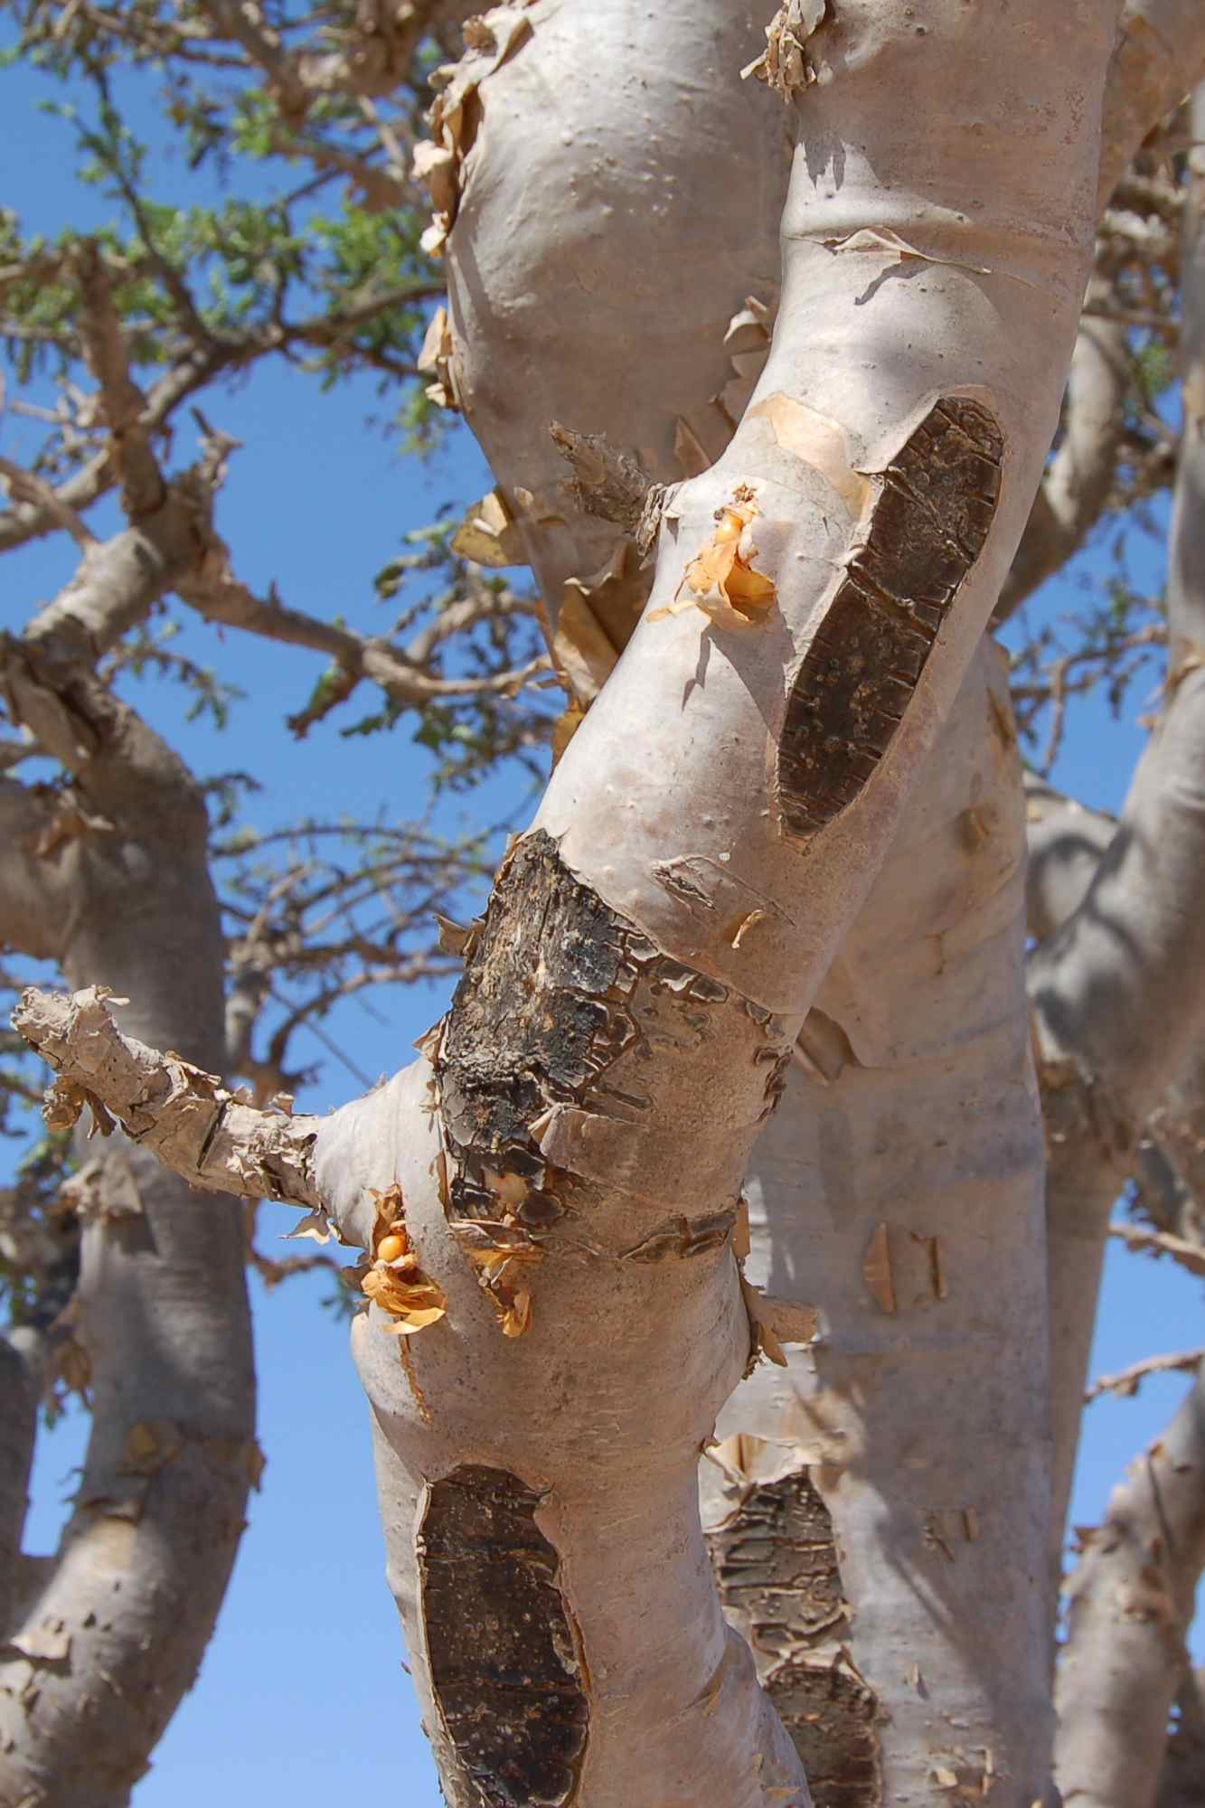
Characteristics
The Frankincense trees grow in the Wādī Dawkah area of Dhofar, between the mountains and the desert.
These trees require direct sunlight for at least 8 hours, well drained sandy soils, and a hot, dry climate. On average, Oman receives ~9.6 hours of sunshine per day (with up to 13 hours per day in May).
In the summer, temperatures across the country can soar up to 40°C with average high temperature in the Wādī Dawkah area being ~32°C in the summer months.
Image source: Wikimedia CC4.0

Slide 8
Adaptations
The Frankincense tree has developed some remarkable adaptations to survive the hyper-arid climate.
Frankincense has temperature regulation by the tree’s bark reflecting sunlight, resin production helps to protect against pests and disease, it has drought tolerance (surviving long periods with minimal water), small thick leaves reduce water loss, and a deep and extensive root system taps into underground water sources.
Image source: Wikimedia CC4.0

Slide 9
The Khareef
Watch the following video.
Using the time stamps, answer the questions on the Khareef.
Challenge: how might the Khareef affect frankincense production?

Slide 10
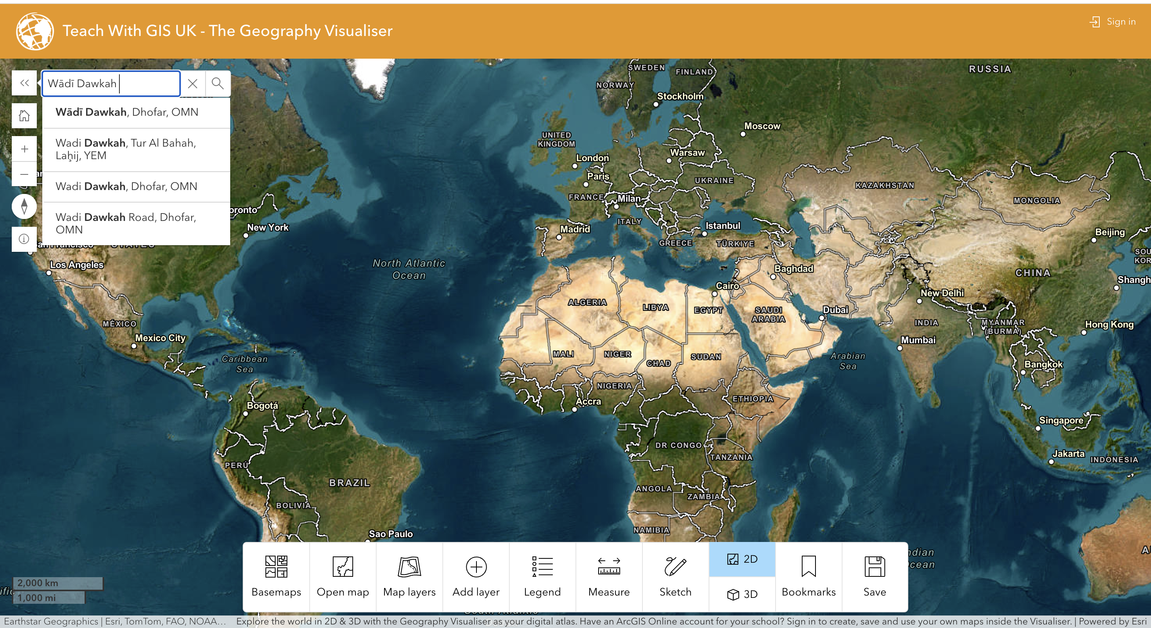
ArcGIS – temperature and precipitation in Oman
Follow the steps to create an online map on the temperature and precipitation in Oman.
Step 1 Go to Teach with GIS UK The Geography Visualiser and search for the Wādī Dawkah area in Dhofar.

Slide 11
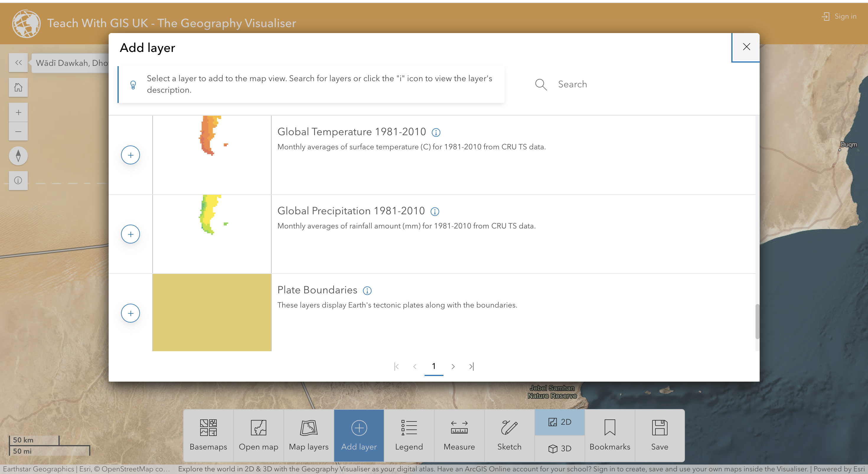
Step 2
Click ⨁ Add layer and scroll down. Find and select Global Temperature 1981-2010 and Global Precipitation 1981-2010 in C° and mm.

Slide 12
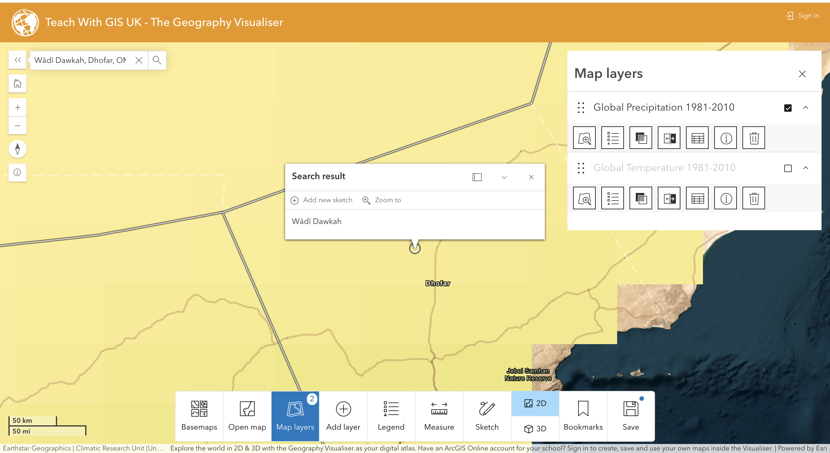
Step 3
You can now switch between Global Temperature and Global Precipitation for the Wādī Dawkah area in Dhofar.
Use the different Map layers (Global Temperature 1981-2010 and Global Rainfall 1981-2010) to describe the environment where the Frankincense trees grow.

Slide 13
The impacts
The atmosphere of Oman is expected to change considerably in the twenty-first century due to climate change.
Most of the country’s 5.1 million people live along the Sea of Oman coastline in either the Al Batinah region or in the Muscat region.
By 2050, temperatures in the Middle East and North Africa (MENA) region are projected to increase by 4°C, with daytime highs potentially reaching 50°C by the end of the century.

Slide 14
The impacts
Open the WWF Risk Filter Suite and select the Water Availability from the drop-down options.
Describe the physical abundance or lack of freshwater resources for the region.
Zoom in on the Sea of Oman, where the majority of the population live. What level of water risk is present along this populated coastline?
Across the Arabian Peninsula flash floods are also expected to worsen. In April 2024 heavy rains and flash floods hit Oman and the UAE. Using this article, highlight the other impacts.

Slide 15
The importance of conservation
Frankincense has been harvested in the Arabian Peninsula and across the Red Sea in the Horn of Africa for millennia.
In Oman, The Land of Frankincense was designated a UNESCO World Heritage site in 2000, originally called The Frankincense Trail.
However, in other places, the frankincense tree is in danger of serious long-term damage.

Slide 16
Comparing frankincense production
Read the article How the west’s wellness industry is driving Ethiopia’s frankincense trees towards extinction
How has the increased demand for frankincense in the wellness industry impacted natural habitats across Ethiopia and Arabia?
What are some of the ethical concerns surrounding the trade of frankincense resin, especially in relation to the local communities?
How do the prices of frankincense products in western markets compare to the earnings of those who collect the resin?
What steps can be taken to ensure the sustainable harvesting of frankincense and protect it from extinction?

