Slide 1
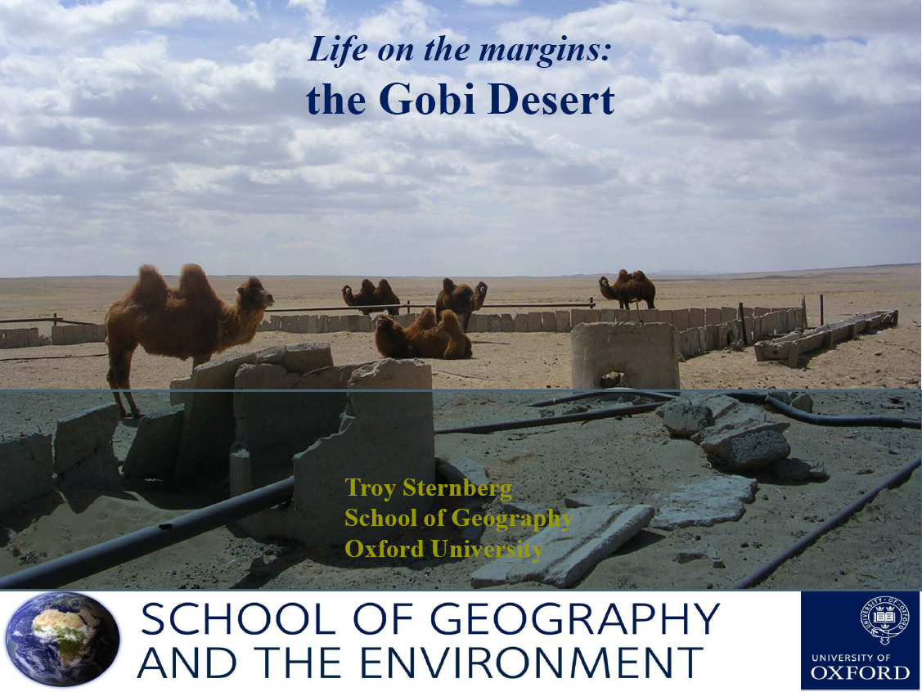
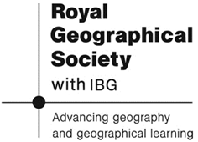

Slide 2
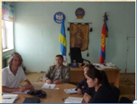
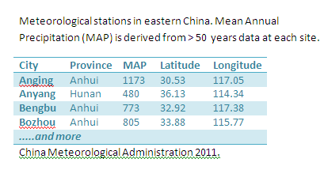
Completing Geographical Research - Qualitative & Quantitative Research
Qualitative Research:
Non numeric field work
Field work methods include extended interviews, field work observations and focus groups.
Although there will be pre set aims and questions an interviewer will want to ask; they may adapt their questioning according to the responses given.
More typically used in human geography.
Quantitative research:
Numerical research where data can typically be graphed and sometimes analysed statistically.
Dr Sternberg used local climate data in China to aid his research.
Field work methods are likely to be
more technically scientific e.g. the
collection of rainfall data over time
using rain gauges in various locations.

Slide 3
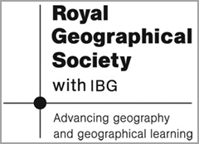
Qualitative & Quantitative Data – Pros & Cons.
Good connections & interpreters are vital.
‘A longer time frame gives a chance for trust to develop and the confidence to go into more depth.’
Often relies on expensive and reliable equipment.
A set of climatic data from a number of different locations and from the last 30 years allows the researcher to compare trends clearly over time and apply statistical correlation tests.
‘An extended interview gives the respondent the time and freedom to express thoughts and ideas that may not fit into a questionnaire’.
Sometimes discussions may touch on issues that are controversial – an interviewee may shy away from discussing particular topics.
‘A limitation is the time involved. Sometimes the answers may wander from the question or occasionally the person does not have a lot to say’.
Quantitative data that covers wide geographical areas can is often available through organisations such as local/central governments (e.g. The UK population census).
Source: Quotes from Dr Troy Sternberg. Also more general statements.

Slide 4
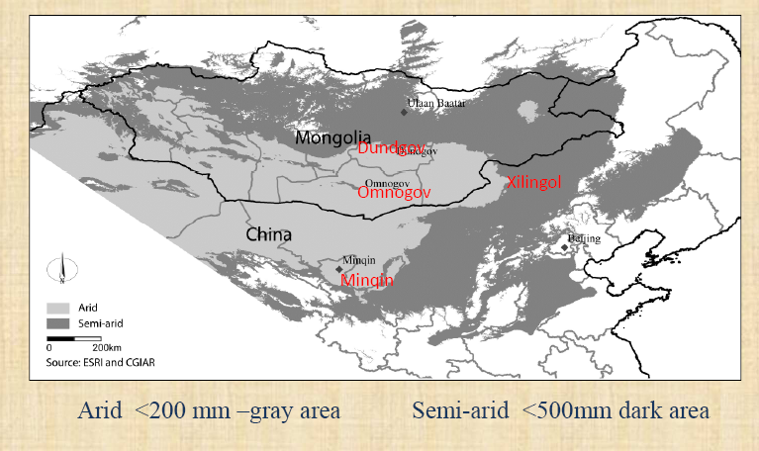
Location of the 3 field work sites, all in the Gobi Desert: i) Omnogov & Dundgov provinces in Mongolia. ii) Minquin County in China. iii) Xilingol County in Inner Mongolia, China.

Slide 5
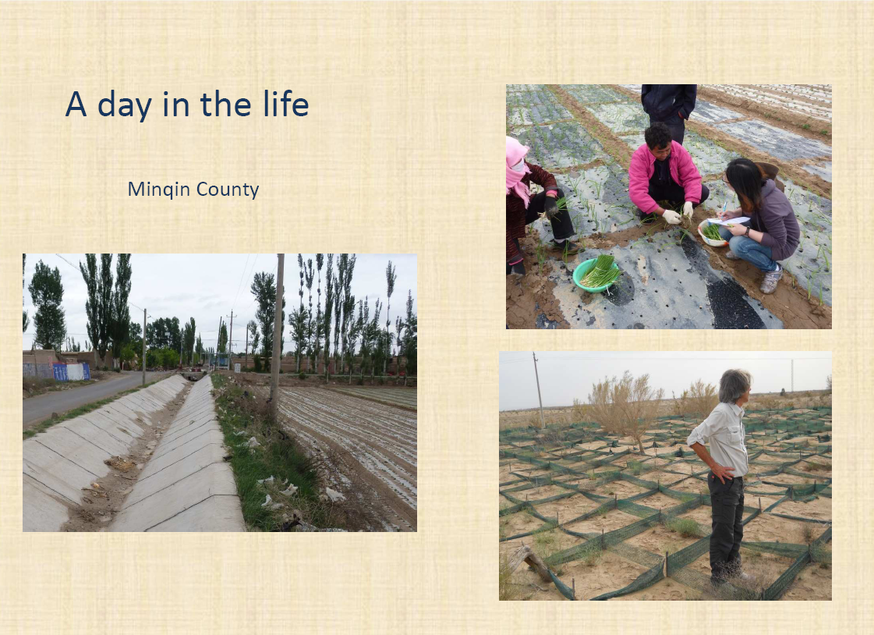

Slide 6
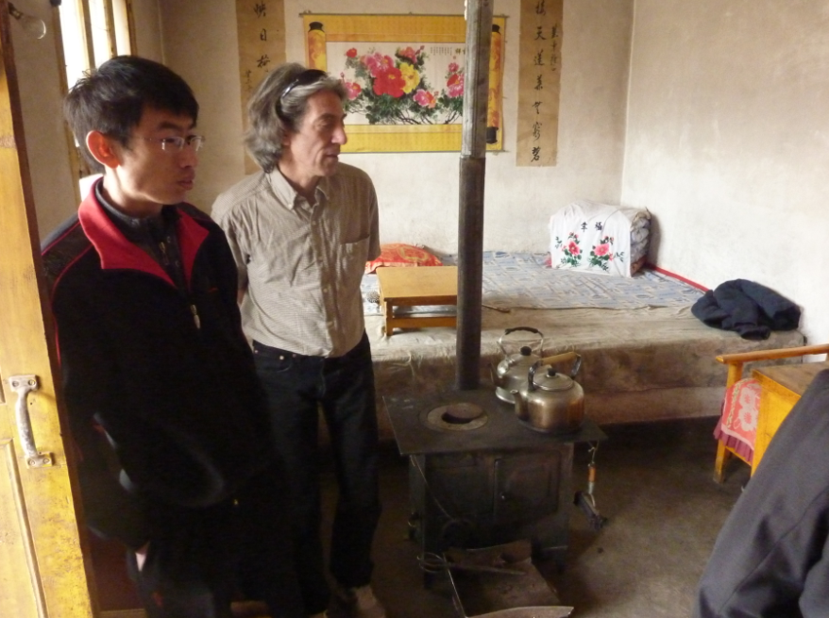
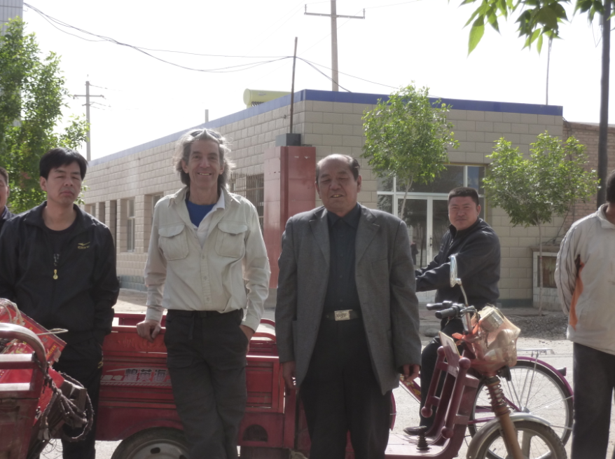
Working with researchers in China:

Slide 7
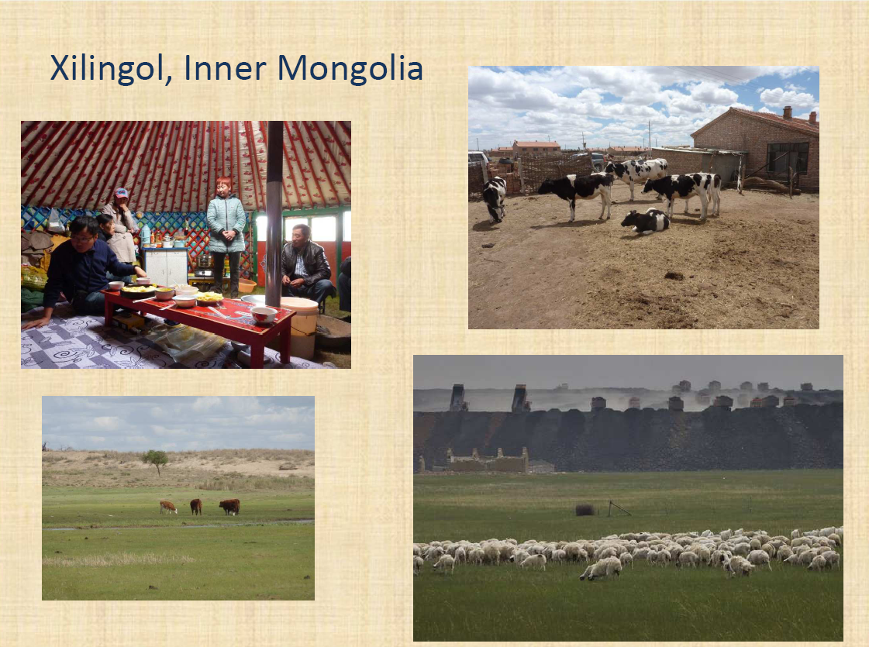

Slide 8
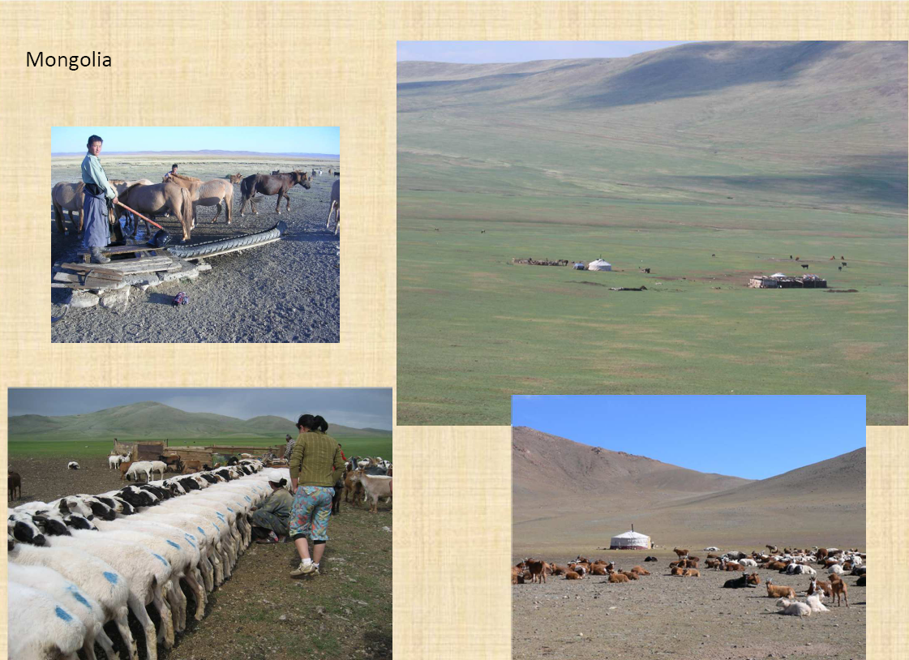

Slide 9
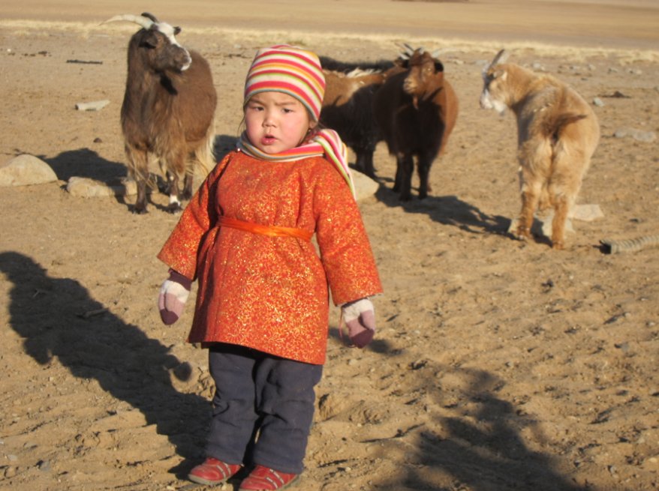
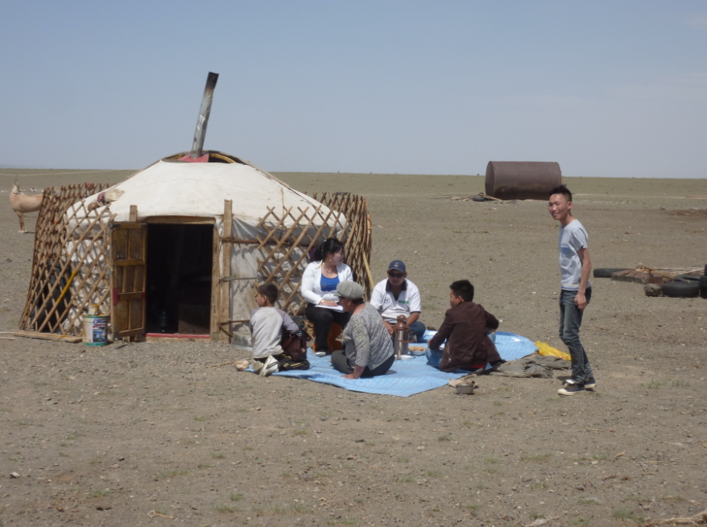
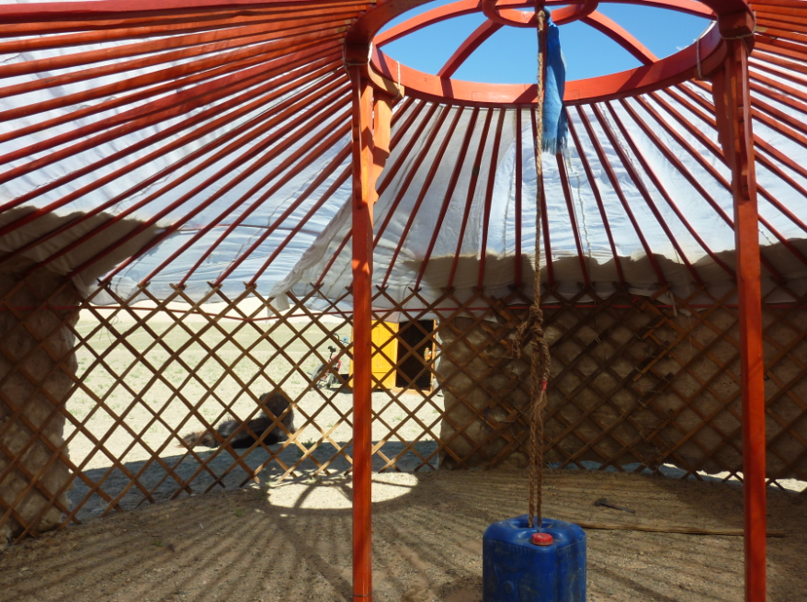
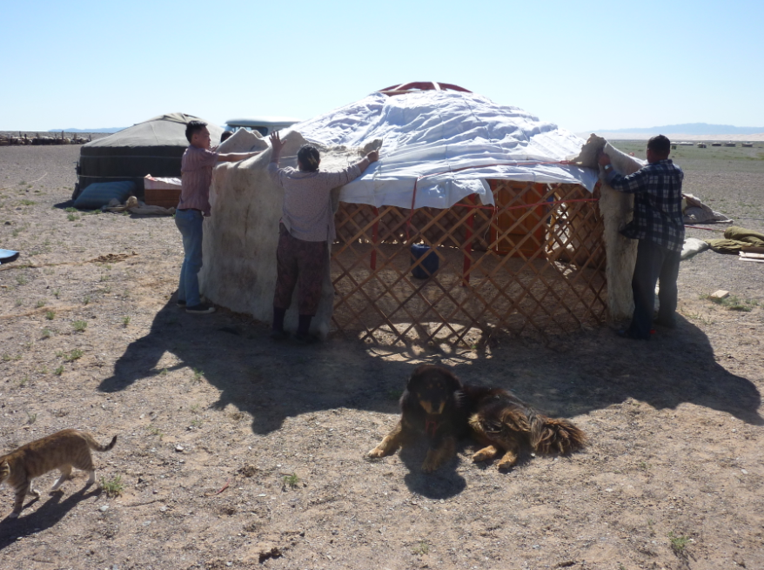
Mongolia Cont... Nomadic Life

Slide 10
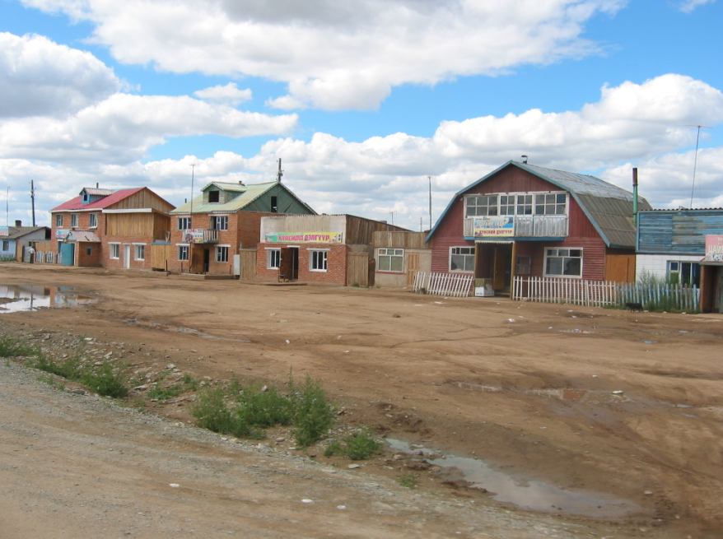
Growing settled housing in Mongolia

Slide 11
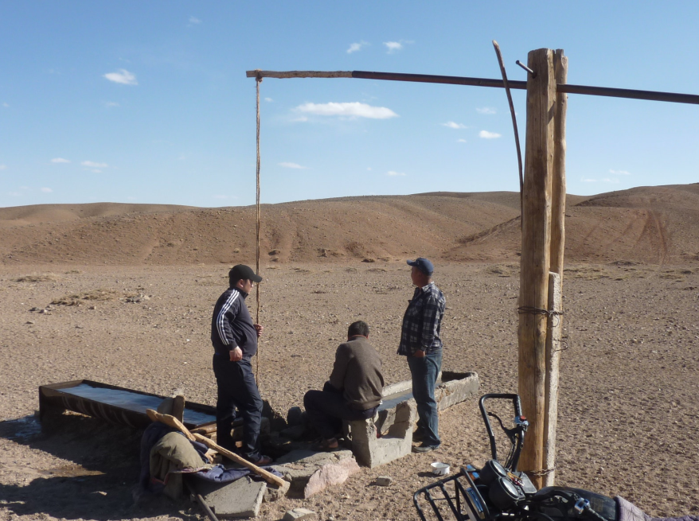
A water well in Mongolia

Slide 12
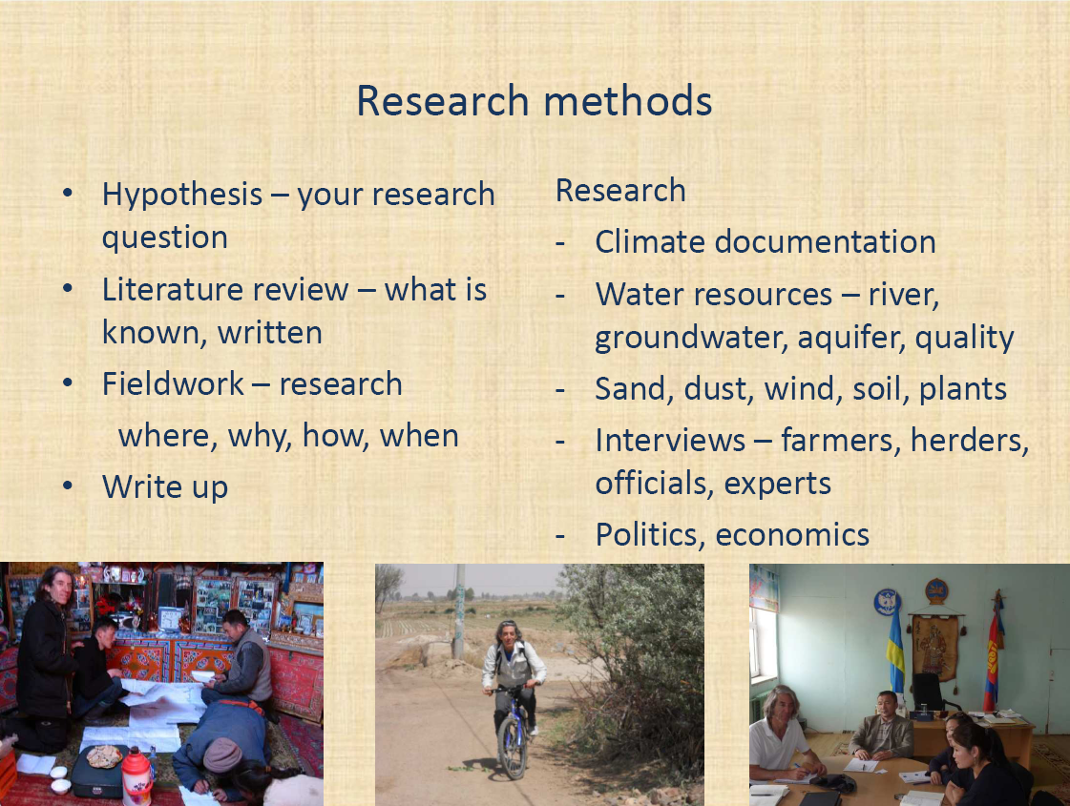

Slide 13
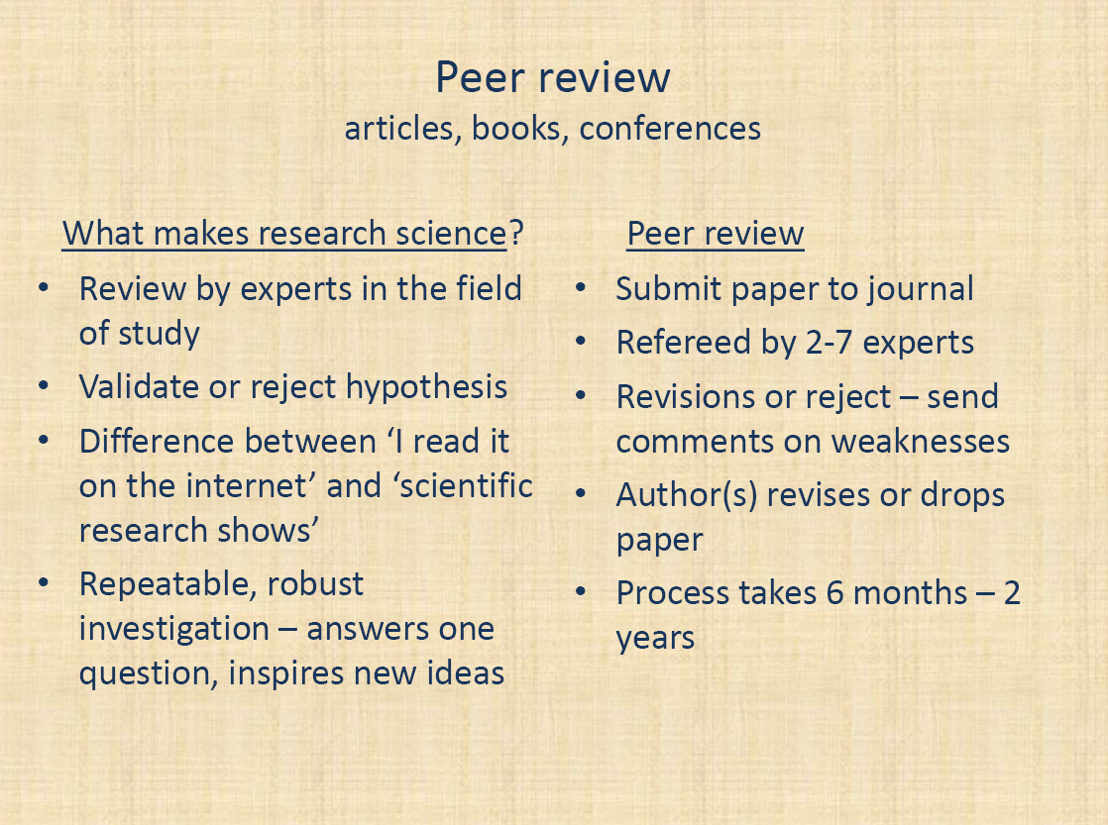

Slide 14
