Slide 1
Photo and video credit: Ana-Maria Pavalache

Slide 2
Coastal features
Complete the mix and match sheet on the key terms for today’s lesson.
Learning Goals
To know examples of some coastal processes.
Use the Omani coastline to understand how these processes work in creating specific coastal features.
Apply knowledge of coastal processes to a specific Omani coastline.

Slide 3
Coastal processes
The coastline is constantly changing due to all the processes which can occur there.
The processes are influenced by the sea, the elements and gravity.
Which process (or processes) dominates will depend on several factors, including:
Time of year;
Type of rock;
Shape of coastline;
How far the waves have travelled;
This lesson, you will be looking at a feature from each different process found along the Omani coastline:
Group 1: Landslides
Group 2: Wave-cut platforms
Group 3: Physical (mechanical) weathering
Group 4: Beaches
Group 5: Longshore Drift
Notes:
Note: features could be a landform and/or a process.

Slide 4
Main task: marketplace
Explain how different processes work along the coastline (6 marks)
Write down the question above.
Working in your allocated groups, you will need to gather information to help you answer this question.
This will be an open book answer – you won’t need to remember anything. We’re looking at how you can apply your knowledge and understanding.
Follow the next few slides to help you organise your work.

Slide 5
Markscheme
Explain how different processes work along the coastline (6 marks)
Level 3 (5-6 marks)
Two clear paragraphs identifying separate processes.
Both paragraphs should have a point, explanation as to how the process works and an example from a place.
Level 2 (3-4 marks)
Two clear paragraphs identifying separate processes.
Both paragraphs should have a point, explanation (one paragraph more detailed than the other) as to how the process works. No example from a place added.
Level 1 (1-2 marks)
One paragraph, possibly a second at the top end with is less developed than the other.
There will be a point made with some explanation.

Slide 6
Information processing and presenting (15 minutes)
Read the information about your process.
Use the highlighters to extract the key points to help answer the question Explain how different processes work along the coastline.
Create an information poster about your process which others can easily interpret.
RULES:
You can only use 10 words.
You must have a title with the name of the process (included in your word count)
Diagrams, pictures, acronyms (i.e. CO₂ rather than carbon dioxide), symbols etc. are allowed.
There is a different colour for each member of the team – all colours should be used as you should all be working together to present your information.
Notes:
If you need a timer, an example of one can be found here: https://www.online-stopwatch.com/countdown-timer/

Slide 7
Information gathering (10 minutes)
You will need one - two members of your group to be the stallholder – they will stay by the poster and be responsible for selling it to others by telling them what it is about.
The remaining members are shoppers. It’s your role to gather and note down information from other stalls ready to share with the rest of your group. It would be an idea to split up and visit different stalls to save time. Remember, you are going to need information to answer the question: Explain how different processes work along the coastline.

Slide 8
Information sharing (10 minutes)
Working in pairs, take it in turns to share the information you gathered from the different stalls with other members of your original group.
Note down the information you have learnt.
Remember, you only need two different processes (your own one can count too) to answer the question: Explain how different processes work along the coastline.

Slide 9
Question Answering (8 mins)
Keeping your notes open in front of you, answer the question:
‘Explain how different processes work along the coastline‘.

Slide 10
Marking (4 minutes)
Mark scheme
Level 3 (5-6 marks)
Two clear paragraphs identifying separate processes.
Both paragraphs should have a point, explanation as to how the process works and an example from a place.
Level 2 (3-4 marks)
Two clear paragraphs identifying separate processes.
Both paragraphs should have a point, explanation (one paragraph more detailed than the other) as to how the process works. No example from a place added.
Level 1 (1-2 marks)
One paragraph, possibly a second at the top end with is less developed than the other.
There will be a point made with some explanation.
Write a level on the answer and explain why that level was achieved.

Slide 11
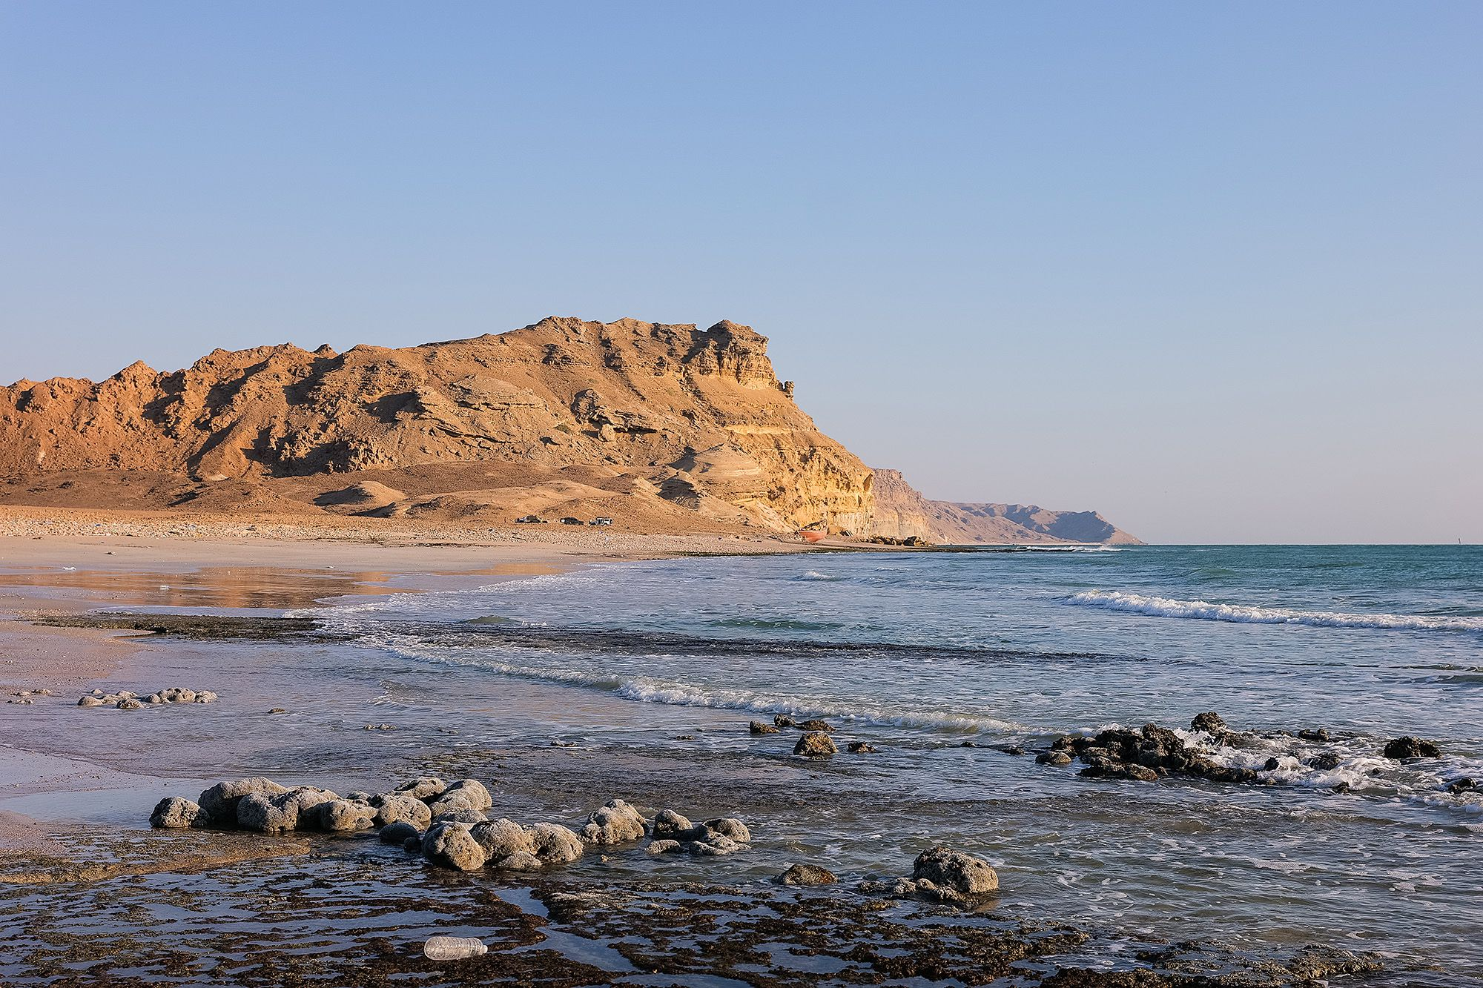
Group 1: Landslides (mass movement)
Landslides along most of the Omani coast are considered as highly likely due to the loose bedrock.
In certain regions such as Dhofar, seasonal rains saturate the land making the rock heavier.
Weaknesses in the rock and the force of gravity bring land down from cliffs in the form of landslides. Some of them make fan shapes at the bottom of the cliff.
Photo credit: Ana-Maria Pavalache
Loose material shifted down the rock face from a landslide near Nafun.

Slide 12
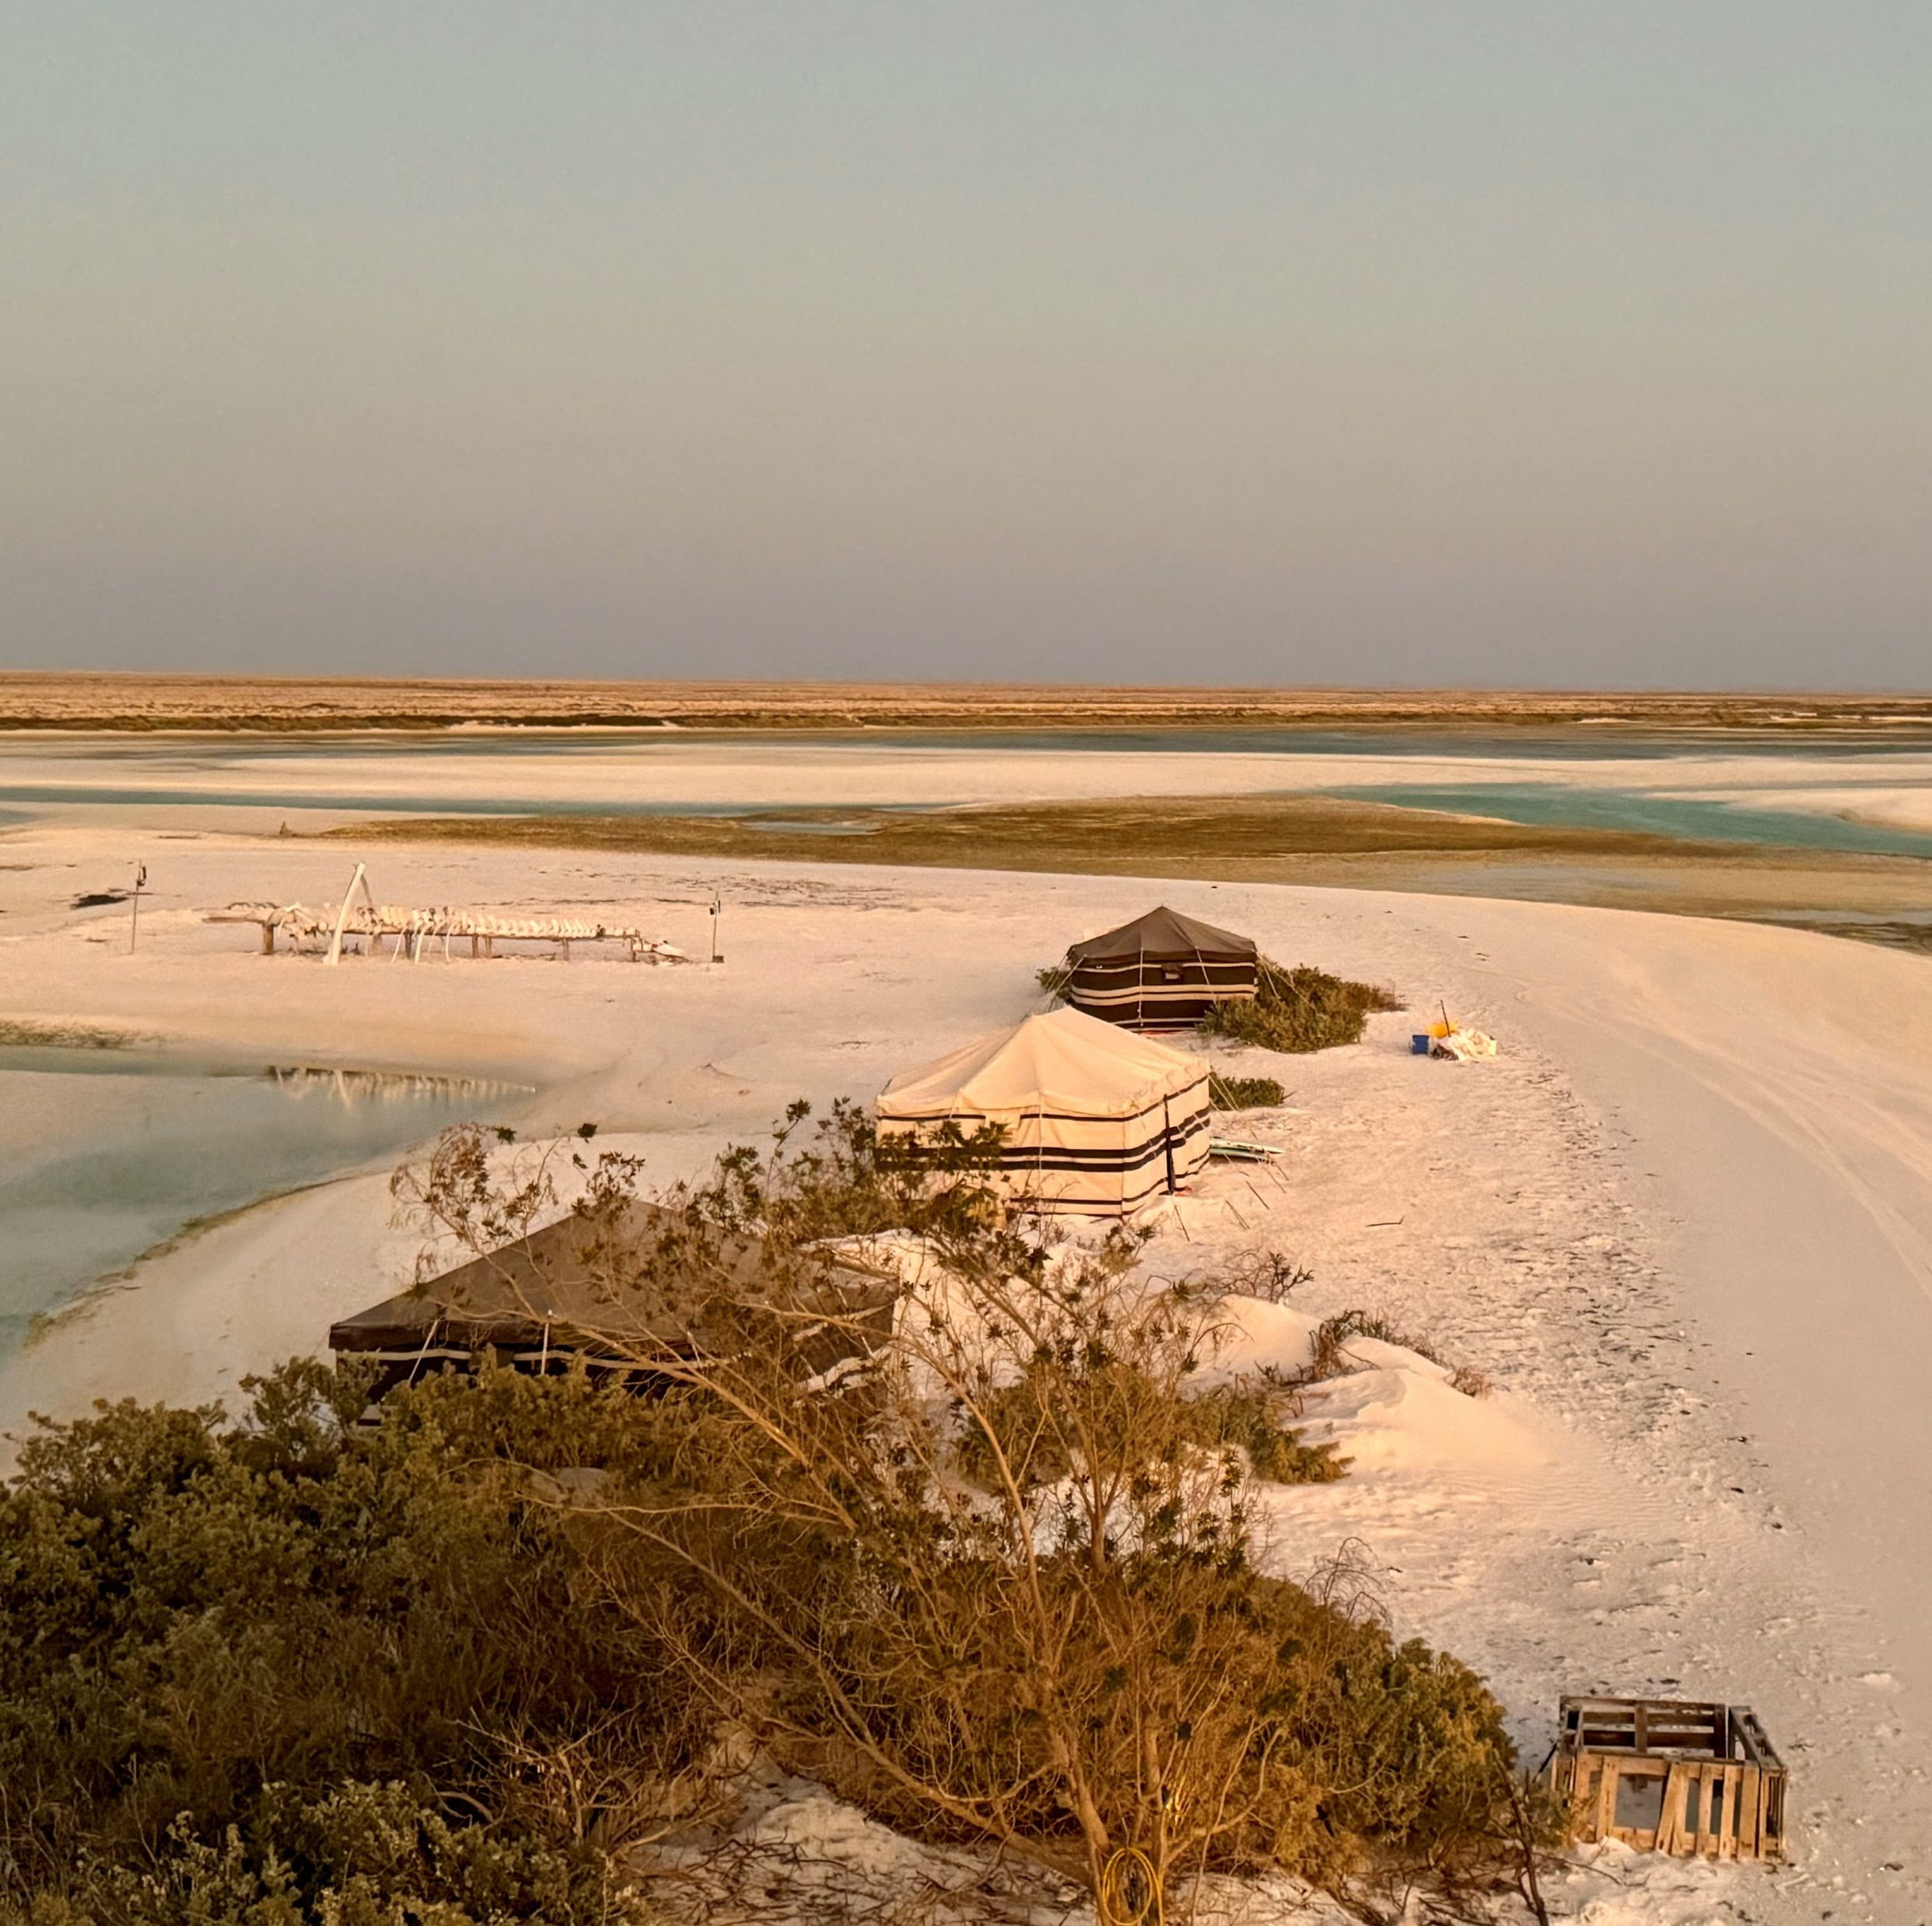
Group 2: Wave-cut platforms (erosion)
Rocky outcrops of Barr al-Ḥikmān thought to be a wave-cut platform.
Oman's coastline has many cliffs, especially along places like Musandam in the north. The strong waves of the Arabian Sea crash against these cliffs, slowly wearing them away. This process is called erosion.
As waves hit the base of the cliff, they erode the rock through hydraulic action (water forcing air into cracks) and abrasion (waves carrying sand and rocks that scrape against the cliff). Over time, this creates a wave-cut notch, or a small hollow at the base of the cliff.
As erosion continues, the notch gets bigger and deeper. The cliff above is left with less support and becomes weaker.
Eventually, the unsupported rock at the top becomes too heavy and collapses into the sea. This sends large chunks of rock crashing down, which are then broken up by the waves.
After many cycles of erosion and collapse, the cliff slowly retreats inland. The eroded rock is washed away, leaving behind a flat, rocky surface where the cliff used to be. This is called a wave-cut platform.
Photo credit: Ana-Maria Pavalache

Slide 13
Group 3: Physical (mechanical) weathering
Wind-driven (Aeolian) weathering is a type of physical weathering where strong winds carry sand and dust which erodes the coastline.
Coastlines like those on Masirah Island are greatly affected by this type of weathering.
Photo credit: Ana-Maria Pavalache
Sand laden winds act like sandpaper smoothing and pitting the cliff surface in a process called abrasion.

Slide 14
Group 4: Beaches (deposition)
Waves carry things like sand, pebbles, and shells from the ocean onto the shore.
These materials come from eroded rocks, coral, and other sources.
When waves lose energy (usually in sheltered areas like bays), they drop the sand and pebbles they were carrying.
This process is called deposition—it helps build up the beach over time an example is Sharbathat Beach.
Seaweed and plant roots hold the sand in place, stopping it from washing away.
Storms and strong waves can wash away parts of the beach or bring in new material.
Strong waves (destructive waves) carry large rocks and pebbles, creating rocky or pebble-covered beaches.
Gentler waves (constructive waves) bring finer sand and create sandy beaches.
Photo credit: Ana-Maria Pavalache
The tide moves in and out twice a day, shifting sand and stones around. Longshore drift, a transportation process move material along the coast by wave action, helps shape the beach.

Slide 15
Group 5: Longshore Drift (transportation)
2. When a wave reaches the shore, it carries sand and pebbles up the beach in the same direction as the wave. This movement of water up the beach is called swash.
3. Once the wave loses energy, the water flows back down the beach towards the sea due to gravity. This movement is called backwash. Unlike the swash, the backwash moves straight down the beach, at a 90-degree angle.
Coastline
Swash
Direction of Wind
Backwash
Sea
Direction of sediment movement
Sea
1. Prevailing southerly winds, especially during the monsoon season (Khareef) in the south, push waves towards the shore at an angle.
4. Because the swash moves at an angle and the backwash moves straight down, sand and pebbles are slowly transported along the coastline in a zigzag pattern. This process is called longshore drift.
In places like Ras Al Hadd, sand is moved along the shore, forming beaches and sandbars.

