Slide 1
Lesson Four: The River Thames

Slide 2
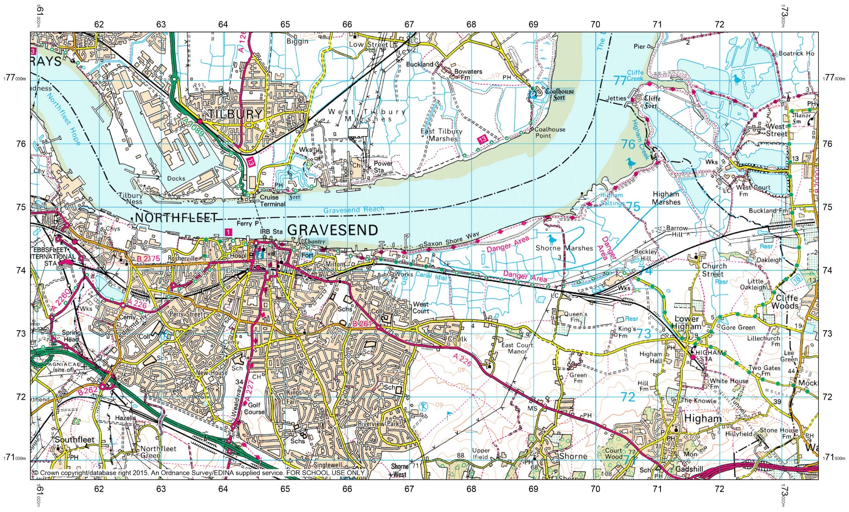
Our Questions

Slide 3
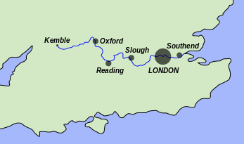
Location
Thames Map © Wikipedia Commons

Slide 4
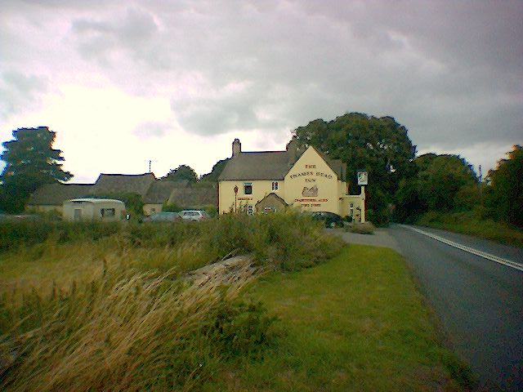
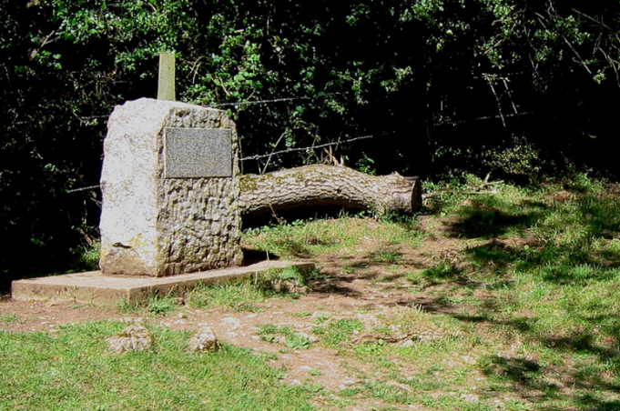
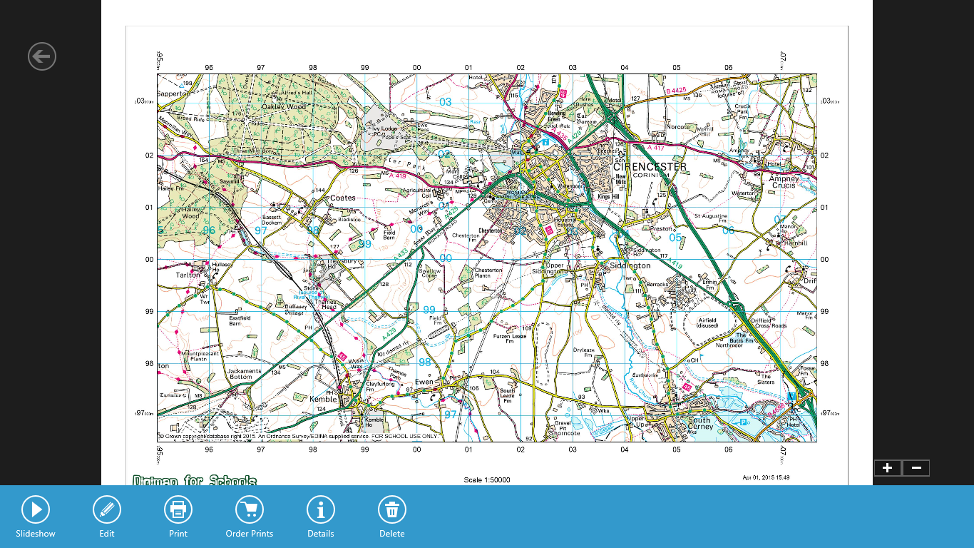
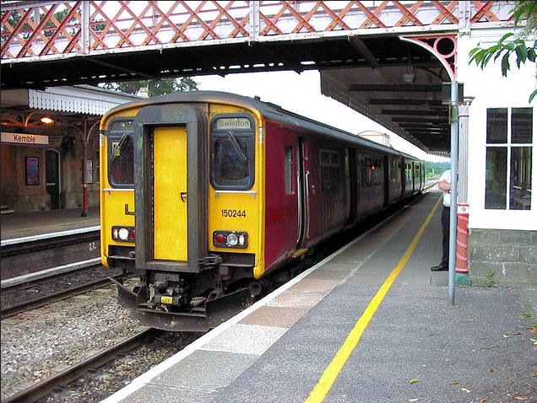
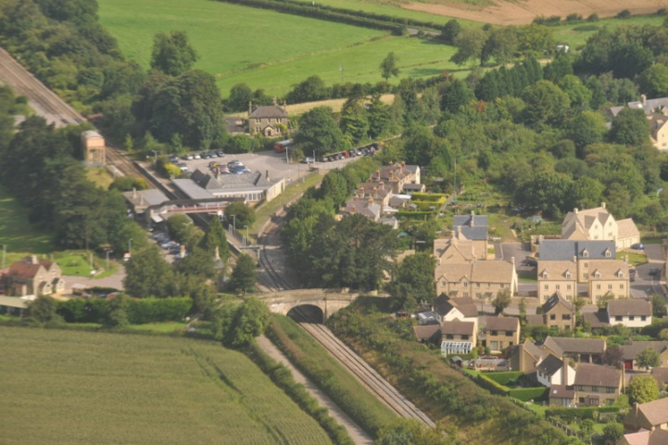
The Source:
Thames Head
Thames Head pub © Scott Cawley, Flickr
Source of the River Thames © summonedbyfells, Flickr
Kemble Railway Station from the Air © Zen Whisk, Flickr
150244 at Kemble © R~P~M, Flickr

Slide 5
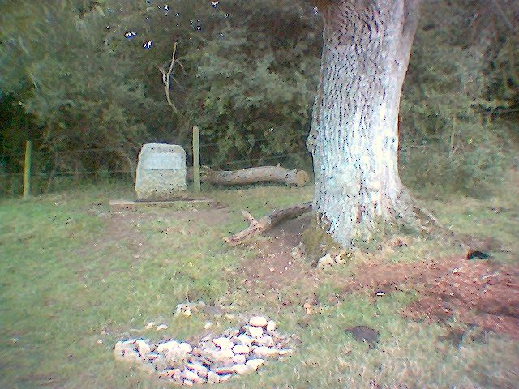
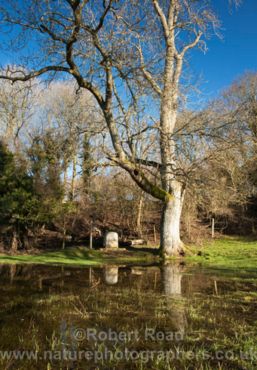
Before and after Heavy Precipitation
The Source Stone © Scott Cawley, Flickr
154561 © Robert Read, Flickr

Slide 6
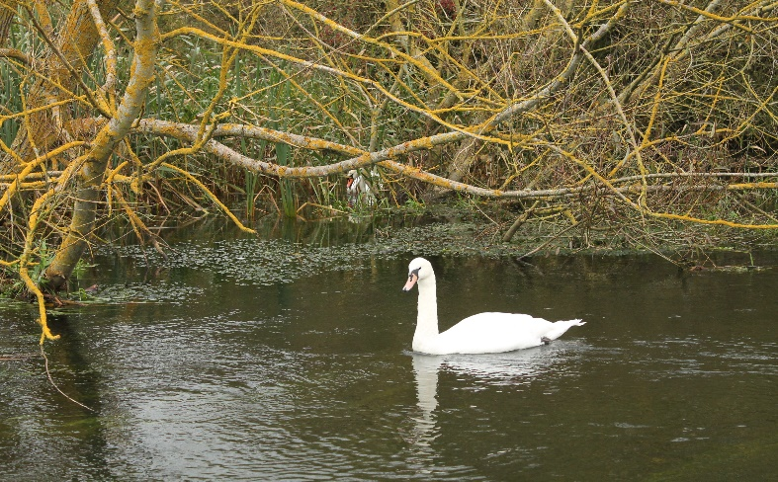
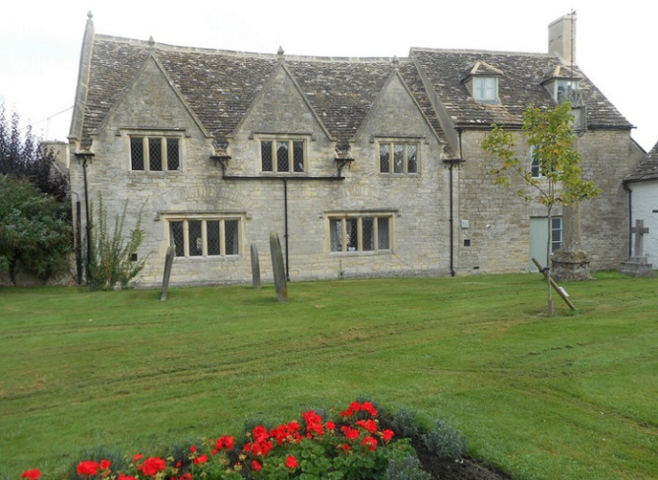
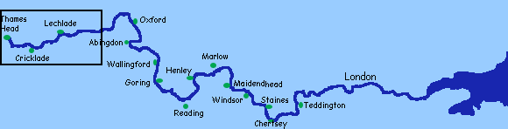
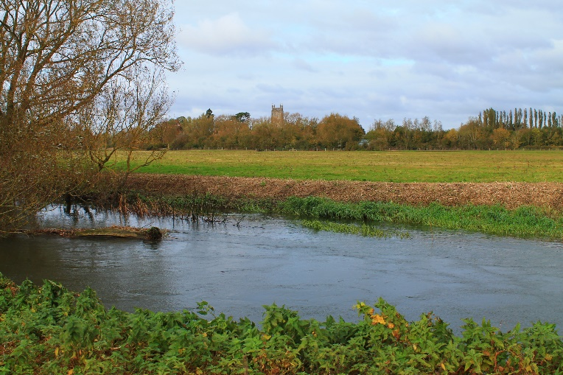
Cricklade: The River Becomes Navigable
Cricklade to Lechlade © Michael O’Donnabhain, Flickr
Jenner Hall, Cricklade © Elaine-Louise, Flickr
Cricklade to Lechlade © Michael O’Donnabhain

Slide 7
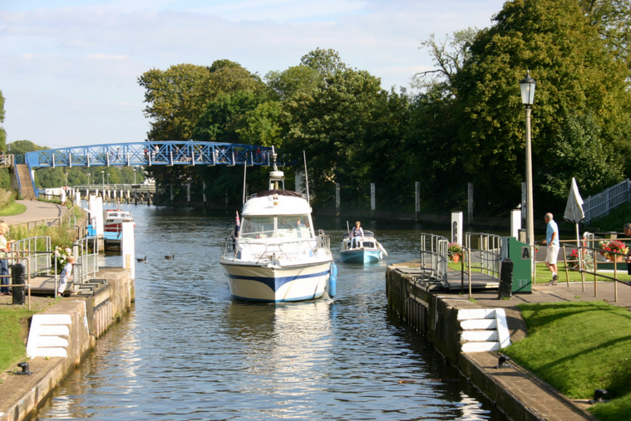
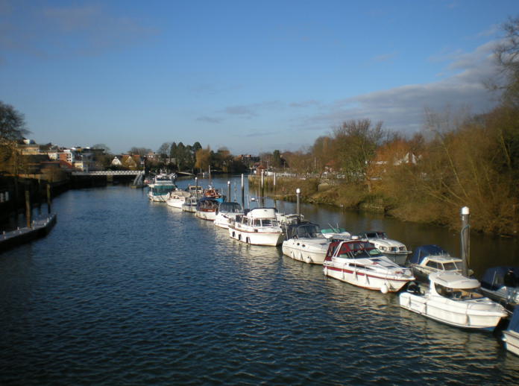
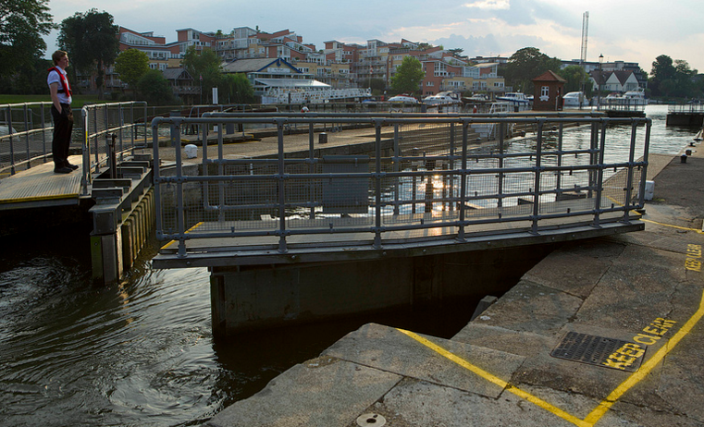
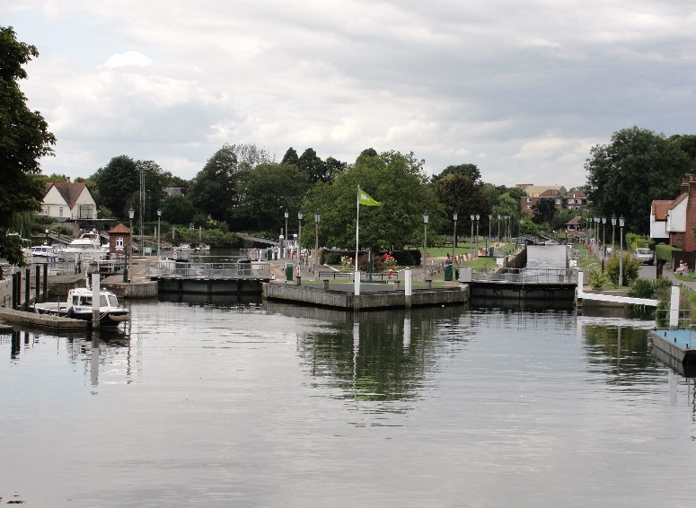
Teddington: The River Becomes Tidal
Teddington © lindad4a, Flickr
IMG_2799.JPG © Matthew Purves, Flickr
25th August 2013 © Emma Durnford, Flickr
Teddington Lock © Maxwell Hamilton, Flickr

Slide 8
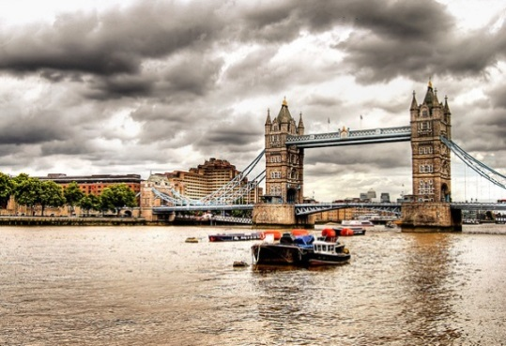
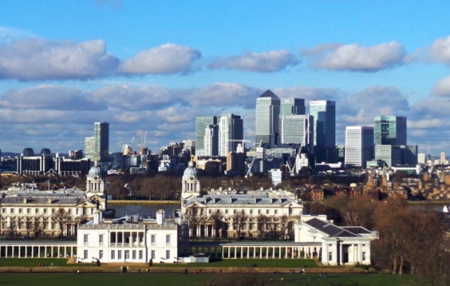
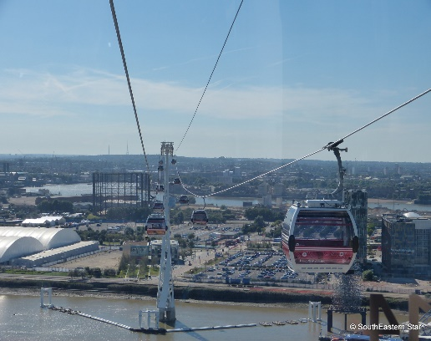
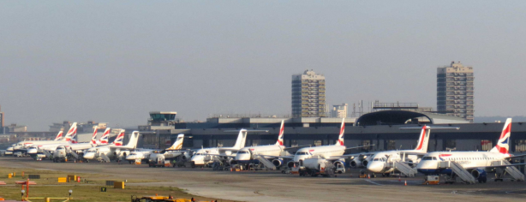
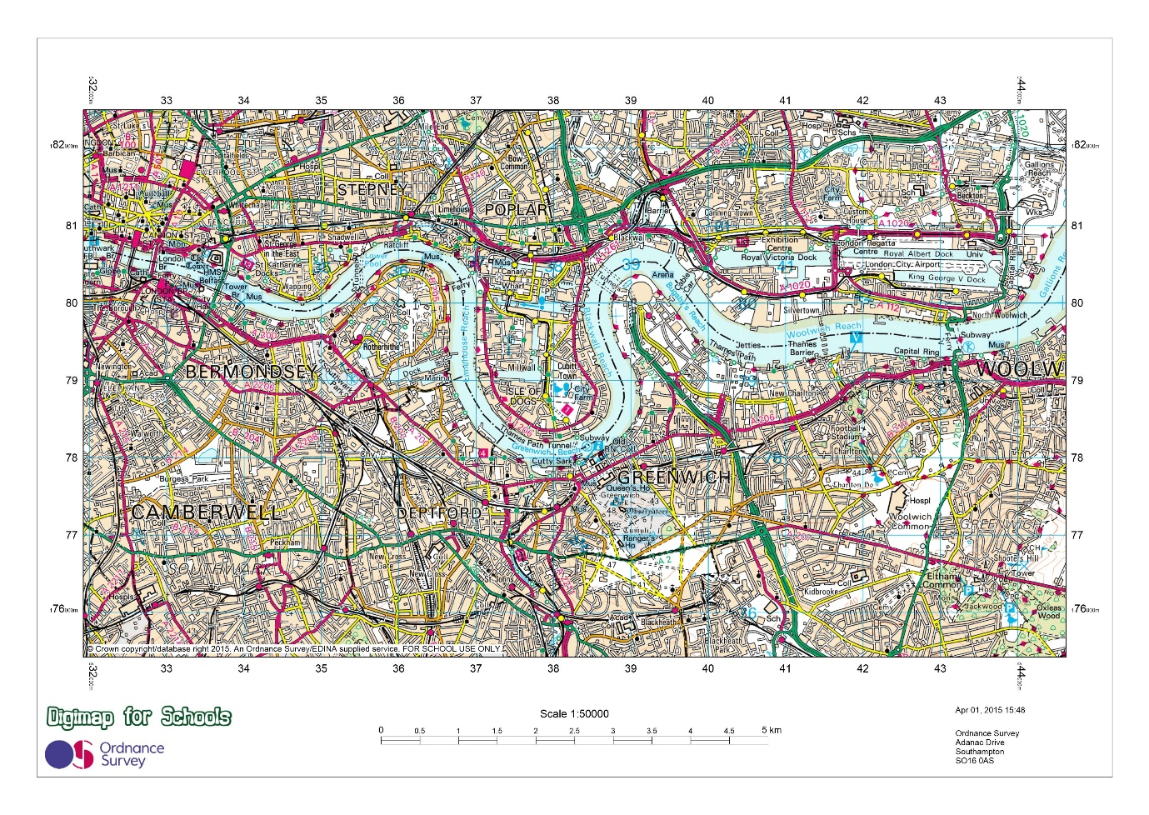
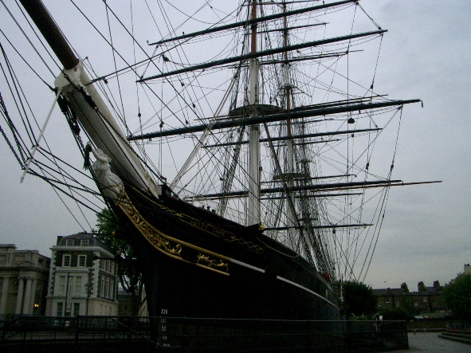
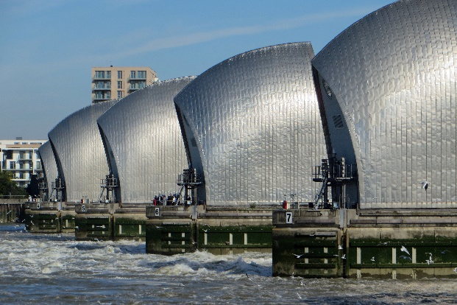
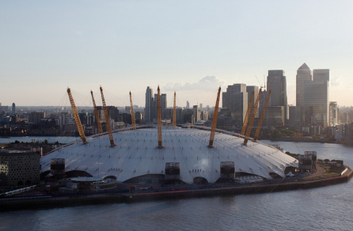
Central London
View from Greenwich Observatory © Ian Roberts, Flickr
Thames Cable Car © SouthEastern Star, Flickr
London City Airport © Tim, Flickr
Tower Bridge, London © gjoseph8, Flickr
A2005-05-29 Cutty Sark © Ananabanana, Flickr
Thames barrier annual closure © diamond geezer, Flickr
The O2 Arena © Alexander Baxevanis, Flickr

Slide 9
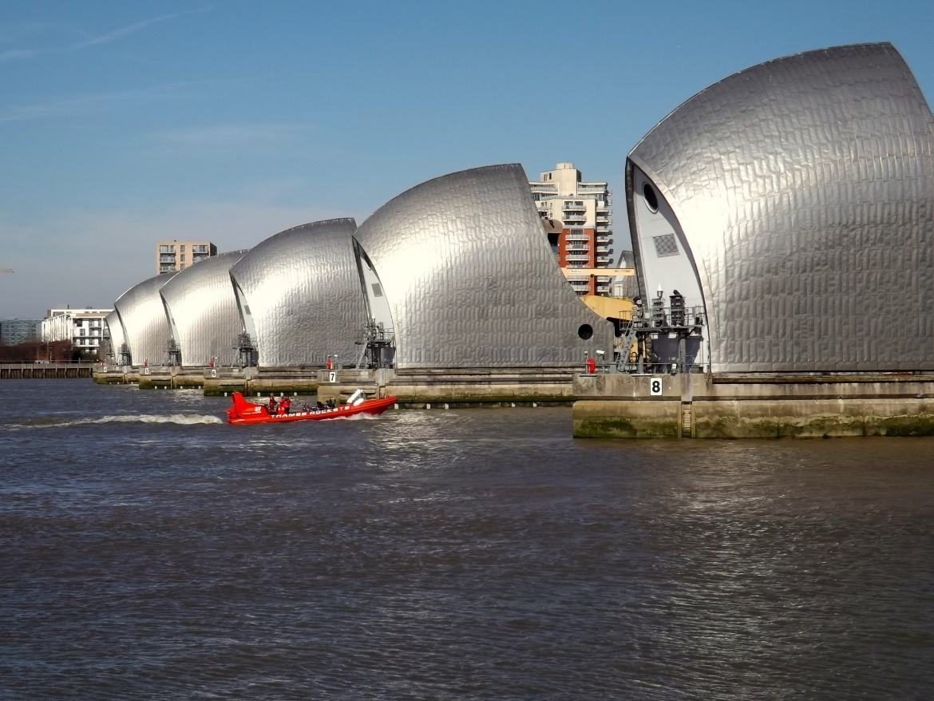
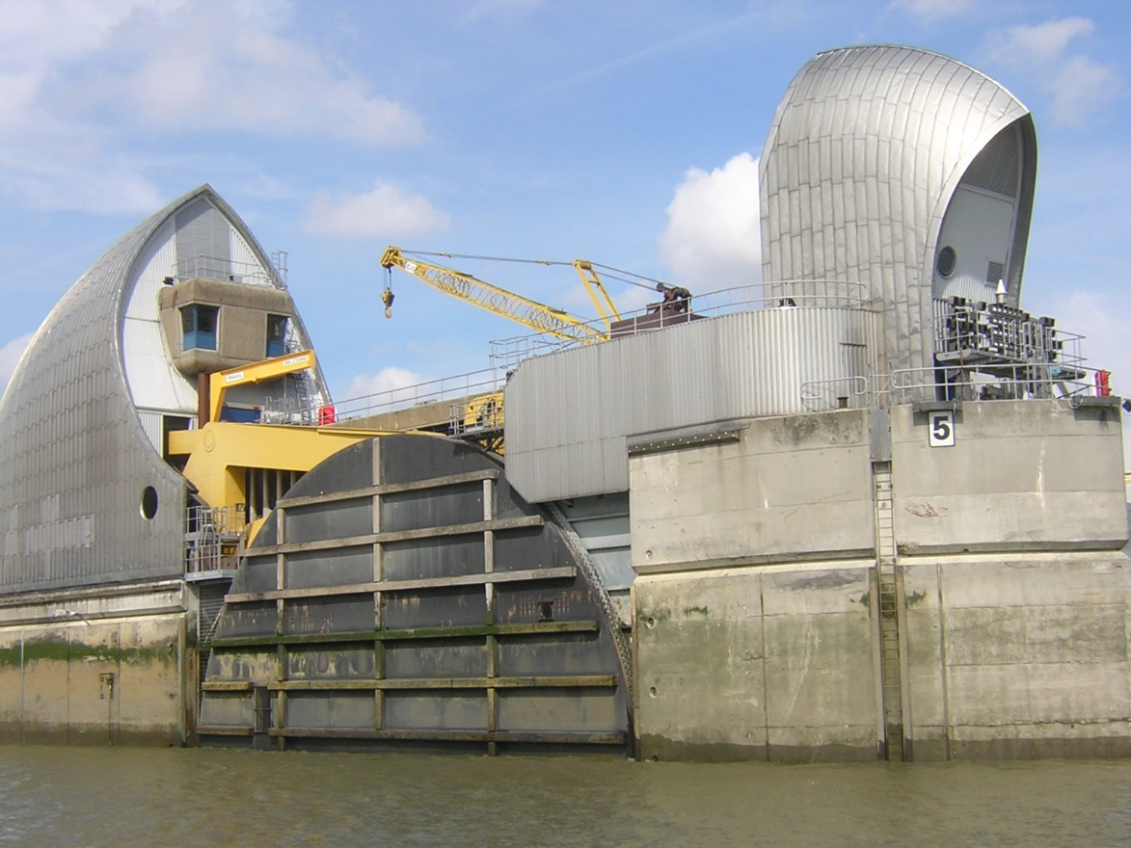
The Thames Flood Barrier
The Thames Barrier © Just1snap, Flickr
Thames Flood Barrier © Ulleskelf

Slide 10
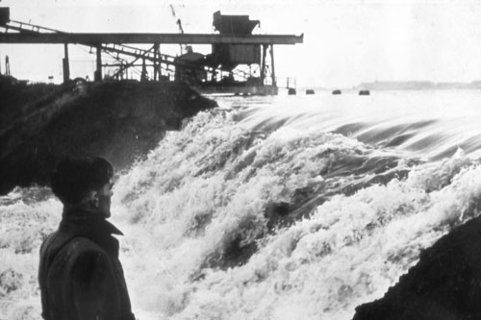
1953 Floods
RGS
21st century Challenges

Slide 11
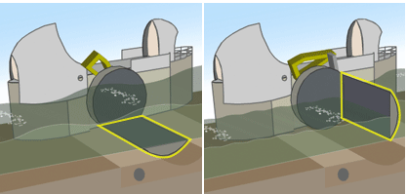
Closing the Barrier
Open
Closed
RGS
21st century Challenges

Slide 12
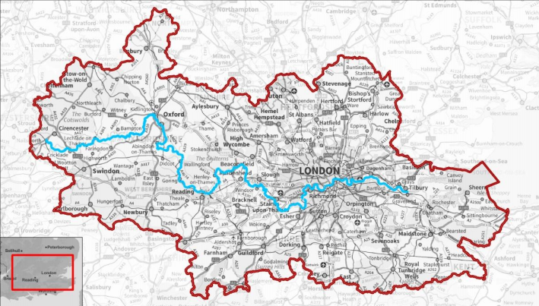
The Drainage Basin
© Environment Agency

