Slide 1
Choose geography
[Name]
[Job Title]
[Date]

Slide 2
A bit about me
What is your job title? What do you do?
How did you get to where you are today? Including: the degree you studied and whether you completed a master’s degree; details of any internships you completed, work experience or volunteering you completed during or after your studies, and how this helped your career; whether you completed a graduate scheme
You may wish to present this information as a timeline

Slide 3

Why is studying geography important?
Notes:
Ask students to discuss in pairs before sharing ideas as a whole class

Slide 4
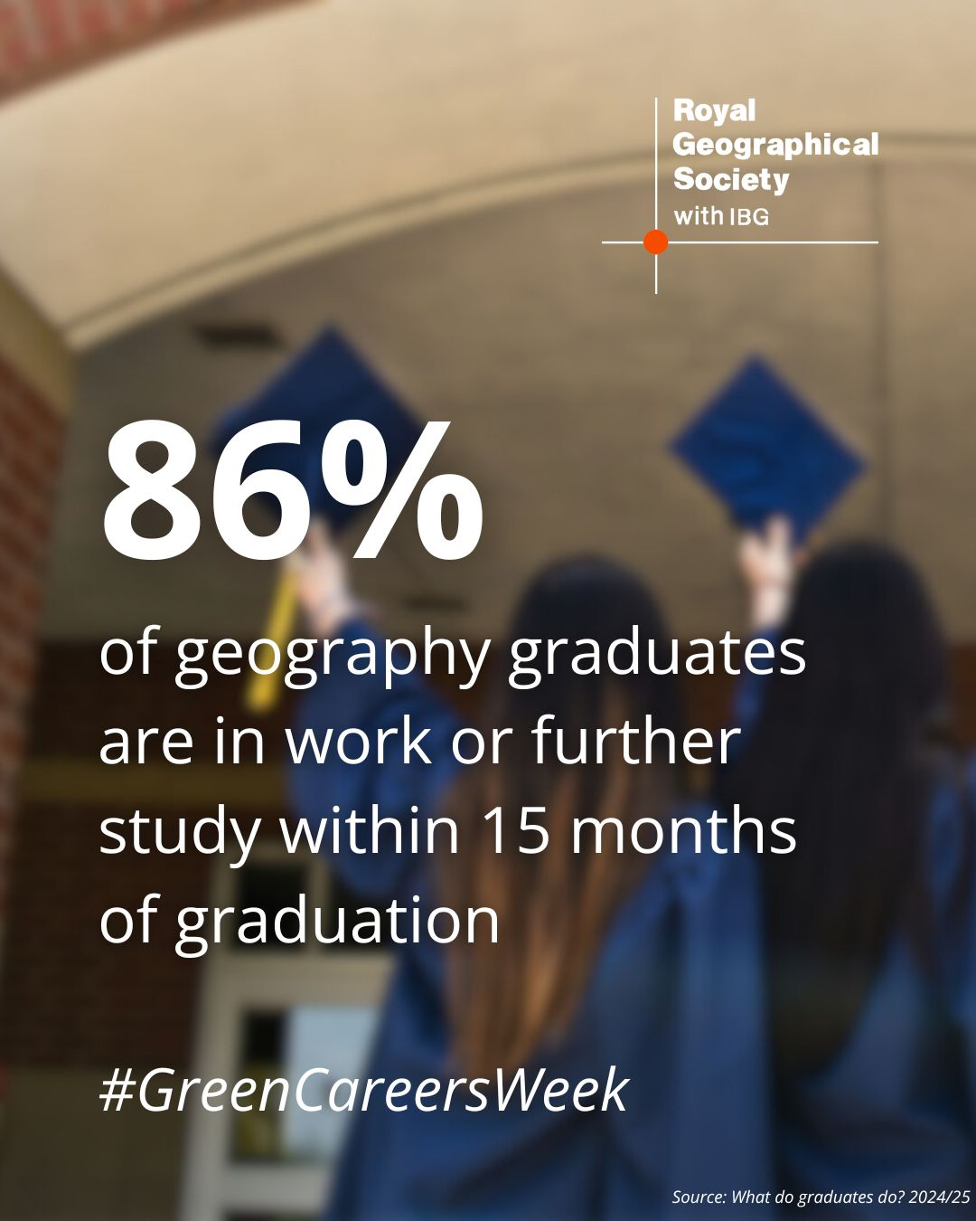
Why should I choose geography?
A subject for the curious, determined and ambitious
Geography is an education for life
Dynamic, vital and endlessly interesting
Diverse skill set
You get to make real world impact
Unparralled career opportunities
Notes:
Why geographers are employable – RGS
Geographers stand out because they bring a combination of analytical thinking, technological proficiency, global perspective, and environmental and social consciousness to the table. This makes them highly employable and equipped to tackle some of the world’s biggest challenges.
Geographers excel in macro and micro systems thinking. Climate change is complex, to understand complexity is the gift of a geographer.

Slide 5
Why did I choose geography?
Why did you study geography?
You may like to talk about your experience of geography at school, or about a particular topic you loved. You may also like to talk about the wider skills gained by studying geography or the career opportunities available with geography

Slide 6
A day in my life
An overview of what you do day-to-day; what does a typical day look like for you?
Whether you have travelled abroad with work, and if so, where you’ve visited

Slide 7
Favourite project
An overview of the project; it’s purpose/aims
What geographical knowledge and skills did you use in this project?
What is the real-world impact of this project?
What were the challenges you faced in this project and how did you overcome them?
What did you love about this project?
This is a chance to connect students to geography in the real world, and showcase how the geography they learn in the classroom is used in real life

Slide 8
Advice to students

