Slide 1



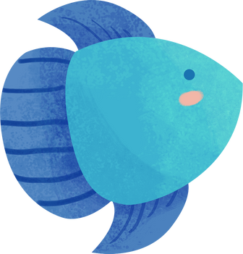
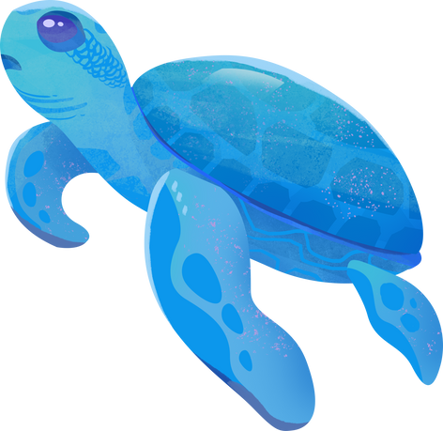

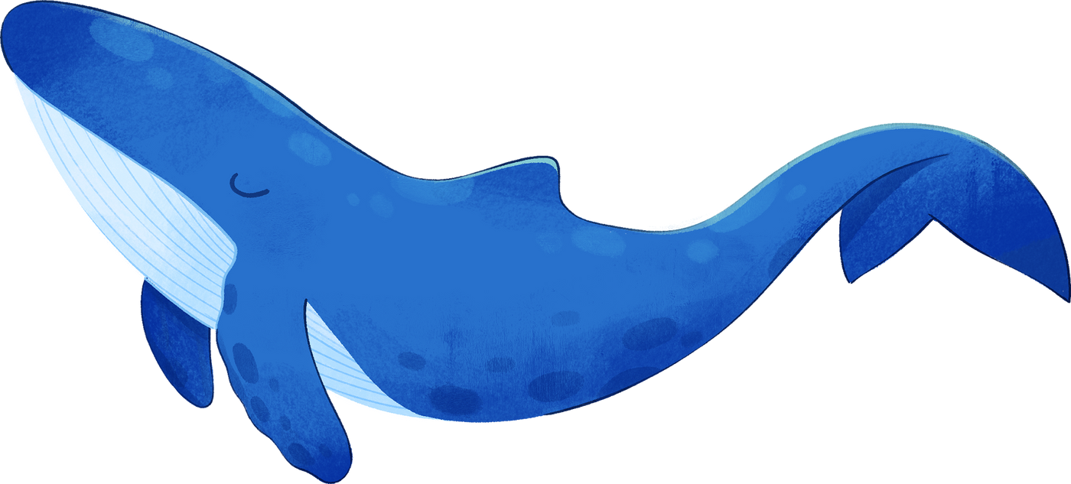


High 5! Take one fact you learnt from last lesson write a question where this fact is the answer.
I CAN SEE THE SEA!
IT’S ALL PART OF THE SYSTEM
Notes:
Presentation adapted from the blue illustrative organic ocean habitat presentation © Olmos Carlos via Canva.com

Slide 2


It’s all part of the system
Learning Goals
1
2
3
4
To understand the role oceans play in the water cycle.
To explore key ocean food chains and webs.
Identify how oceans are part of people and society.
Predict potential futures for oceans.
Key Terms
Producers ~ Consumers ~ Predator
Notes:
Presentation adapted from the blue illustrative organic ocean habitat presentation © Olmos Carlos via Canva.com

Slide 3

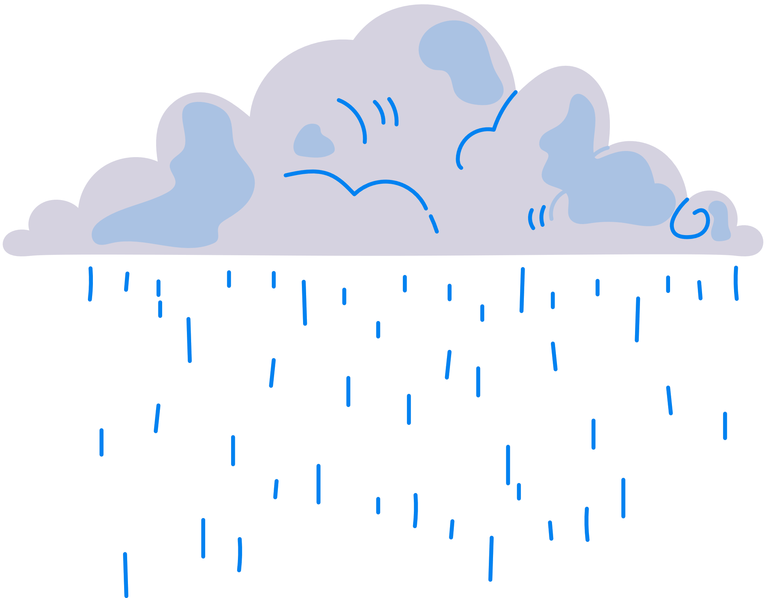



  78%
  86%
78% of all global precipitation occurs over the ocean.
86% of all global evaporation comes from oceans.
OCEANS AND THE WATER CYCLE
  Heat Balance
  Water Transfer
When the water condenses it releases heat helping to transfer warmth from the Tropics to the rest of the planet.
Evaporated water vapour condenses into clouds and falls as precipitation far away from where the water was originally evaporated.
Key terms
Condensation: water vapour cooling and turning into a liquid.
Evaporation: water turning into vapour when heated.
Transpiration: loss of water from plants.
Precipitation: any form of water falling from the sky i.e. rain, snow etc.
Notes:
Presentation adapted from the blue illustrative organic ocean habitat presentation © Olmos Carlos via Canva.com

Slide 4

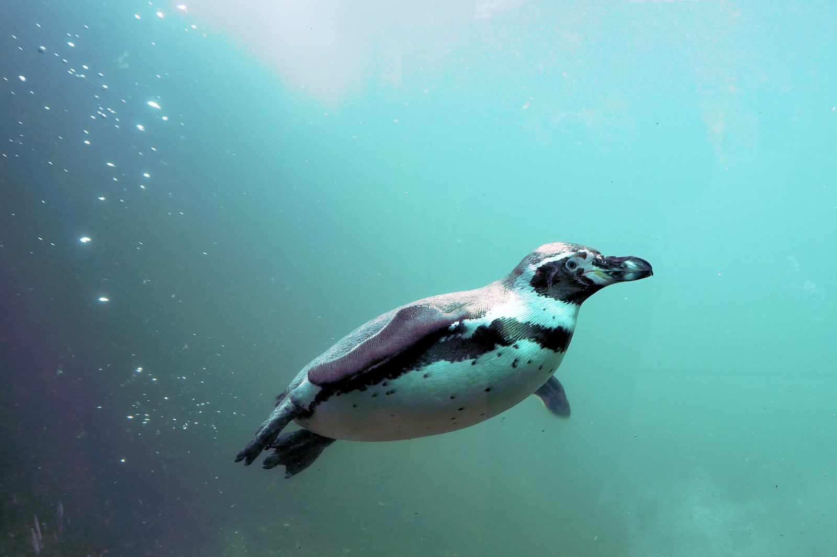
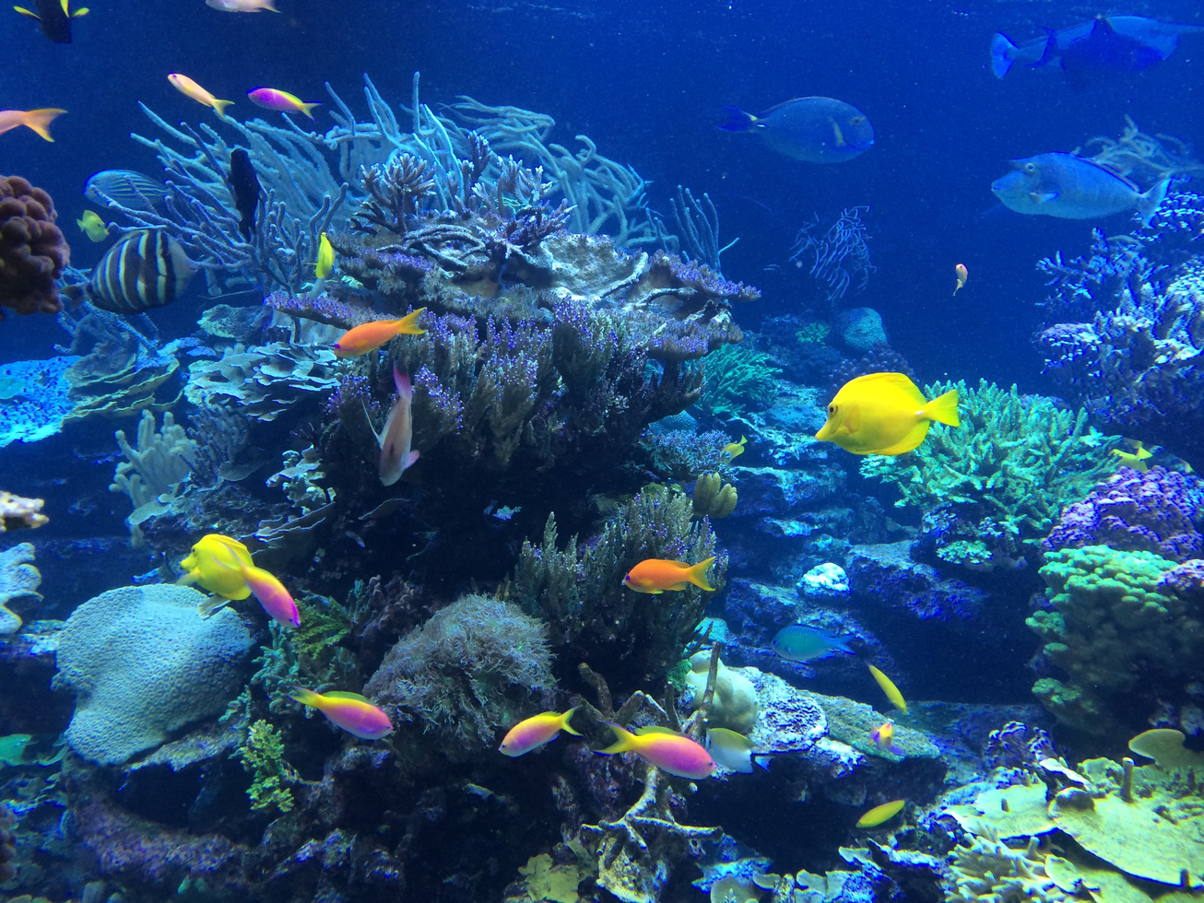
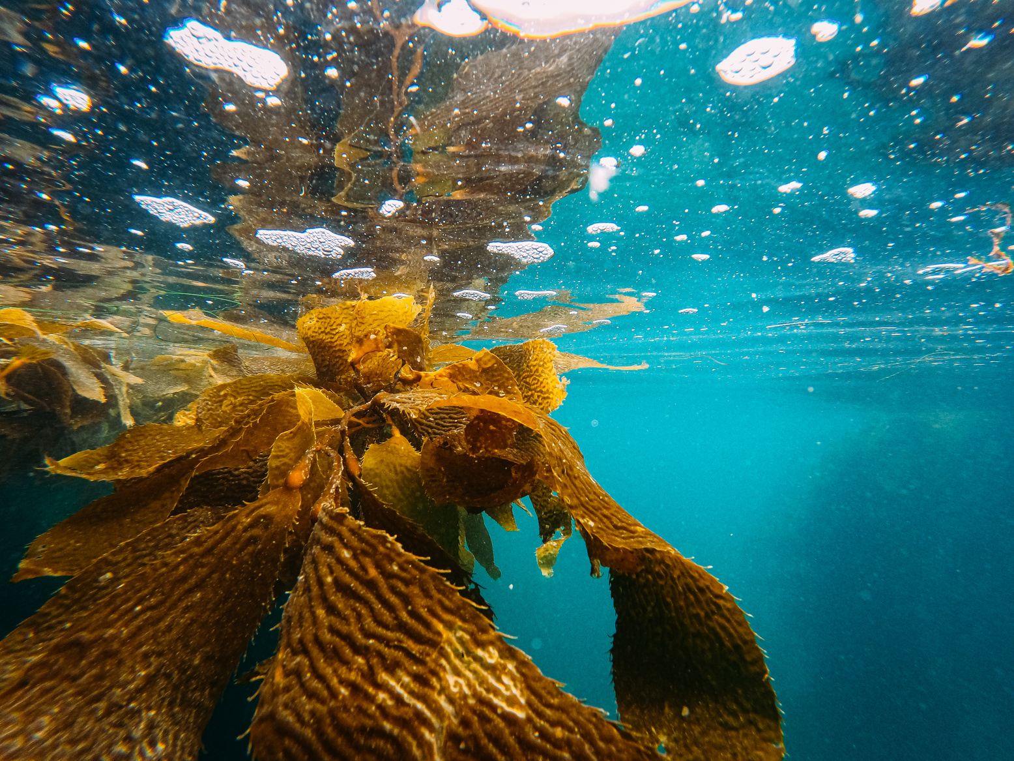

Ocean food chains and webs
TROPICAL
POLAR
POLAR
These re found between the Topic of Cancer and the Tropic of Capricorn, Their waters are warm, and it would be where you find Coral reefs. These reefs are home to 25% of all marine fish.
Located in the far north and south of the Earth’s hemispheres it is where warm ocean current from the Tropics cool and return to the Equator.
Located in the far north and south of the Earth’s hemispheres it is where warm ocean currents from the Tropics cool and return to the Equator.
TEMPERATE
These can be found between the topics and the polar regions. This is where warm water from the Tropics passes through to the Poles and cold polar water moves to the Equator.
Photo credit:
Tropical Fish Underwater, librtybeth, Pixabay
Kelp underwater, Kindel Media, Pexels
Penguin in the water, Webandi, Pixabay

Slide 5
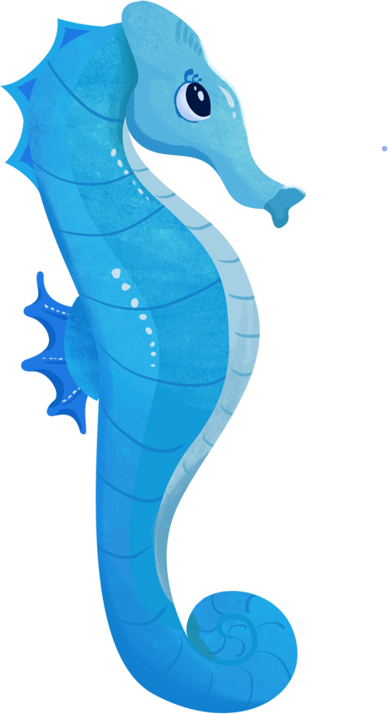

Did you know?
Fish can be found in products we might not even have thought about such as beer, salad dressings and even lipstick!
Oceans and people
Oceans are very important to people. They provide us with a source of food, but they are also home to vast resources such as oil and natural gas.
90% of the things you will find in your home have travelled by ships at sea to get to you. People harm oceans by polluting them with plastics, overfishing and killing wildlife, but they also protect oceans by creating laws to limit how we can use them.
Notes:
Presentation adapted from the blue illustrative organic ocean habitat presentation © Olmos Carlos via Canva.com

Slide 6
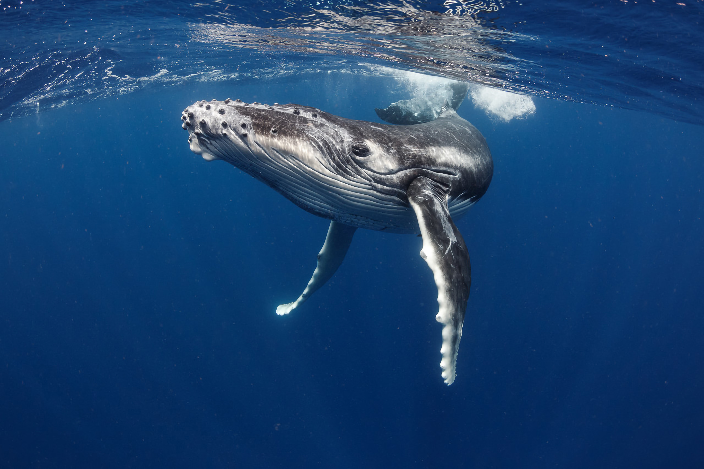
What happens if...?
You will have a scenario to consider in groups. You need to work together to think about how you would consider it to help the marine environment and people.
Be ready to talk about your ideas to the class!
Photo credit: Shasin Satuei, Pexels
Notes:
Presentation adapted from the blue illustrative organic ocean habitat presentation © Olmos Carlos via Canva.com

