Slide 1


Anthro
Alan Parkinson
Head of Geography, King’s Ely Junior
CGeog, FRGS

Slide 2
What is the anthropause?
the global-scale, temporary slowdown in human activity, which is likely to have a profound impact on other species.

Slide 3
The term emerged during the first lockdown
There will be unforeseen opportunities to reinvent the way we live our lives, and to forge a mutually beneficial coexistence with other species. It would be wonderful if careful research during this period of crisis helped us to find innovative ways of reining in our increasingly expansive lifestyles, to rediscover how important a healthy environment is for our own well-being, and to replace a sense of owning with a sense of belonging. We hope that people will choose to hear the wake-up call.
https://www.nature.com/articles/s41559-020-1237-z
Prof Christian Rutz et al

Slide 4

Neologism
https://languages.oup.com/word-of-the-year/2020/

Slide 5

Free Access
https://www.google.com/covid19/mobility
/
Google Mobility reports

Slide 6
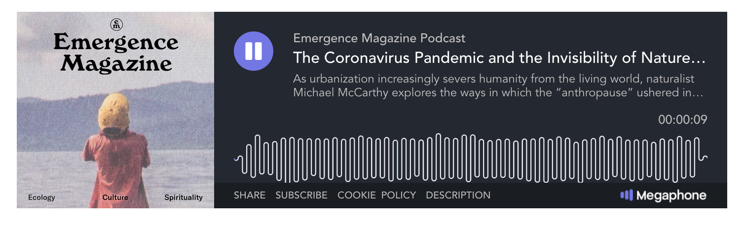
Free Access
https://emergencemagazine.org/essay/the-consolation-of-nature/
Emergence Magazine Podcast
Naturalist Michael McCarthy
“Spring in the time of Coronavirus”

Slide 7
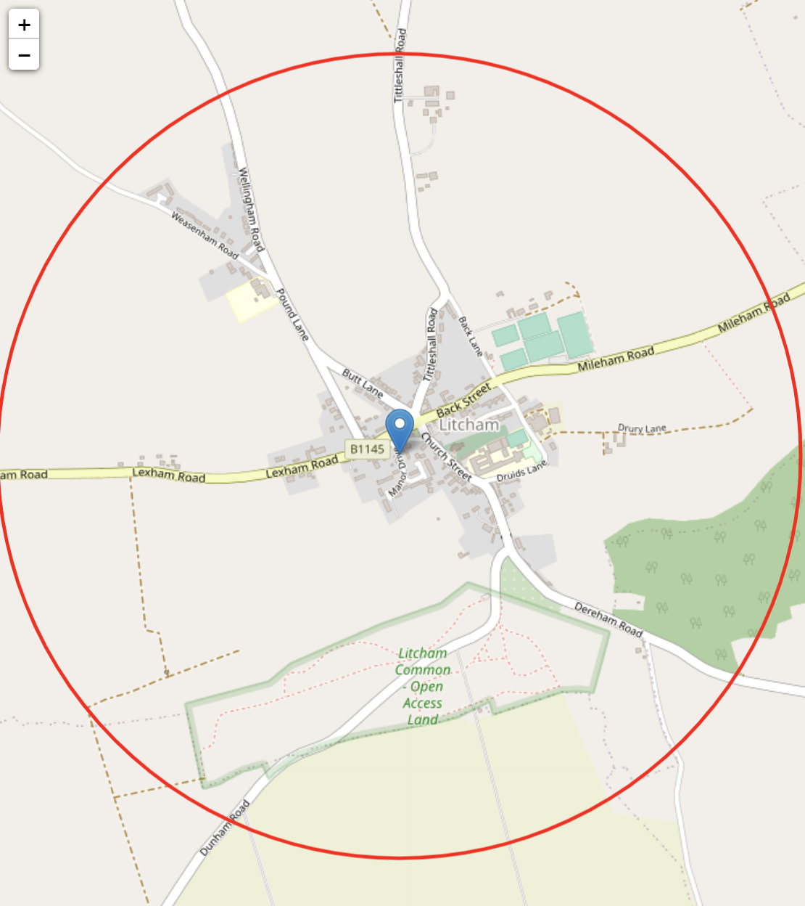
Create your own map with different diameters using: https://2kmfromhome.com/
Appreciating the local
1km from home

Slide 8
The temporal experience of the current anthropause is universally framed as a slowing‐down of everyday life; at odds with the general accelerationism of globalised extractive economies.
The time we’re living through feels borrowed against a future which is no longer guaranteed. There are glimpses of what the new world could be like—slower, quieter, more given to care—but much of this strange time looks like the old world of inequality and neglect asserting itself with a vengeance. The transition from old to new seems far from clear. This is why, I think, I keep looking for new ways to get lost, even briefly, in places that are most familiar to me.
David Farrier
https://rgs-ibg.onlinelibrary.wiley.com/doi/10.1111/geoj.12373
https://emergencemagazine.org/op_ed/desire-paths/

Slide 9
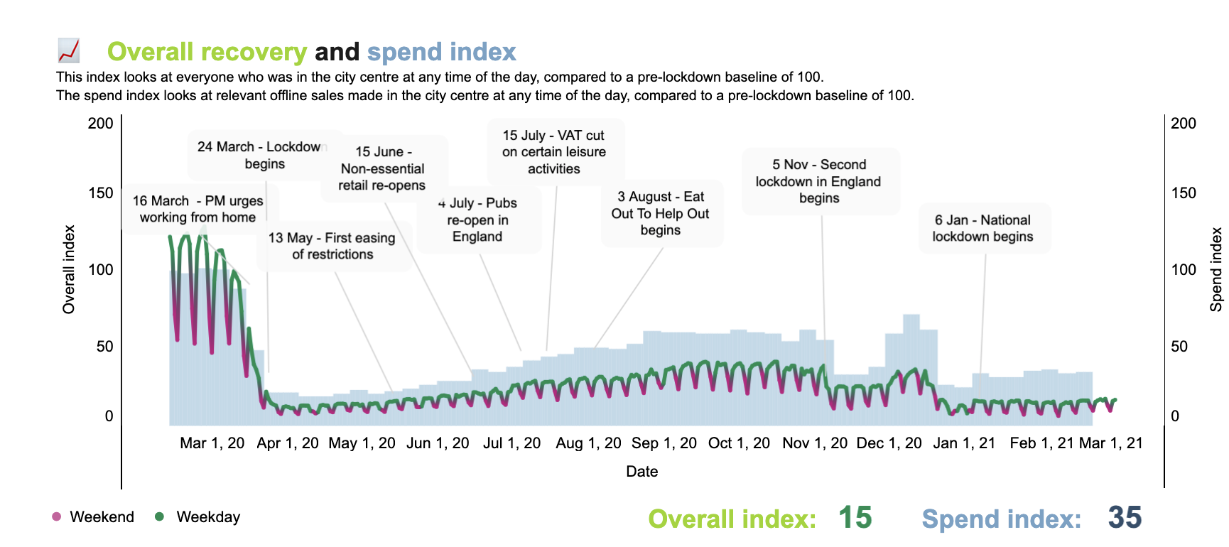
https://www.centreforcities.org/data/high-streets-recovery-tracker/

Slide 10

Pauses to keep...
https://lithub.com/covid-19s-anthropause-has-made-nature-visible-again-at-least-for-now/
“...the resultant fall in global emissions of carbon dioxide: in the first six months of this year, the total was an 8.8 percent decrease from the same period in 2019, a drop of more than 1.5 billion tonnes of CO₂”

Slide 11
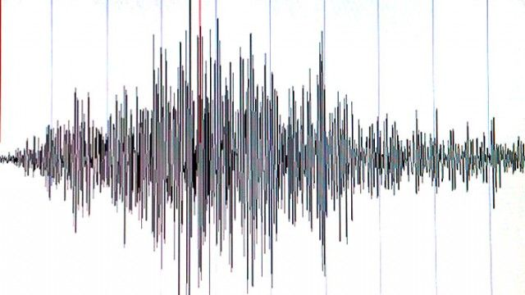
“Human buzz”
Traditionally, seismology has focused on measuring seismic waves, resulting after earthquakes. Seismic records from natural sources, however, are contaminated by high-frequency vibrations ("buzz") from humans on the surface — walking around, driving cars, and catching the train. subsurface. Heavy industry and construction also generate seismic waves that are recorded on seismographs.

Slide 12
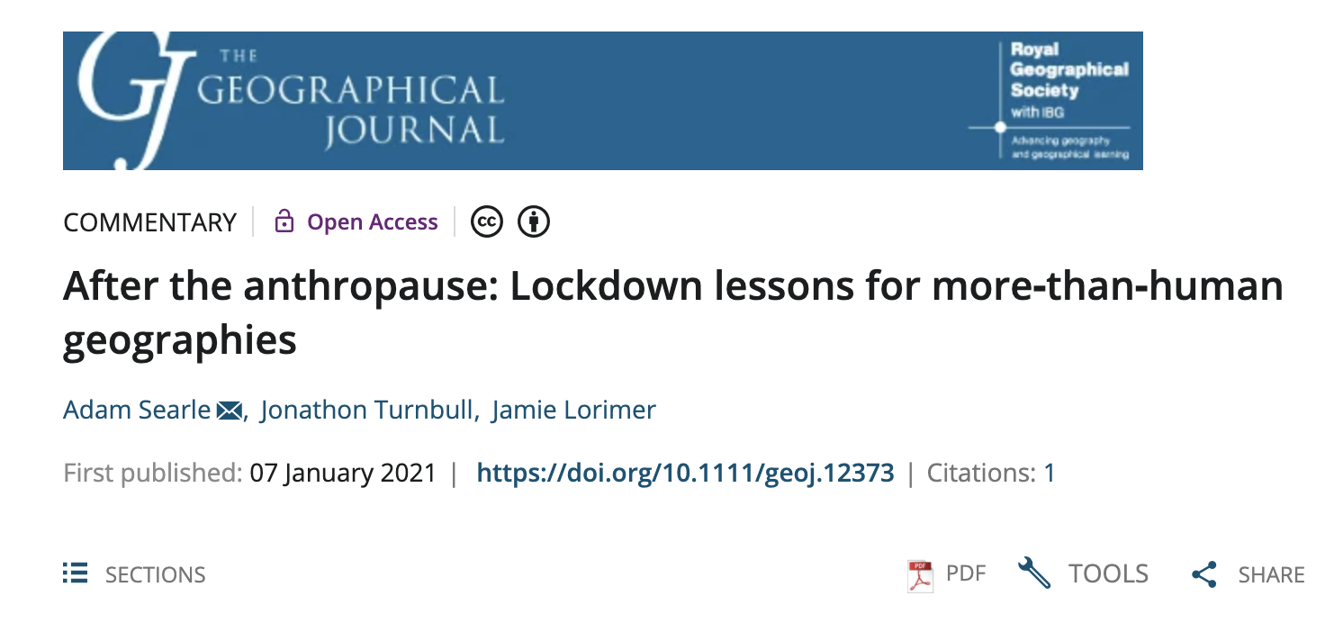
Free Access
https://rgs-ibg.onlinelibrary.wiley.com/doi/10.1111/geoj.12373

Slide 13
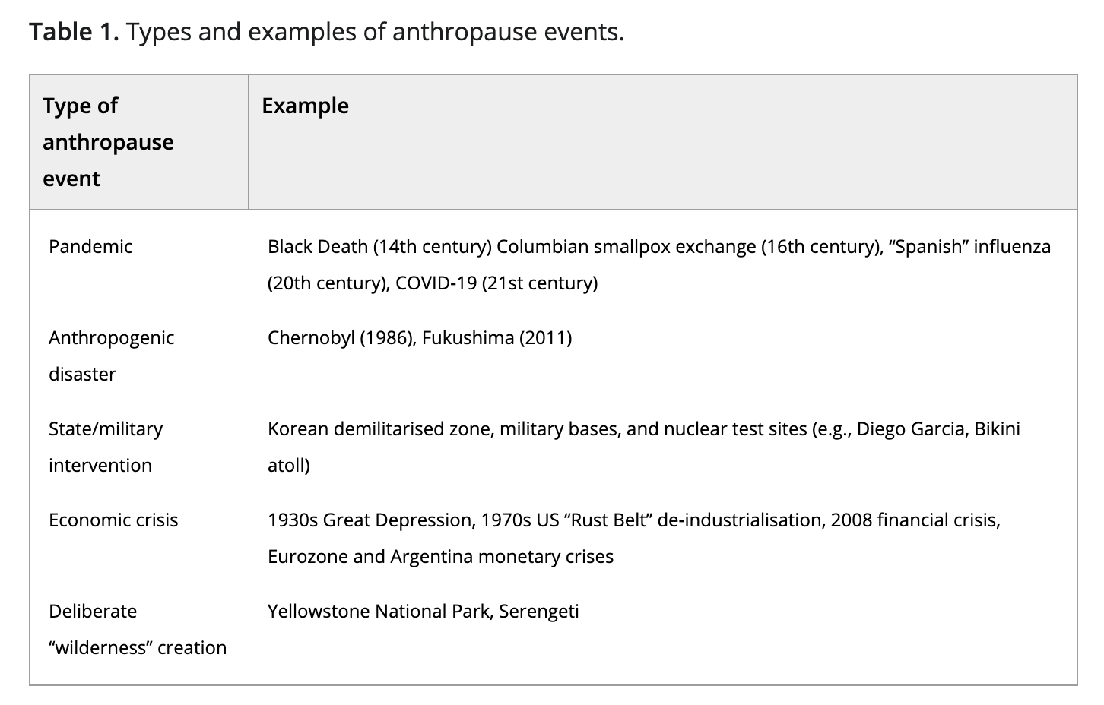
https://rgs-ibg.onlinelibrary.wiley.com/doi/10.1111/geoj.12373

Slide 14

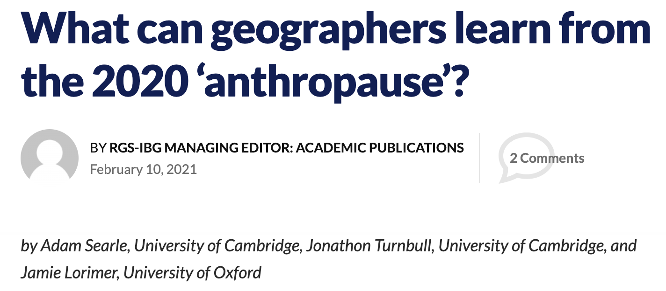
Free Access
https://blog.geographydirections.com/2021/02/10/what-can-geographers-learn-from-the-2020-anthropause

Slide 15
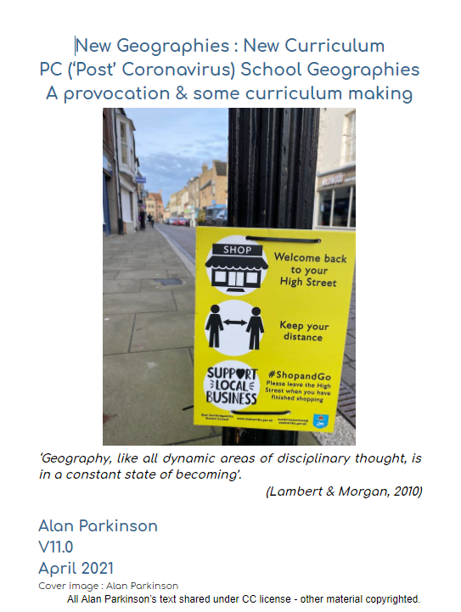
New PC Geographies - over a year in the writing
V11.0
About 200 pages
https://docs.google.com/document/d/1WEuZiEydbcxmBOs0lfs0_2_vzwIX-OLGljw-SS-M4UU/edit?usp=sharing

