Slide 1
Just a minute…
Clker Free Vector Images, Pixabay
Think about what you can remember from last lesson about the Pink Lake in Oman.
Why might people want to visit these places?

Slide 2
Pink lake of Oman - fieldwork
Learning Goals
Interpret a series of sources exploring the physical features of an area.
Use source material to show understanding of the impacts of tourism in an area.
Offer solutions to the impacts of tourism in an area.

Slide 3
Virtual fieldtrip
What are the impacts of tourism at the pink lake, Al Ashkharah, Oman?
Impacts can be both good and bad.
What equipment do you think you might need?
Are there any risks you can think of if you were visiting these lakes in person?
How would you protect yourself (and others) from the risks?

Slide 4
Virtual fieldtrip
There are 4 different stations around the room.
Visit each one to look at the different impacts of tourism.
Use your carousel sheet to help you complete the tasks at each station.
Answer the final question on your carousel sheet – what are the impacts of tourism on the pink lake in Oman?

Slide 5
How can we protect the pink lake?
The pink lakes are very delicate ecosystems.
They get affected by people visiting them in a number of ways. From your fieldwork, what ways have you seen?
Create a poster or a slogan to help protect the lake.

Slide 6
Station 1: International tourist numbers in Oman
Number of visitors from outside of Oman (in Millions)
Year
Data Credit: Statista

Slide 7
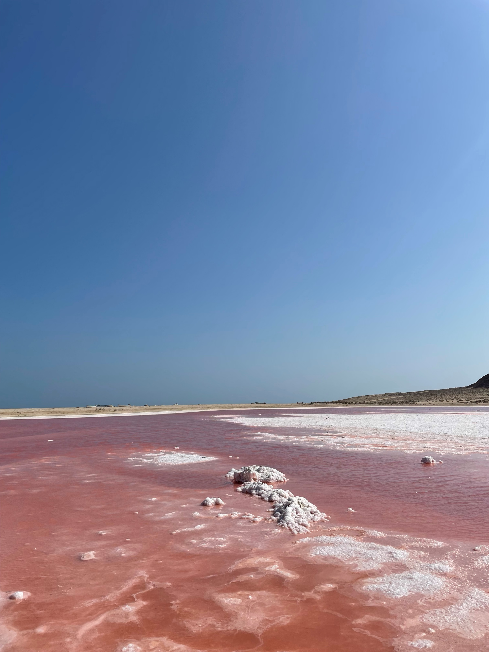
Station 2: Photo analysis
Photo credit: Kai Vacher

Slide 8
Station 3: Money made from tourism in Oman
Data Credit: Statista

Slide 9
Station 4: Tourist reviews
‘Due to birds and fisherman just 150m away it stinks awfully.’ Chris K, Google Review 2022
…‘like almost everything in Oman, the pink lakes are easy to reach by car, and some people seem to enjoy driving through the middle of the lakes’… MR Google Review, 2024
‘Beautiful, quiet spot off the main road. No pink for me, maybe due to high level of the lake or the light, but still worth the stop for sunset. Unfortunately, there is trash everywhere.’ Marie Perin, Google Review 2023
‘Beautiful spot’. Jean Philippe Pignol, Google Review, 2024
…‘Horrible amounts of plastic bottles, plastic bags and plastic crates’... Safiya Salim6, Google Review, 2022

