Slide 1
Lesson Two: Flooding

Slide 2
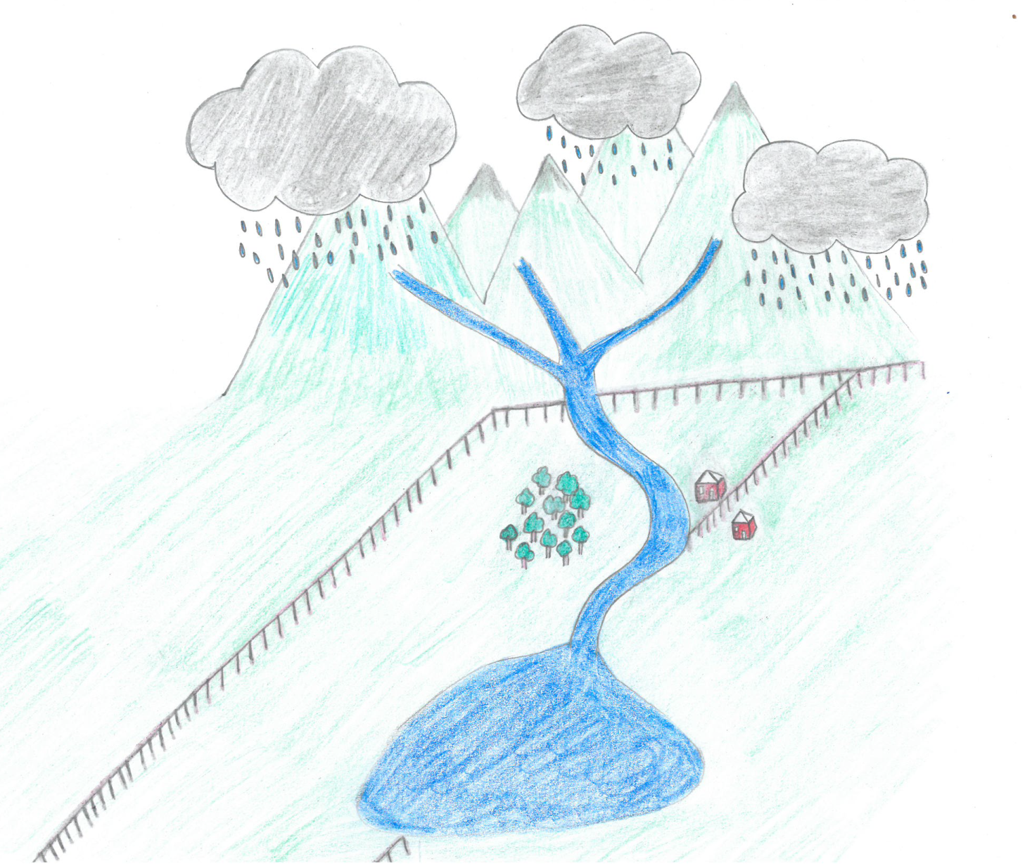
Precipitation in the Upper Course Geographical Questions

Slide 3
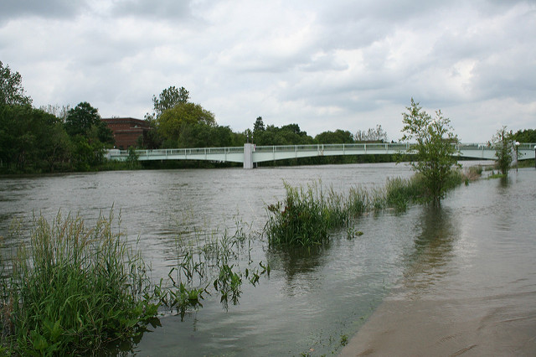
Overbank Flow
Overbank flow
Flooding © rachaelvoorhees, Flickr

Slide 4
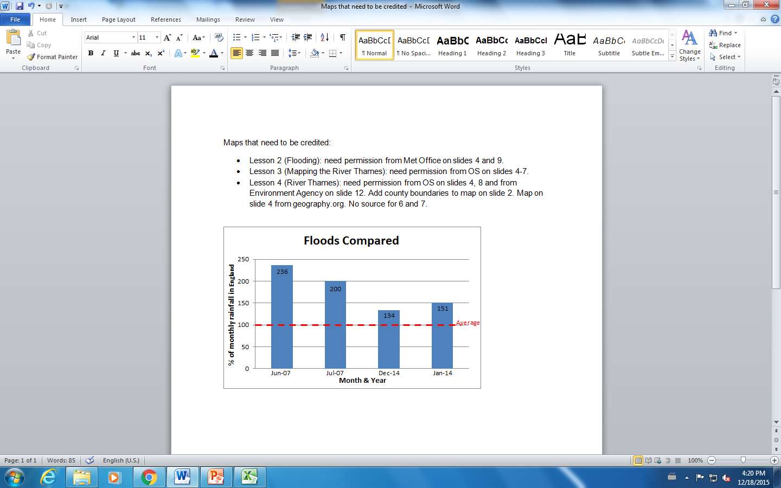
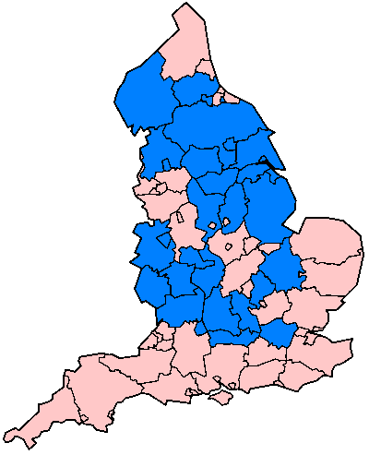
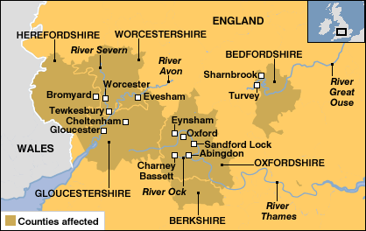
Flooding 2007
Administrative counties in England affected in June and July 2007 floods (marked in blue).
Tewkesbury
Wikipedia Commons
BBC News
Notes:
https://commons.wikimedia.org/wiki/File:English_1998_admin_areas_flood_damage_July_24_2007.png
http://news.bbc.co.uk/1/hi/uk/6912650.stm

Slide 5
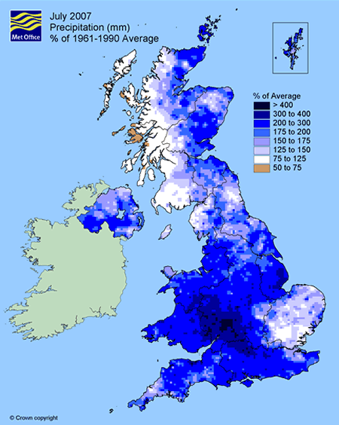
Flooding July 2007
Source: Met Office

Slide 6
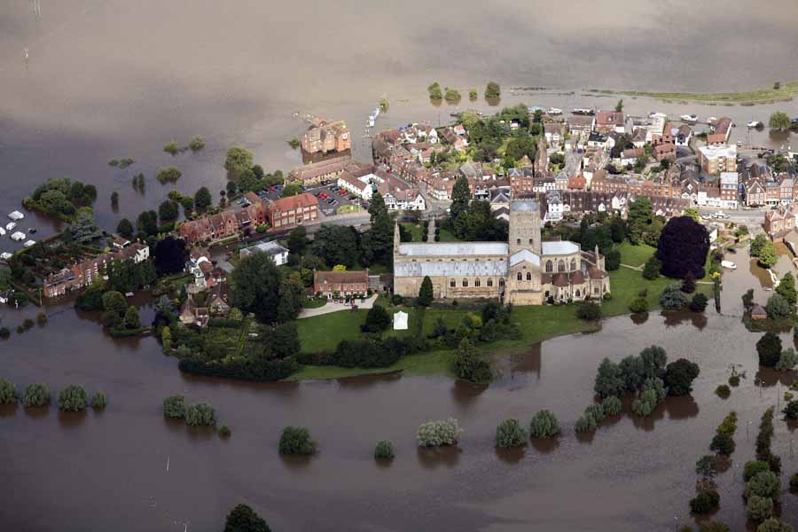
Tewkesbury Abbey 2007
Jonathan Webb, RGS-IBG

Slide 7
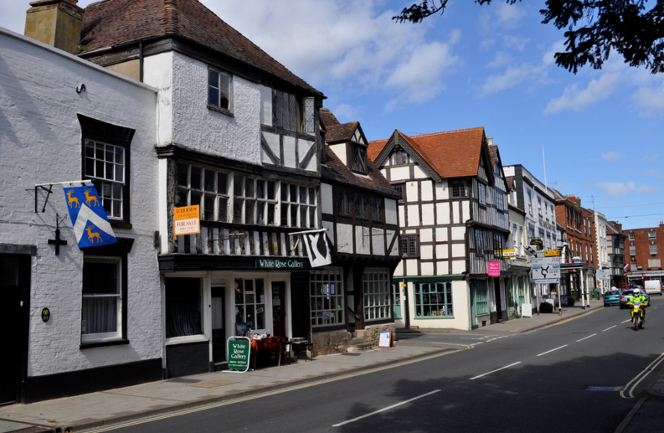
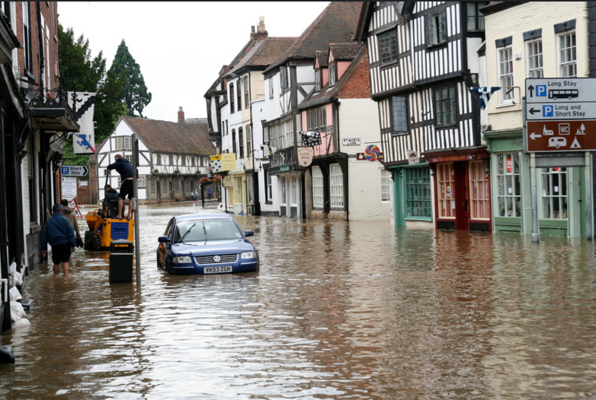
Tewkesbury:
Before and After
Tewkesbury © Jim Killock, Flickr
Flooding in Tewkesbury, July 2007 © Chris Shervey, Flickr

Slide 8
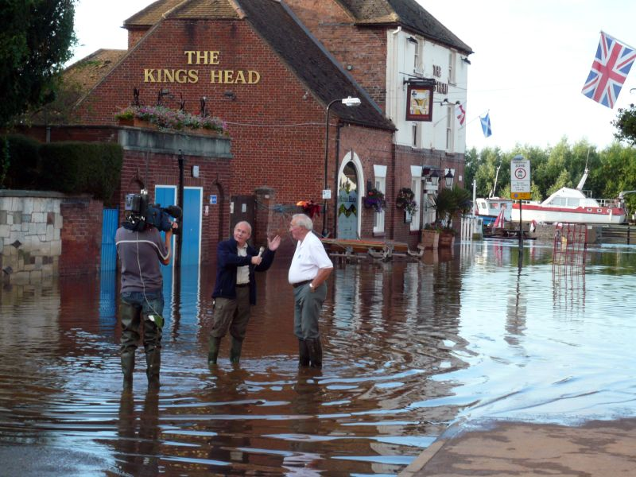
Tewkesbury:
Flooded Businesses
Severn flood 2007 Interview with ITN © Wikipedia Commons

Slide 9
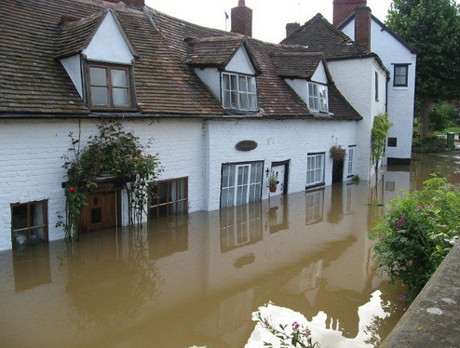
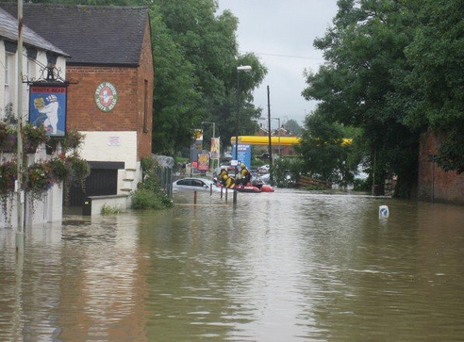
Tewkesbury:
Flooded Homes
Tewkesbury flood 4 © curiouslypersistent, Flickr
Tewkesbury flood 2 © curiouslypersistent, Flickr

Slide 10
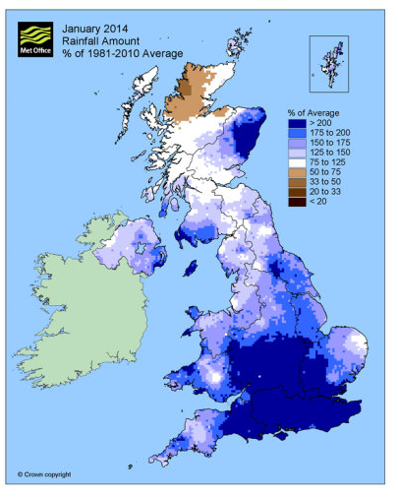
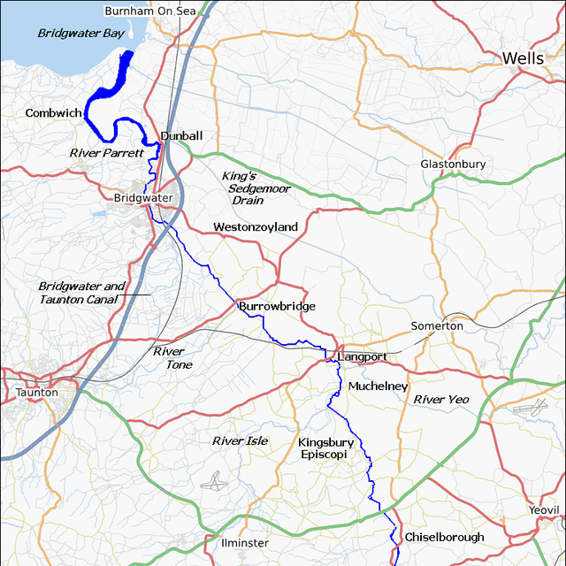
Flooding 2014
River Parrett map © Wikipedia Commons
Go to the Guardian to view an article on the 2014 floods in Somerset and map showing the location of the rivers affected.
Source: Met Office

Slide 11
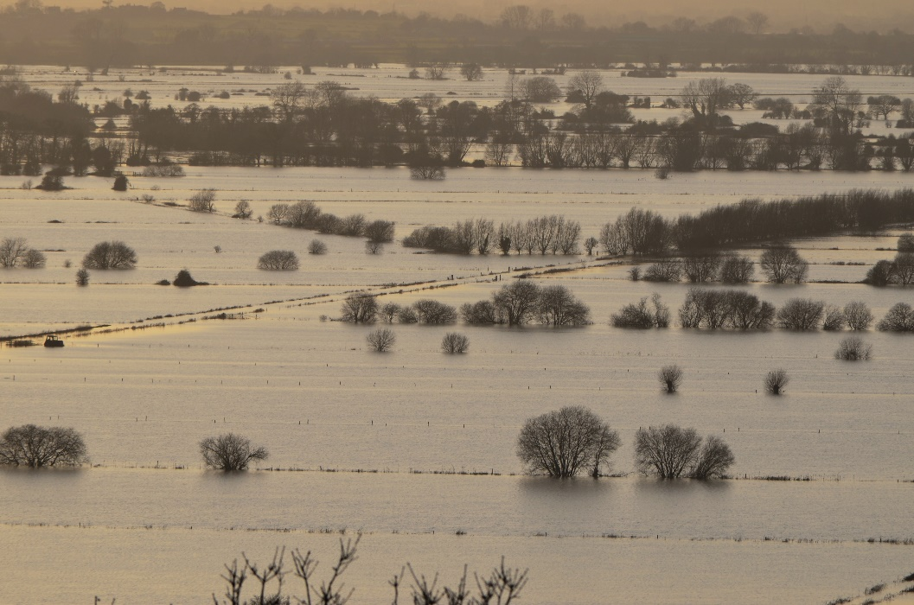
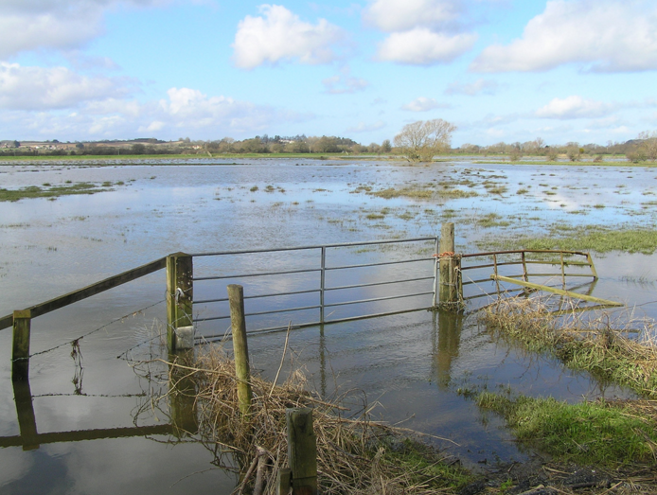
The Somerset Levels
The Somerset Levels © Nick, Flickr
Flooded Somerset Levels in 2007 © Tony Ethridge, Flickr

Slide 12
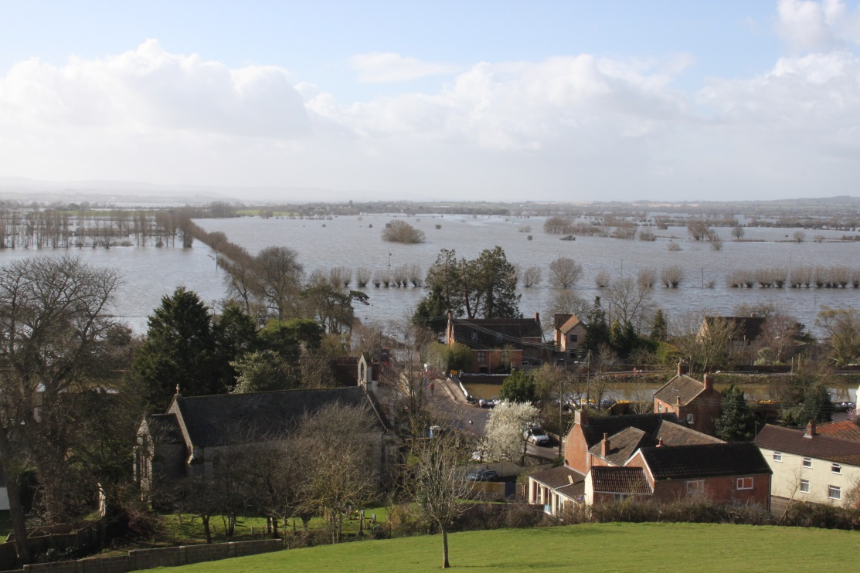
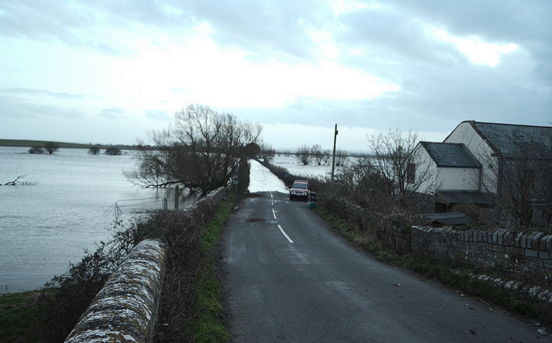
Burrowbridge and Muchelney
Burrowbridge, Somerset taken from Burrow Mump during flooding in Feb 2014 © Wikipedia Commons
Muchelney, Somerset Levels © Nick, Flickr

Slide 13
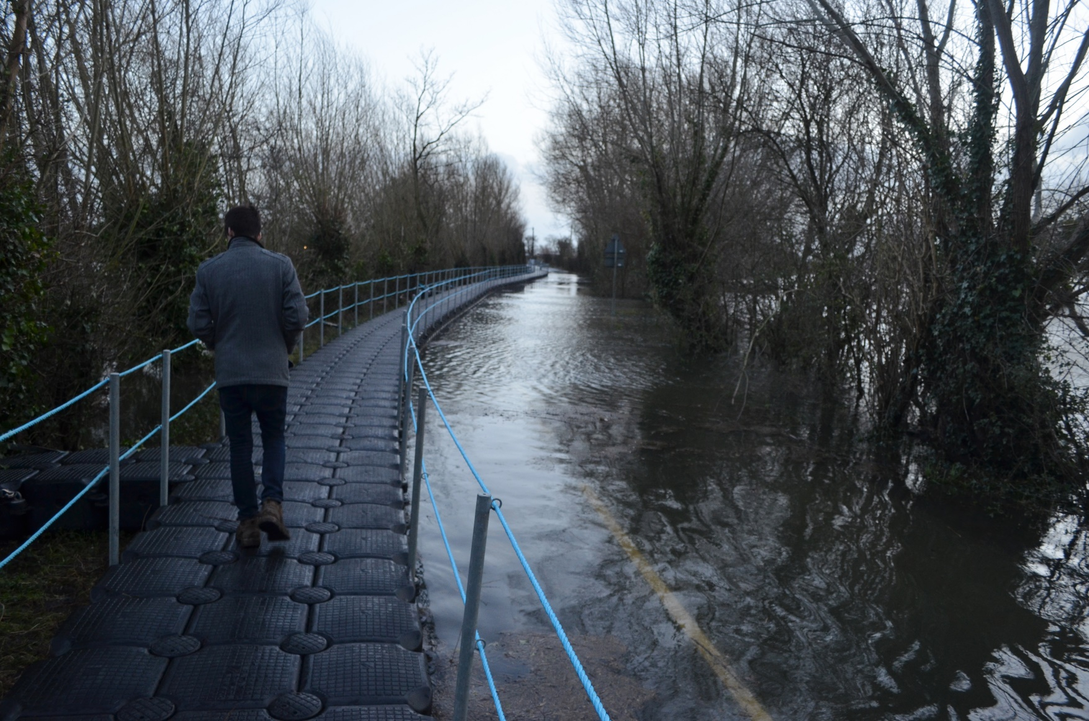
A Pontoon to Muchelney
The Somerset Levels © Nick, Flickr

Slide 14
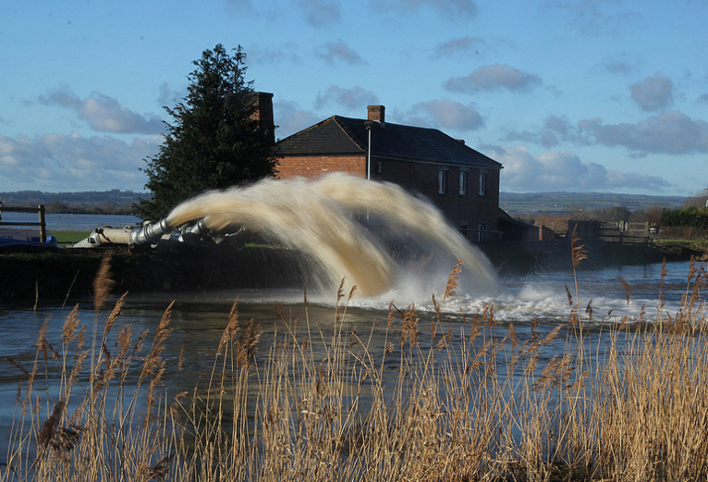
Pumping Water into the River Parrett at Burrowbridge
Water pumps © Mike Barnard, Flickr

