Slide 1
6 Endurance
Shackleton 100
Endurance 100
Geography History

Slide 2
Endurance
?

Slide 3
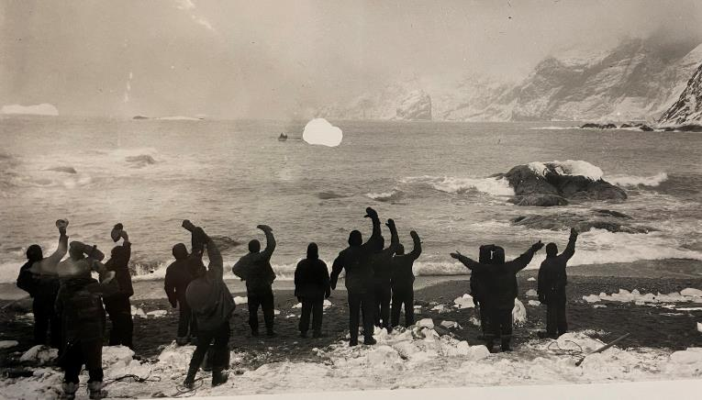
Photograph Frank Hurley

Slide 4
Assembly Notes
Slide 2: A big question mark. Today’s assembly is about endurance. Has anyone heard the word before? Does anyone know what it means? Gather some ideas from the children. It may be that quite a few older ones know what it means, in which case you can say that you are going to give them what you think is a good example of this, and they can say whether they agree with you or not. It might be the best example ever? But they can be the judge. Probably, some will have heard of it but very few can explain what the term means accurately. In that case, you can say that you are going to tell a true story that will help make the term clear.
Slide 3. Ask children to look at this image. What can they notice? Ask them to look very carefully and respond with something they have spotted. Lots of people, snow, ice, a small boat. Elicit as much vocabulary as possible. Ask why the people are waving.
Tell a shortened version of Shackleton’s expedition. In your own words or adapting this:
… Over a 100 years ago, before phones and satellite tv and internet, an explorer called Ernest Shackleton set off to be the first to cross Antarctica (Use a large globe to show Antarctica and the South Pole). The coldest continent in the world. He sailed in a ship that used coal for its engines and sails for when the wind blew – which was often. It was dangerous and the sea ice came extra early that year. It froze the ship before it could even reach Antarctica. It crushed the ship and it sank. All the crew escaped onto ice floes with just a few belongings, as much dried food as they could save and their small wooden lifeboats. But there was too much ice to sail anywhere! They lived on ice floes for months, in tiny canvas tents, drifting with the currents, no hope of rescue. They endured great hardships.

Slide 5
Assembly Notes cont.
They endured cold, killer whales, frostbite, illness, hunger, horrendous storms and biting winds. The coldest place on earth. Eventually when a brief summer came, and it’s not much of a summer in Antarctica, the sea ice began to melt and they were able to sail in their boats to find some nearby land. They endured gales and hunger and cold and were soaked through. They managed to reach a small island (Elephant island). No-one lived there apart from seals and penguins. There was no hope of anyone finding them. They didn’t have phones or radios. They endured cold, they endured hunger, loneliness. They missed their families back home.
Six crew members led by Shackleton and the ship’s captain, left the island to sail 800 miles in a battered small wooden boat across the most ferocious waters of the world, the Southern Ocean, to try and reach help. The men left behind endured more hunger, cold, illness and hardship. It was now nearly two years since they had set sail from a safe harbour in South Georgia, full of plans and hope to achieve their plan. Two years of cold and hardship. They prayed that Shackleton would survive and bring back a rescue ship.
Now – do you know why these men were waving and what is happening? (Take replies)
Yes, despite the odds, Shackleton and his team managed to reach help and rescue the men. All of the crew here were saved. It is a tale of endurance. Who can explain to me now what this means?
Endurance is a power we can grow in ourselves to get through difficult situations without giving way. We need to have faith that we will get through it. Shackleton’s lost ship was also called the Endurance.

