Slide 1
Lesson four: Famous Football Cities

Slide 2
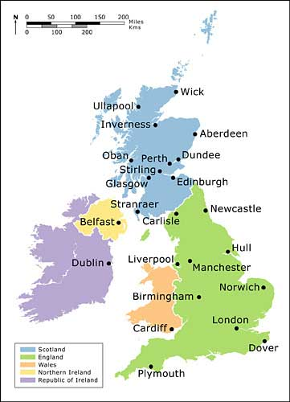
The Cities of the UK
Source: isizedconsultltd
Notes:
http://www.isizedconsultltd.com.ng/map-and-climate/

Slide 3
UK cities: Population
CITY | COUNTRY | POP. (Millions)
London | England | 8.25
Birmingham | England | 1.09
Glasgow | Scotland | 0.6
Liverpool | England | 0.55
Bristol | England | 0.53
Sheffield | England | 0.52
Manchester | England | 0.51
Leeds | England | 0.47
Edinburgh | Scotland | 0.46
Leeds | England | 0.44
Cardiff | Wales | 0.35
Belfast | N. Ireland | 0.33
Data source: David Pyle

Slide 4
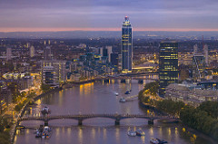
UK Cities and Population Growth
UK city growth has resulted from:
The Industrial Revolution (late 18th century) as people migrated from rural areas to work in factories.
The growth of the railway network
Specialisation of industry e.g. brass in Birmingham
Since 1950: decentralization of retailing/entertainment owing to increased car ownership and city centre congestion
View of London, England
Rolling, Rolling, Rolling on the river ©
Chris Chabot, Flickr

Slide 5
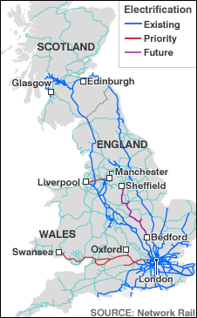
Transport: Rail Network
Notes:
http://www.bbc.co.uk/2/hi/uk_news/6691471.stm.

Slide 6
Motor transport
By the 1930s, there were a million cars on the road in Britain. The development of motor transport changed the way people lived and worked and had an equally big impact upon the railways, signalling the end of their greatest days.
For a video clip on ‘Transport in Britain since 1930’ go to BBC Education
BBC

Slide 7
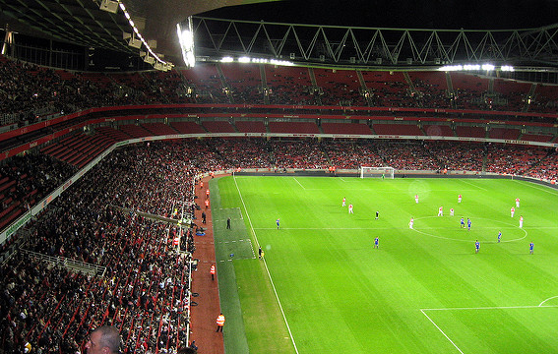
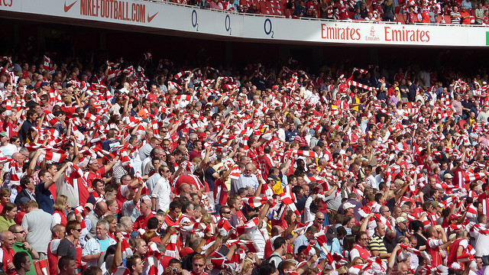
Football: England’s favourite game
Stadium © wonker, Flickr
Scarf waving © wonker, Flickr
Notes:
Flickr: Stadium, wonker. Accessible at: https://www.flickr.com/photos/wonker/421980487/in/photolist-DhL6D-bFBaJM-bq1GYx-bq1FvB-bq1WFB-bjJnEX-fDAvju-bq1LKX-dqxP7X-bq1Jon-bq1Gzp-bq1LSv-bq1L5v-bq1Gnt-fDj3tv-bq1CXz-bq1DNg-fDj45F-bq1Eqa-8ekDUc-cQCUuS-95dHLy-6kRkoB-bq1HXe-9Jc8CT-dR9Ktf-bq1Km4-9Nbm3V-bq1KRB-7kC1cN-bkF5du-9Nb81K-9NbdPF-9Nbtkv-dAadsG-9NbkgK-bq1Jbp-bq1WtV-9Ne9nQ-9NbnsP-dSu5yo-nKEsRs-j85Lbr-h2cSXv-kdz114-9A9btw-fDAD83-daZbvx-dVd2GF-9trgx5
Flickr: Scarf Waving, wonker. Accessible at: https://www.flickr.com/photos/wonker/3845938367/in/photolist-6RRruc-cQCUm7-bq1E2K-7kC1BG-hUPAdE-6gdaME-boGvXR-bq1JDk-douR6W-6qNxkf-7uzWti-fH5FRA-bq1Fgi-ch5H2f-4PoaaF-9Ne7XY-jHBNTH-7uDQUQ-bq1EY4-fGN7Bp-8akqgP-95dxx1-7j4HqA-fow9Uc-bq1EHt-8YpoR9-7uzY6V-6JvUmW-oj5qcF-jHBP8v-cPGQTu-9NbtgR-7uDPR7-e7kC5Y-4nefx7-8bkjmf-7uzUVV-2WCGqf-ooR7cS-9Nb738-adF8FF-7kzmaB-6fwz5N-jHBNQr-849YqE-bq1MQn-ksPAEo-dzBWVv-2TGCx9-7kDe3L

Slide 8
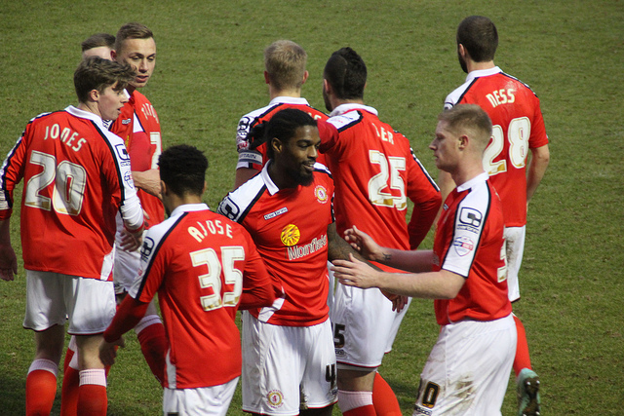
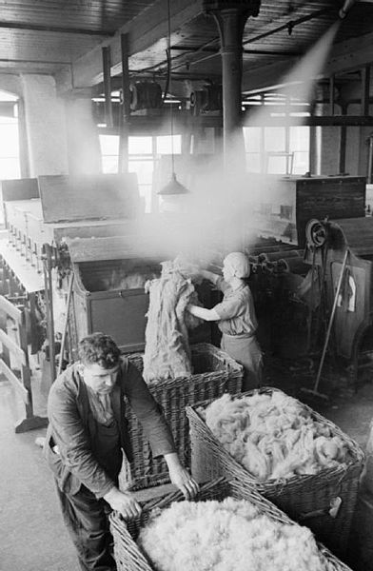
Football teams: nicknames and origins
‘Railwaymen’ – Crewe Alexandra
Gained their nickname as Crewe had a large railway industry
Colchester Utd 2-3 Crewe Alexandra EEPaul © Flickr
‘Hatters’ – Luton Town
The team was named after the hat-making industry in the town.
Workers at a British hat factory prepare rabbit fur ready for its transformation into felt, 1940. Wikipedia Commons
Notes:
Crewe – Flickr: Colchester Utd 2-3 Crewe Alexandra, Paul Wilkinson (EEPaul). Accessible at: https://www.flickr.com/photos/eepaul/16286423410/in/photolist-nxgBP4-cEwxEd-7YZGHB-kvbssi-ndZQvc-qPbbgC-nvd5Pz-ne1xJo-nvwgzj-nveivA-cgDeWU-nvcw5B-kvbvUD-nxgNsD-q9WSht-oSXMKz-82Xbij-ndYtyc-nvuNk2-pxmZs5-ne1hZH-nts7A9-oSXUh2-nxgDYe-ne1hVX-ne12mS-nvcPH2-cEwHgQ-qPhfpK-nxghxi-cEwwPC-nvuRV8-nvdU6Q-nvuQXB-nvusvn-a9mvpP-cgDg1N-kvbq8D-cEwAx9-a9pjcQ-nxgcZk-ne17o5-ne19HU-kvdCbm-ne19by-nvuzDk-mPSPdt-cEwtsU-pxjnWC-pGHJBh

Slide 9
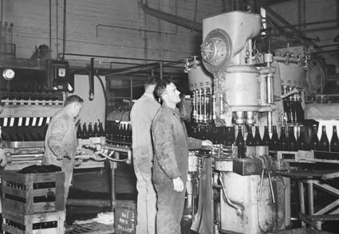
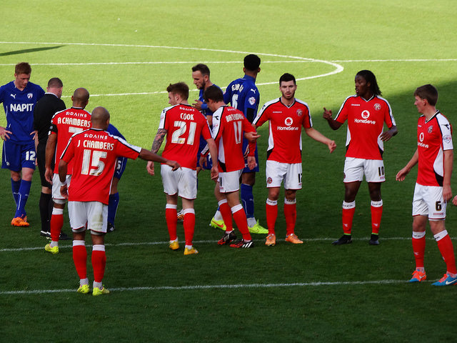
Football teams: nicknames and origins
‘Brewers’ – Burton Albion
Gained their nickname due to the large brewery in town.
Wikipedia Commons
‘Saddlers’ – Walsall
The team was named after the leather manufacturing industry in the area nearby
DSC01601 © Ben Sutherland, Flickr
Notes:
Google images: History of beer, en.wikipedia.org. Accessible at: https://upload.wikimedia.org/wikipedia/commons/0/05/Australian_beer_production_1945.jpg
Walsall – Flickr: DSC01601, Ben Sutherland. Accessible at: https://www.flickr.com/photos/bensutherland/15447948567/in/photolist-cXKvrL-cXKtEY-pPA7cC-p3aHvi-hqtueL-hqzArm-hqzV8Z-hqu8ix-hqtrmw-hqzz91-hqu8sm-hqzpvo-hqAi3F-hqzCLb-hqzuoQ-hqz83z-hqtNJE-hquZCv-hqArFT-px5LUP-pPAbR7-px5FR2-pMqi4U-pPvVRt-px2kwc-oSEmeQ-px5GpX-oSHhS2-px7Ghw-pPhf8n-pPvND2-pPvS7p-px51dL-pMqomC-pPA979-oSEr6o-px2not-pPvXwn-px5L8P-pPAfeE-pPvUwe-px7EmC-px4XNf-pPAdyf-px2hkn-px5H92-pMqgc7-px5FtD-px2hwV-pPAdhU

Slide 10
Northampton Town ‘The Cobblers’
The shoe manufacturing industry gave rise to the nickname ‘The Cobblers’. Northampton was the world capital of shoemaking and it must have been a great sight, seeing everyone in the town walking around in fashionable shiny boots.

Slide 11
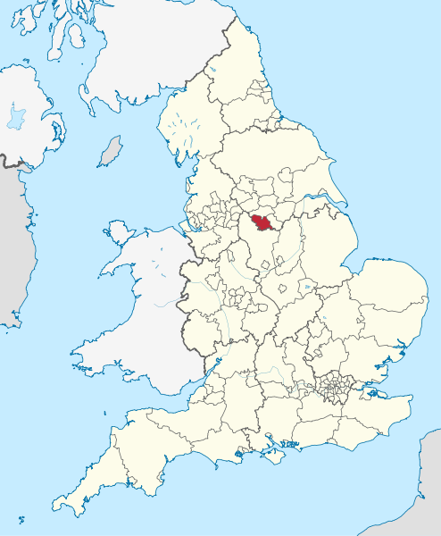
Case study: Sheffield
Wikipedia Commons
Notes:
Google images: File: Sheffield in England.svg, commons.wikimedia.org. Accessible at: https://upload.wikimedia.org/wikipedia/commons/thumb/a/a6/Sheffield_in_England.svg/494px-Sheffield_in_England.svg.png

Slide 12
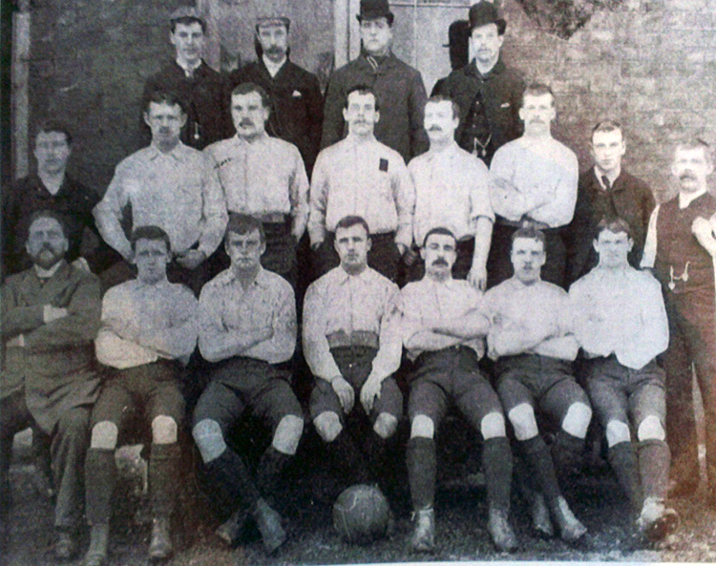
Sheffield: The Blades
Wikipedia Commons
Sheffield United was nicknamed ‘The Blades’ from one of the most famous trades of the town – steelmaking.
Notes:
Google images: File: 1891 – 92 Sheffield United F.C. team.jpg, commons.wikimedia.org. Accessible at: https://upload.wikimedia.org/wikipedia/commons/0/0c/1891-92_Sheffield_United_F.C._team.jpg

Slide 13
The Blades
‘Blades’ or ‘Cutlers’ were formerly the names of all senior Sheffield football clubs, particularly when they were playing away.
A popular headline in the newspapers when Sheffield United and Sheffield Wednesday played was a ‘Clash of Blades’.

Slide 14
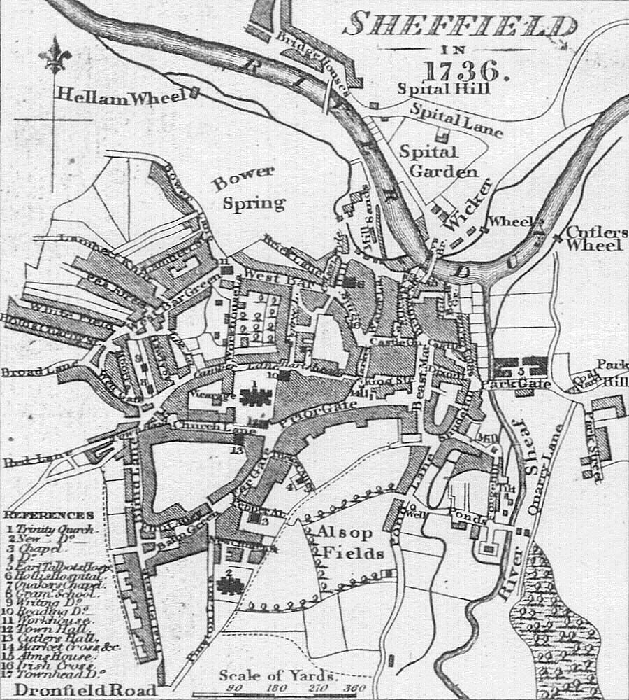
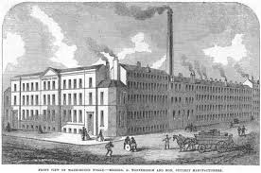
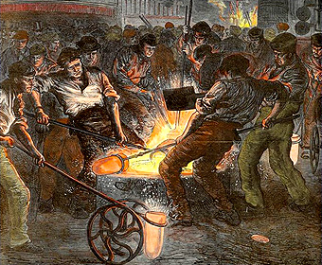
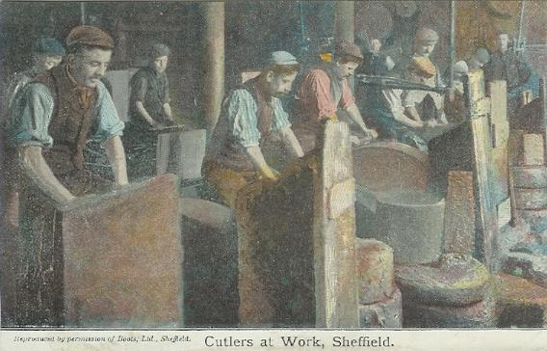
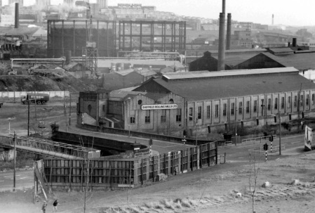
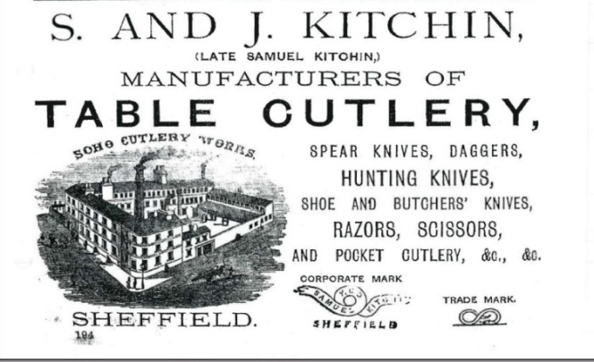
Sheffield: Growth and Decline
Notes:
All images from LESSON 4 SHEFFIELD INDUS TIMELINE RESOURCE SHEET

Slide 15
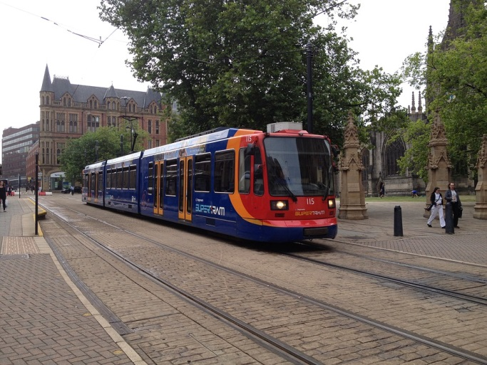
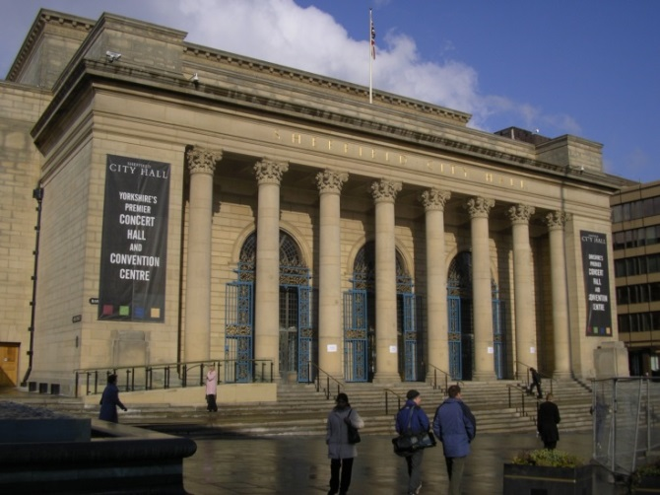
Sheffield Now
Trams
City Centre
pixabay
Wikipedia Commons
Millennium Square
Wikipedia Commons
Notes:
Tram – Google images: Free photo: Sheffield, the Tram, Tram, Public Transport, Transport, pixabay.com. Accessible at: https://pixabay.com/static/uploads/photo/2016/01/13/04/36/sheffield-1137159_960_720.jpg
Town – Google images: Millenium Square (Sheffield), en.wikipedia.org. Accessible at: https://upload.wikimedia.org/wikipedia/commons/0/0e/Millennium_Square.JPG
Google images: Sheffield City Centre, en.wikipedia.org. Accessible at: https://upload.wikimedia.org/wikipedia/commons/d/dc/Sheffield_City_Hall.JPG

Slide 16
Extension
To research the association between other UK towns and industries go to ‘The Beautiful History’ website: http://www.thebeautifulhistory.wordpress.com/clubs
TOWN/FOOTBALL TEAM | FOOTBALL CLUB NICKNAME | INDUSTRY
Reading | Biscuitmen | Hunters & Palmers Biscuits
Burton Albion | Brewers | Brewing Industry
Wycombe Wanderers | Chairboys | Furniture making
Yeovil Town | Glovers | Glove making
Luton Town | Hatters | Hat making
Scunthorpe United | Irons | Iron Industry
Stoke City | Potters | Pottery Industry
Crewe Alexandra | Railwaymen | Railways
Walsall | Saddlers | Saddle making
Southend United | Shrimpers | Shrimping Industry

