Slide 1
6 Then and Now
Shackleton 100
Endurance 100
Geography History

Slide 2
The Story So Far…
In brief
The story so far in brief…
In 1914 the explorer Sir Ernest Shackleton set out on an ambitious expedition to cross the continent of Antarctica from one side to the other. He failed. However he achieved one of the greatest feats of turn of the century polar exploration; he returned with all his 27 men – alive, despite the loss of his ship. Shackleton’s ship, the Endurance, was crushed and sank in ice in the Weddell Sea, before his team could even begin that ill-fated attempt to cross the hostile continent of Antarctica.
Find out more here Royal Geographical Society - Geography resources for teachers (rgs.org)
In 2022, the Centenary of Shackleton’s death, Dan Snow travelled to Antarctica on board the S.A. Agulhas II, as part of the Endurance22 expedition, in a successful attempt to locate the missing wreck of Shackleton’s ship.
Find out more here Expedition Team - Endurance22

Slide 3
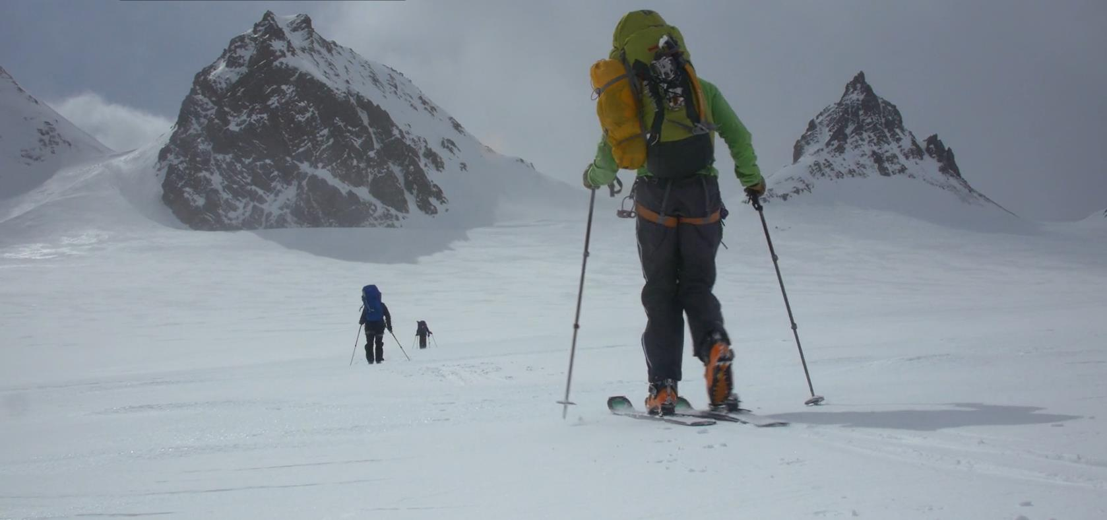
Crossing South Georgia
This 20 minute film shows young explorers replicating Shackleton’s team journey across South Georgia
Crossing South Georgia | Antarctic Heritage Trust (nzaht.org)

Slide 4
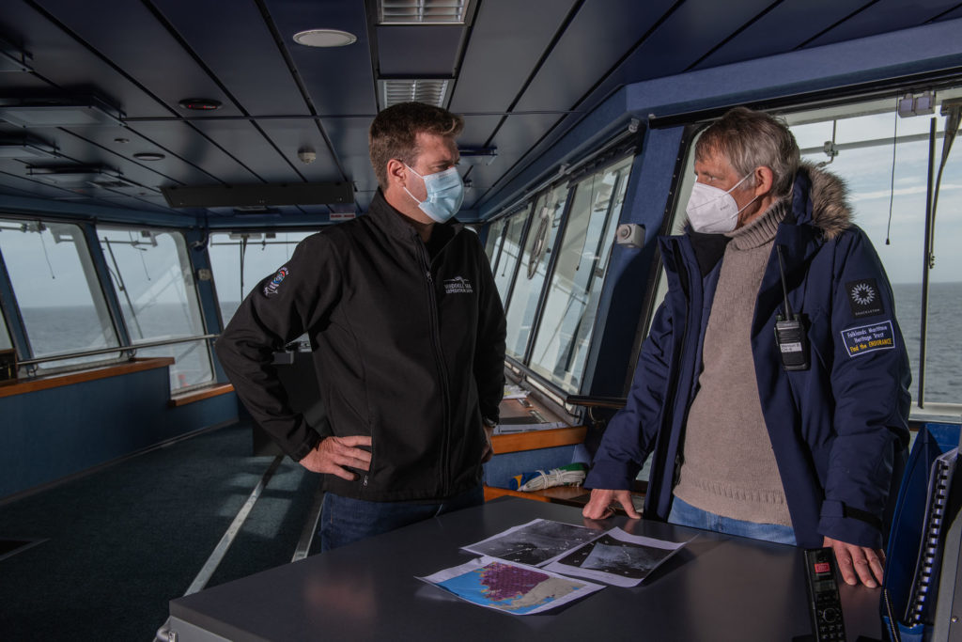
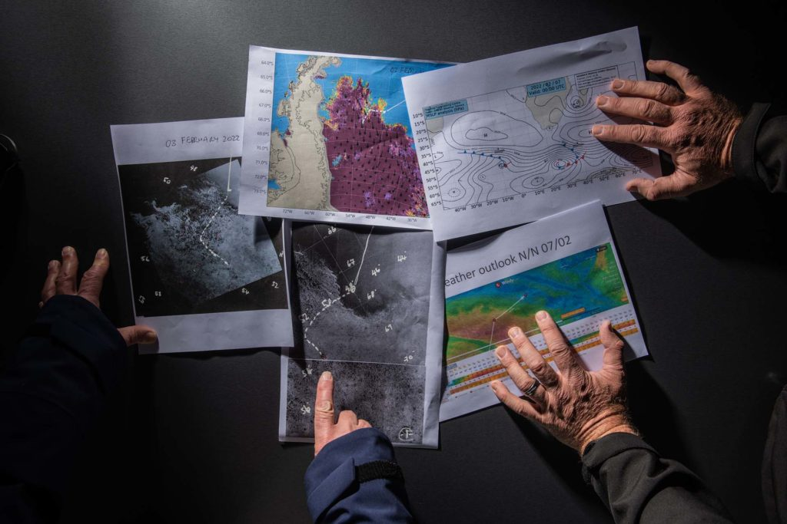
Simon Frederick Ligthelm, ice pilot and Mensun Bound, director of exploration of Endurance22 expedition, discuss the weather and ice conditions aboard Agulhas II, the expedition ship that found the wreck of Endurance.
Photo by Esther Horvath
Endurance22 Expedition Blog: 7 February 2022 -

Slide 5
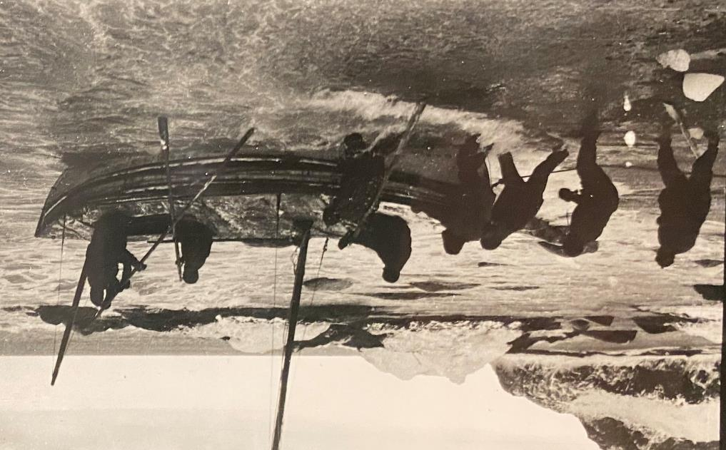
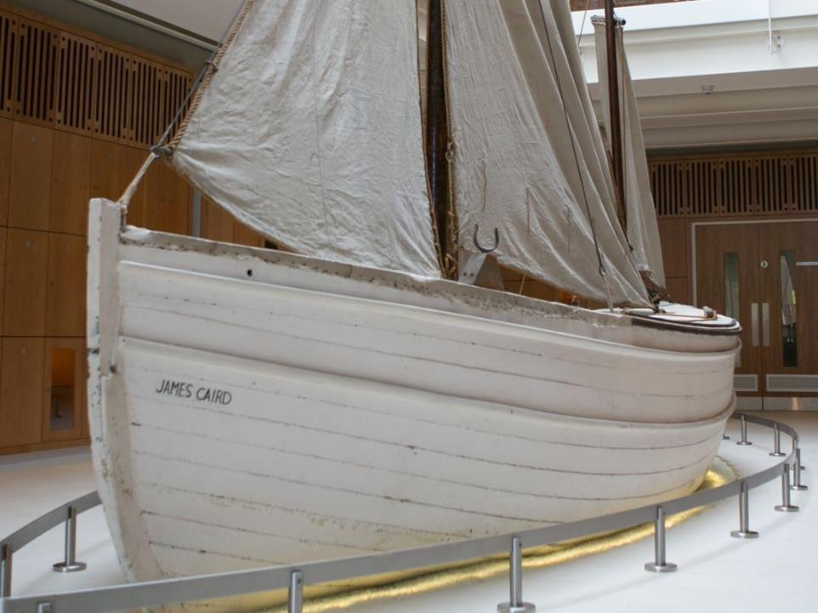
The James Caird
then and now
Launching the James Caird 24th April 1916
Photograph Frank Hurley
The James Caird today – James Caird Society

Slide 6
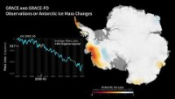
Ice Loss Antarctica 2002-2020
Research based on satellite data indicates that between 2002 and 2020, Antarctica shed approximately 150 billion metric tons of ice per year, adding to global sea level rise.
Antarctic Ice Mass Loss 2002-2020 - YouTube

Slide 7
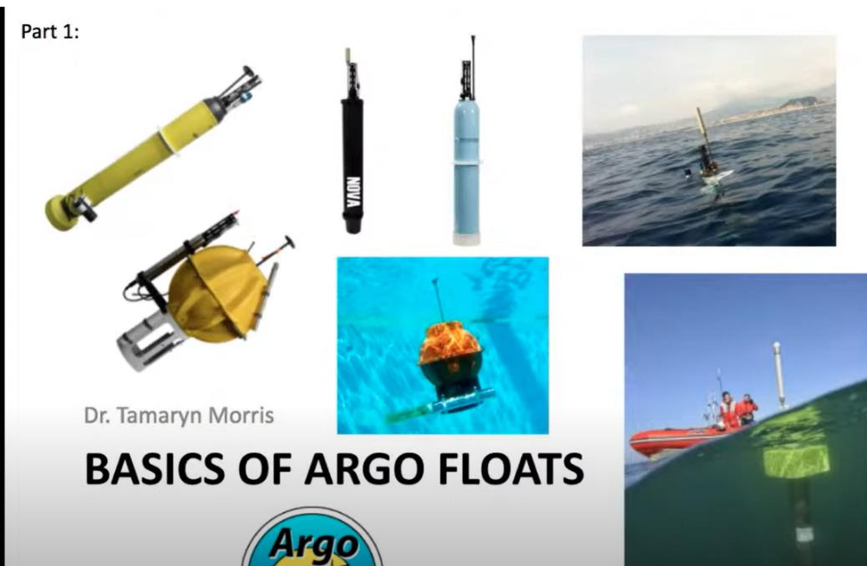
Ocean Monitoring
Argo floats are special mini robots that collect data (information) from oceans.
e.g.
Ocean pressure
Temperature
Salinity (amount of salt in the water)
Putting (Very) Smart Buoys to Work | Reach the World

Slide 8
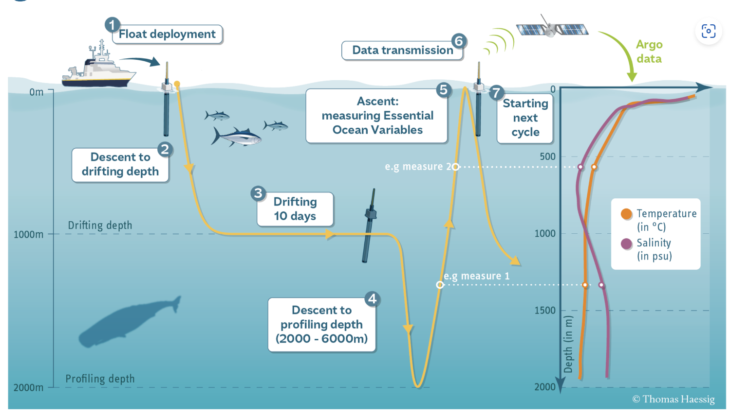
What do Argo Floats do?
Explain the diagram and what happens to the Argo float
How do floats work | Argo (ucsd.edu)

Slide 9
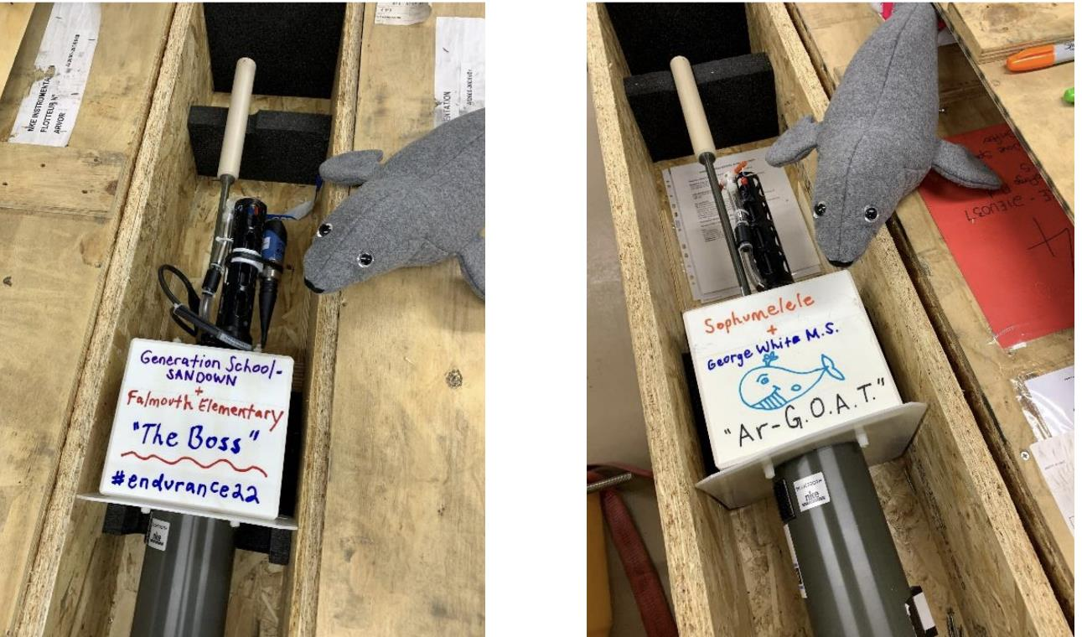
Adopt a Buoy
11 schools in North America were matched with 11 schools in South Africa and Namibia to name and “adopt” an Argo smart buoy and collaborate on classroom projects using the data collected
Science_Report_Endurance22_final_version.pdf

Slide 10

What data could you collect in your school?
Daily weather data: temperature, rainfall and wind direction?
Yearly records of seasonal change eg first Daffodil?
Carbon footprint of your school lunch, your journey to school?

Slide 11
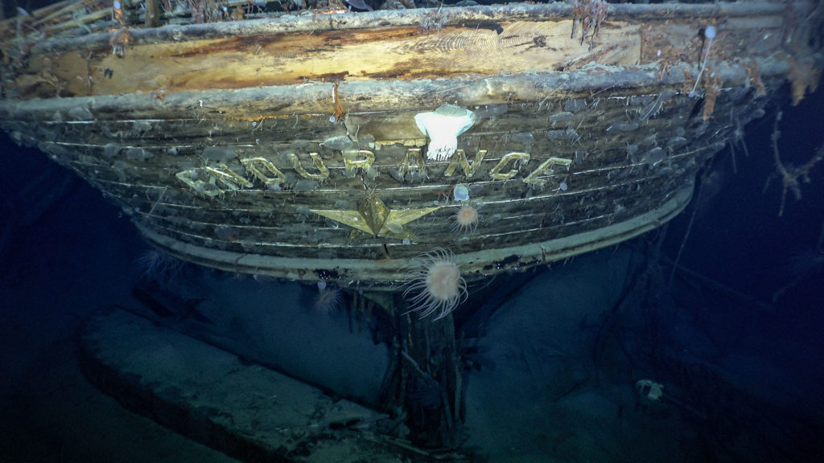
Finding Endurance
Endurance is Found - Endurance22

