Slide 1
5 Assembly
Shackleton 100
Endurance 100
Geography History

Slide 2
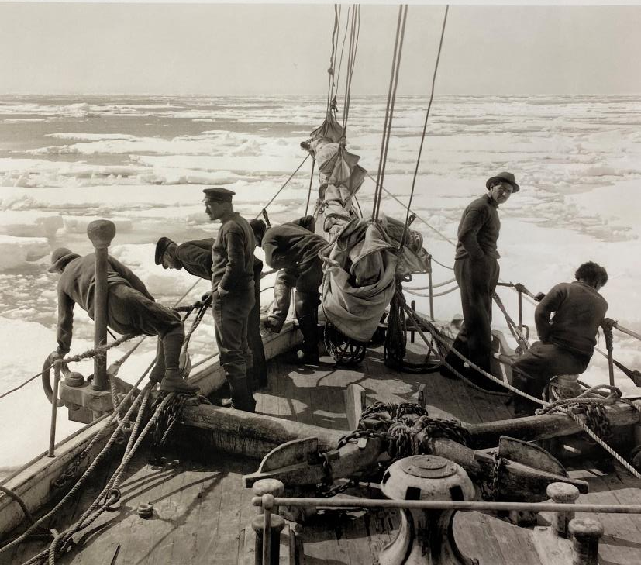
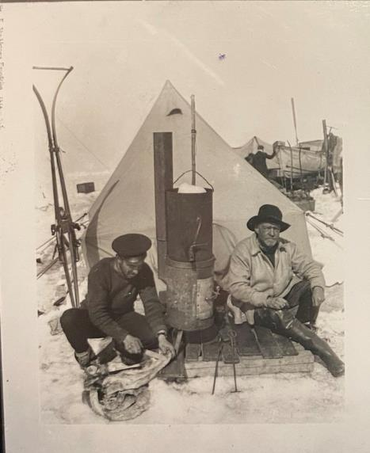
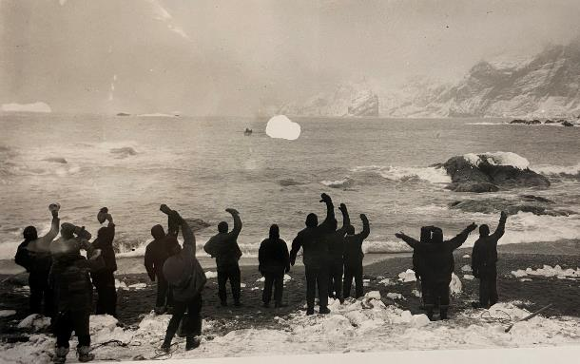
Patience
Shackleton’s Crew on their way to Antarctica
Marooned on an ice floe at ‘Patience Camp’
Rescued from Elephant island nearly two years later

Slide 3
Assembly Notes
You might start the assembly by waiting and looking around and saying you are being patient and waiting for everyone to be sitting very quietly. Ask the children what ‘patience is’ and take some ideas. Ask for an example of ‘being patient’ and if anyone has had to wait a long time for something very exciting to happen. Perhaps waiting ready to leave for a party at a friend’s house? Perhaps waiting for a birthday, or a special celebration day like Christmas or Divali? Take some examples and discuss how you might feel when you’re trying to wait patiently but nothing goes right, and the waiting time gets longer. You could give an example of waiting in a traffic jam, or waiting for your turn to use a piece of play equipment. Discuss how hard it is to wait sometimes when you know you can’t do anything to hurry things along.
Tell the children you are going to tell them a story of some brave people who had to be very patient, waiting and hoping they could make their way home again to see their families. They waited more than two years for a rescue. They spent much of that time marooned on ice floes, then on an island without any shelter in one of the coldiest, windiest places on earth, Antarctica.
The previous slide shows three images. First one, is the expedition setting out to explore and cross Antarctica. Sadly their ship was surrounded by ice and froze, then it sank several months later, after they had patiently waited for the summer to return and the ice to melt enough to free the ship. They then drifted for months on ice floes before making it to land again, but still in Polar waters miles from home, no telephones or modern technology. This is image 2, showing some crew members at a camp they called ‘Patience Camp’. The crew eventually reached Elephant island, where they waited again whilst their captain undertook a dangerous journey to reach land at St Georgia and get help. Picture three shows them being rescued.
Ask children why the crew called their camp on the ice floe ‘Patience Camp’. Remind children that sometimes being patient is hard. You think something is never going to happen, but if you have faith and believe, you can remain positive and cheerful and this makes being patient easier. These men always believed and had faith and they managed to stay alive because of it.

