Slide 1
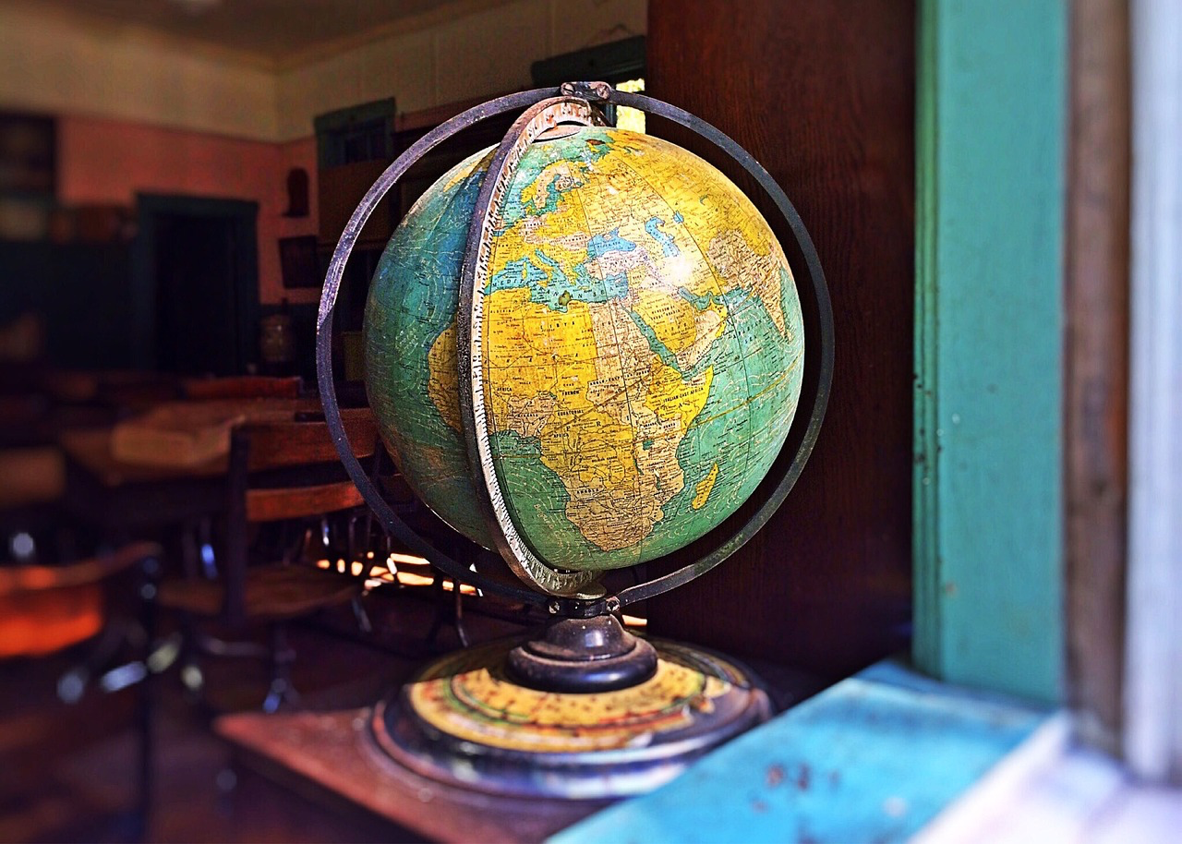
The Room Where it Happens: Influential and Inspirational Geographers
DO NOW: With your partner, write down ideas of why geography is important to society… think of the examples of careers we’ve studied during this topic.
Notes:
Image: https://pixabay.com/photos/globe-world-earth-planet-sphere-967304/

Slide 2
Geography Gallery Walk
Task: Around the room are profiles of inspirational and influential geographers - old and new. Circulate around the room and summarise the information into your table.
Name and expertise | Contributions | Impact to society | Would you like to do this job - Why? Why not?

Slide 3
David Attenborough
Background: Born on May 8, 1926, in London, England, David Attenborough is a renowned broadcaster, natural historian, and author. He studied natural sciences at the University of Cambridge and began his career at the BBC in the 1950s, where he produced and presented various wildlife documentaries. His passion for nature and storytelling has made him a household name worldwide.
Contributions: Attenborough is best known for his well-known documentary series, including "The Blue Planet," "Planet Earth," and "Our Planet." His work focuses on the intricate relationships between living organisms and their environments, shedding light on ecosystems across the globe.
Impact: Attenborough’s documentaries have profoundly influenced public opinions of nature, conservation, and biodiversity. His efforts have motivated movements for environmental awareness and conservation, urging viewers to understand the critical challenges facing our planet. His support for climate action and sustainable practices has inspired global movements to protect natural habitats.
Relevance: Attenborough's work shows the links between of social geography and environmental studies, illustrating how human activities impact ecological systems. His commitment to environmental education has encouraged a more sustainable approach to living.

Slide 4
Greta Thunberg
Background: Born on January 3, 2003, in Stockholm, Sweden, Greta Thunberg is a famous climate activist who gained international attention at a young age for her passionate advocacy against climate change. After learning about the climate crisis in school, she began skipping school on Fridays to protest outside the Swedish Parliament, inspiring students worldwide to join her in "Fridays for Future."
Contributions: Thunberg has delivered powerful speeches at various international forums, including the United Nations Climate Change Conference (COP) and the European Parliament. She has called out global leaders for their inaction on climate change and highlighted the urgency of addressing the crisis through immediate and impactful measures. Thunberg's activism has promoted a global youth movement, empowering young people to take a stand for their future.
Impact: Her straightforward approach and emotional appeals have impacted millions of people worldwide. Thunberg highlights the impact of climate change on vulnerable populations, linking environmental issues to economic inequality and human rights. Her activism has encouraged students, communities, and organisations to demand change in environmental policies.
Relevance: Thunberg’s work demonstrates the importance of social geography and emphasises that environmental issues are also social issues, which require collaborative and worldwide solutions.

Slide 5
Tim Walz
Background: Born on April 6, 1964, in West Point, Nebraska, Tim Walz is an American politician serving as the 41st governor of Minnesota since January 2019. He is currently Kamala Harris's running mate for the Presidential election in the USA. He holds a Bachelor of Science degree in Geography. Walz’s background as a geography teacher has influenced his approach to politics.
Contributions: Walz has used his understanding of geographical concepts to address issues such as land use, environmental policy, and public health. His focus on inequality in Minnesota has informed his policies aimed at economic development and environmental sustainability.
Impact: As governor, Walz has implemented policies that reflect an awareness of Minnesota's varied geography, including initiatives for sustainable land use, climate action, and public transportation. His administration has worked to address climate change through investments in renewable energy and infrastructure that accommodate Minnesota’s unique geographical challenges.
Relevance: Tim Walz’s background in geography is crucial to his role as a governor, as it shapes his understanding of how environmental, social, and economic factors are all related. His career highlights the importance of geography in politics, demonstrating how geographical knowledge can inform effective policy making and community engagement.

Slide 6
Bear Grylls
Background: Edward Michael Grylls, known as Bear Grylls, was born on June 7, 1974, in London, England. He served in the British Special Forces and later became a television presenter and adventurer. Grylls is best known for his survival shows, including "Man vs. Wild," where he demonstrates survival techniques in extreme conditions.
Contributions: Through his television programs, Grylls has educated audiences about survival skills, navigation, and the importance of understanding geographical terrains. He emphasises outdoor safety and encourages viewers to appreciate nature while developing skills necessary for wilderness survival.
Impact: Grylls' work has made outdoor education and adventure tourism popular. His adventures showcase the challenges posed by different environments and by sharing his experiences, Grylls promotes respect for nature and the importance of preserving natural landscapes.
Relevance: Grylls demonstrates the connection between geography and personal resilience, showing how understanding the environment can enhance survival skills. His encouragement for exploration encourages his viewers to go outside and develop a sense of responsibility for environmental conservation.

Slide 7
Name and expertise | Contributions | Impact to society | Would you like to do this job - Why? Why not?

Slide 8
Who inspired you the most?
Class discussion: Which of the geographers during the Gallery Walk inspired you the most? Why?
Notes:
Follow up questions - Reflection Questions
Which geographer’s work had the biggest impact on society?
How does their work relate to current issues in the world (e.g., climate change, urbanisation)?
What skills or knowledge from geography do you think are most important for future challenges?
Image: https://pixabay.com/photos/startup-freelancer-business-4045676/

Slide 9
Geography Stand-Off
You will read a series of statements related to geography. You must decide how strongly they agree or disagree with each statement by moving to the corresponding side of the room.
Statement 1: Geography helps me understand global issues like climate change
Statement 2: Geography offers many career opportunities.
Statement 3: Geography helps develop important skills like map reading, data analysis, and research
Statement 5: Geography is more interesting than subjects like history or economics
Statement 4: Studying geography will help me make a difference in my community
Strongly Disagree
Strongly Agree
Disagree
Agree

Slide 10
Plenary
If you could sum up why a student should choose to study geography into one sentence, what would it be?

