Slide 1
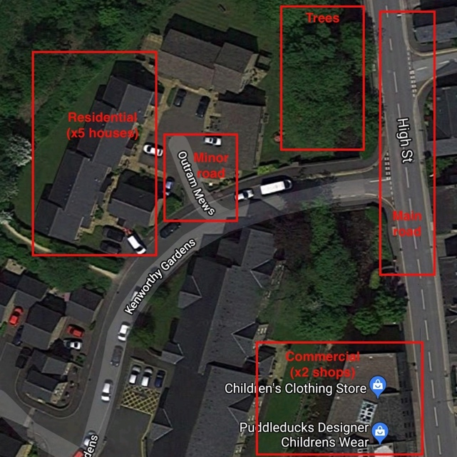
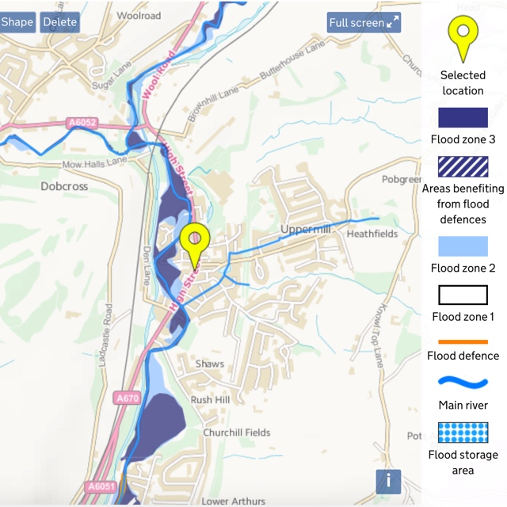
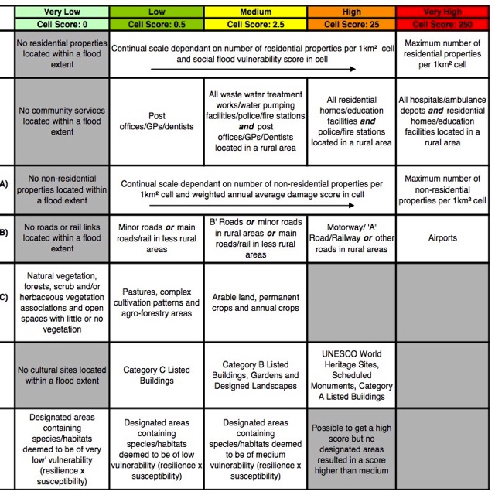
Integrating Professional River Study Techniques into School Fieldwork
Project 2:
Flood Hazard Assessment
Notes:
Images:
(left) Annotated Google Maps screen grab (Kenworthy Gardens, Uppermill)
(centre) Screen grab of Environment Agency flood risk map for Uppermill (https://flood-warning-information.service.gov.uk/long-term-flood-risk/map)
(right) Screen grab of Multi-parameter risk from the Scottish Environment Protection Agency National Flood Risk Assessment Methodology (https://www.sepa.org.uk/media/99914/nfra_method_v2.pdf)

Slide 2
Background & Introduction
Flood risk assessment and management strategies are of increasing concern for local and national governments
Protect human life and infrastructure
Critical for planning new infrastructure
Critical for budgeting water resources
Prepare communities for changing river regimes due to climate change and/or human interference upstream
Should be considered in terms of both hazard and risk
Hazard: a potential source of harm
Risk: likelihood of a hazard causing harm
Notes:
Images:
- Pexels.com (stock photography with a CC0 licence)

Slide 3
‘Real-world’ Examples
Flood risk assessments performed as standard by governments and private organisations at all levels. For example:
The 2011 Torbay Flood Risk Assessment
The 2015 Haringey Flood Risk Assessment
The Scottish National Flood Risk Assessment
Flood risk assessment documentation used by the USA Federal Emergency Management Agency (FEMA) for training
Notes:
Links to examples:
http://www.torbay.gov.uk/media/7736/preliminary-flood-risk-assessment.pdf
http://www.haringey.gov.uk/sites/haringeygovuk/files/sfra_document_high_res_red_0.pdf
https://www.sepa.org.uk/media/99914/nfra_method_v2.pdf
https://training.fema.gov/hiedu/docs/fmc/chapter%204%20-%20flood%20risk%20assessment.pdf

Slide 4
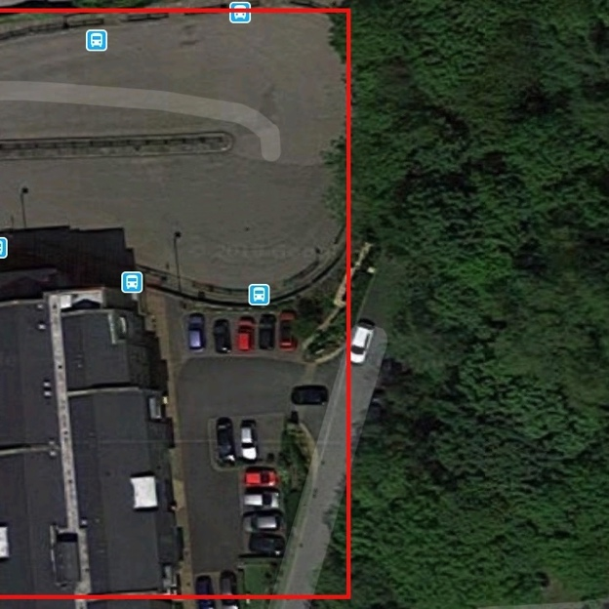
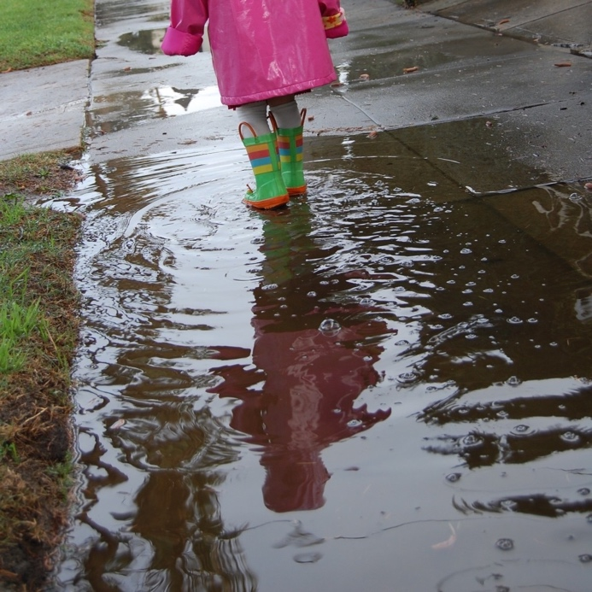
Pre-Fieldwork Activities
Research Questions & Hypotheses
Research should be framed around scientific questions & hypotheses
For example:
Changes to flood risk according to land use type
Changes to flood risk according to runoff and infiltration rates
Notes:
Images:
- (right) Annotated Google Maps screen grab (Uppermill)
- (left) Images from Pexels.com (stock photography with a CC0 licence)

Slide 5
Pre-Fieldwork Activities
Site Selection
Access to land adjoining a natural watercourse
At least 2–3 sites for comparison
For example:
River flowing across a floodplain
River flowing through an area of changing topography / gradient (e.g., steep river valley)
River meander site
River flowing through an urban area
River flow interrupted by full-width engineered structure (e.g., dam or weir)
River flow interrupted by other human intervention (e.g., bridge supports, flood defences)
Confluence of two watercourses
For comparison: man-made water course (i.e., a canal)
For best results, include at least one urban and one non-urban location

Slide 6
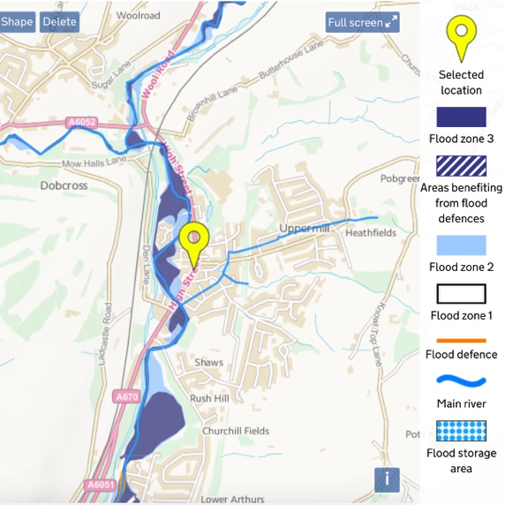
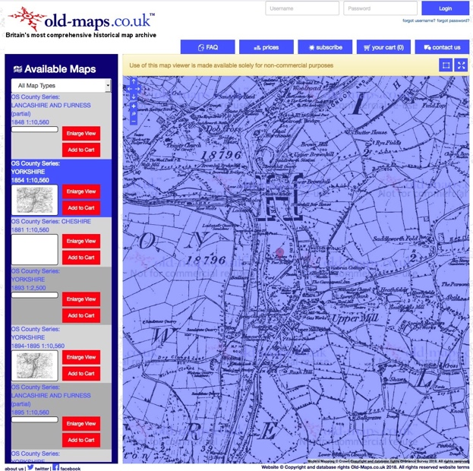
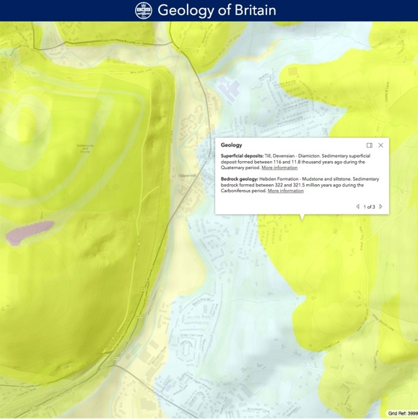
Pre-Fieldwork Activities
Metadata: Cartography
Political & topographical maps (e.g., Ordnance Survey, Google)
National-, regional-, catchment-, local-scale
Geological maps (e.g., BGS iGeology App / BGS GeoIndex)
Satellite & aerial maps/images
Land use maps
Historical maps
e.g., Uppermill, Greater Manchester
Google Maps satellite image
1854 political map
Geological map
Notes:
Images:
(left) Screen grab from Geological map from British Geological Survey Geology of Britain (http://mapapps.bgs.ac.uk/geologyofbritain3d/index.html)
(centre) Screen grab of historical (1854) map from https://www.old-maps.co.uk/#/Map/399649/405953/10/101748
(top right) Screen grab of Environment Agency flood risk map for Uppermill (https://flood-warning-information.service.gov.uk/long-term-flood-risk/map)

Slide 7
Pre-Fieldwork Activities
Metadata: Hazard Maps
For each site, students should source flood hazard maps
Ideally (for this study), these should NOT be ‘risk maps’
(creating risk maps is the purpose of the study)
Other secondary data sources
Local and national press
Local knowledge
Historic flood maps
UK Magic Map of designated land
Notes:
Images:
- Screen grab of Environment Agency flood risk map for Uppermill (https://flood-warning-information.service.gov.uk/long-term-flood-risk/map)

Slide 8
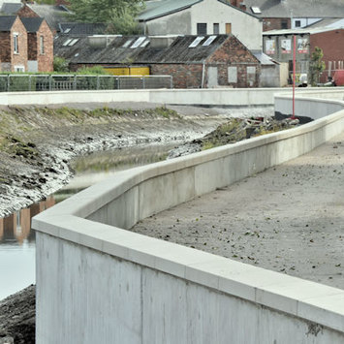
Pre-Fieldwork Activities
Research Techniques
No ‘one size fits all’
Dependent on field area/ field sites
Dependent on features & processes to measure
Dependent on research questions and hypotheses
Dependent on spatial and temporal scales of study
Dependent on available resources (i.e., time, money, expertise)
Professional flood risk assessments include:
Landscape characterisation (e.g., topography, geology, soils, streamflow data, rainfall data)
Historical flood data (e.g., government records, newspaper articles, local knowledge, flood marks on buildings and other infrastructure)
Inventories of residential land, services (e.g., hospitals, schools, transport routes), agricultural land, businesses, protected land (e.g., cultural, historical, environmental or scientific sites)
Identification of areas most susceptible to flooding
Data on existing flood defences
https://www.rgs.org/schools/teaching-resources/sampling-techniques/
Notes:
Images:
Flood prevention barriers, Ireland. Image by Albert Bridge (http://www.geograph.ie/photo/5111498). Image licence: CC-BY-SA 2.0

Slide 9
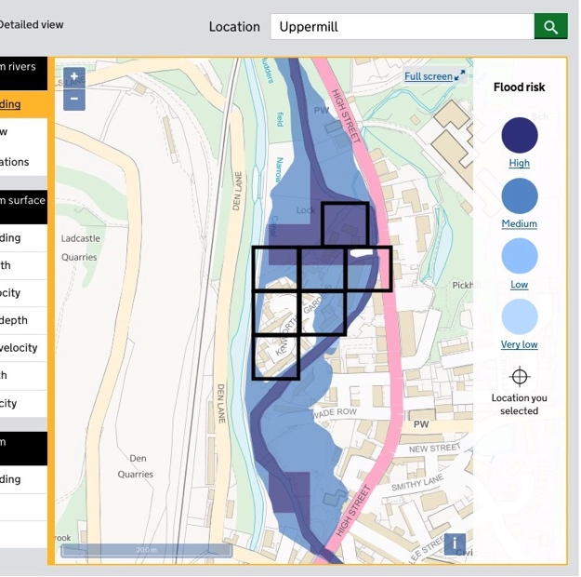
Pre-Fieldwork Activities
Logistical Planning
Field Plan
Dependent on time available
Dependent on number of sites & transit times
Dependent on number of team members
Dependent on data collection techniques
Methodology for flood risk assessment should include:
Sub-divided field sites (e.g., gridded segments). Data should be collected from each sub-area
During analysis, data from sub-areas can be combined to produce a comprehensive flood risk assessment for each site
Notes:
Images:
- (top left and right) Images from Pexels.com (stock photography with a CC0 licence)
- (bottom) Annotated (gridded) screen grab of Environment Agency flood risk map for Uppermill (https://flood-warning-information.service.gov.uk/long-term-flood-risk/map)

Slide 10
Pre-Fieldwork Activities
Logistical Planning
Field Kit (Universal)
Clothing (long trousers, long sleeves, wet weather gear, boots)
Field note book
Charged mobile phone
GPS device
Camera
Sharpened pencils
First aid kit
Field Kit (Fieldwork Specific)
Research equipment (e.g., tape measure, stopwatch, etc.)
Notes:
Images:
- Pexels.com (stock photography with a CC0 licence)

Slide 11
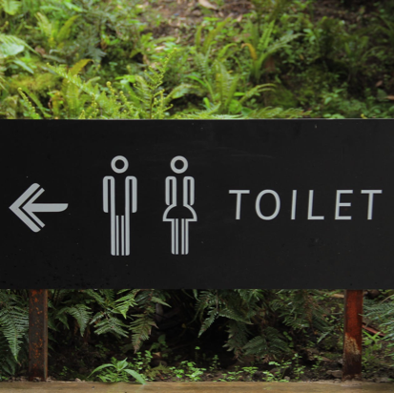
Pre-Fieldwork Activities
Logistical Planning
Site Practicalities
Parking (incl. bus parking)
Toilets
Picnic sites
Shops & cafes
Field centres & visitor centres
Accessibility (roads, foot paths, etc.)
Nearest A&E Department
Notes:
Images:
- Pexels.com (stock photography with a CC0 licence)

Slide 12
Comparative Study of River Regimes Pre-Fieldwork Activities
Products of an evolving planet
Pre-Fieldwork Activities
Logistical Planning
Risk Assessment
Hazard Control Measures Residual Risk
Working in/near water
Uneven / unstable ground
Biological hazards (insects, Giant Hogweed, etc.).
Assessment of flow conditions; work in groups, avoid loose clothing, always walk downstream, take small steps ……. etc.
Keep to flat areas; walk with care; ……. etc.
Insect repellent; stay away from undergrowth; ….. etc.
MEDIUM
LOW
LOW
https://www.rgs.org/in-the-field/fieldwork-in-schools/fieldwork-safety-and-planning/risk-assessments/
Notes:
Example of factors to consider (NOT exhaustive)

Slide 13
Comparative Study of River Regimes Data Collection Technique
Products of an evolving planet
Data Collection Technique
Field Notebook
Critical fieldwork aspect
Record of sites, activities, & data
For professionals, field notebook can be a legal document
Date, time, weather conditions, investigator mood
Name of field site, GPS waypoint name, co-ordinates
Brief site description (e.g., land use, human infrastructure, natural features & processes, vegetation, other relevant observations)
Site sketch
Record of methods & collected data

Slide 14
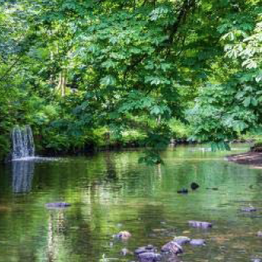
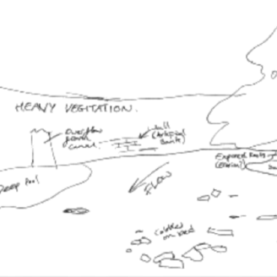
Comparative Study of River Regimes Data Collection Technique
Products of an evolving planet
Data Collection Technique
Field Notebook
Site Sketch Good Practice
Include major features
Sense of scale and spatial distribution of features
Notes:
Images:
- (both) Images courtesy of Environmental Resource Management (ERM)

Slide 15
Data Collection Technique
Likelihood of Flooding (Flood Hazard)
Data to be collected on various contributors to flood risk
What is Measured?
Flood hazard (i.e., likelihood of flooding)
See Pre-Fieldwork Activities
Notes:
Image:
- Screen grab of Environment Agency flood risk map for Uppermill (https://flood-warning-information.service.gov.uk/long-term-flood-risk/map)

Slide 16
Data Collection Technique
Infrastructure Inventory
What is Measured?
Residential infrastructure (e.g., houses, apartments)
Community facilities (e.g., hospitals, police, post office, doctors, water treatment plants, etc.)
Commercial infrastructure (e.g., shops & business)
Transport infrastructure (e.g., motorways, A roads, B roads, railways)
Non-agricultural green spaces
Agricultural land
Protected land (e.g., designated sites of scientific, ecological, cultural, or historical importance)
Flood mitigation infrastructure
Data collection from fieldwork only, or from aerial/satellite images supported by field-based ground-truthing
Report data in terms of total area (m²) or total number of units (e.g., number of houses)
Notes:
Image:
(top) Annotated Google Maps screen grab (Kenworthy Gardens, Uppermill)
(bottom) Flood prevention barriers, Ireland. Image by Albert Bridge (http://www.geograph.ie/photo/5111498). Image licence: CC-BY-SA 2.0

Slide 17
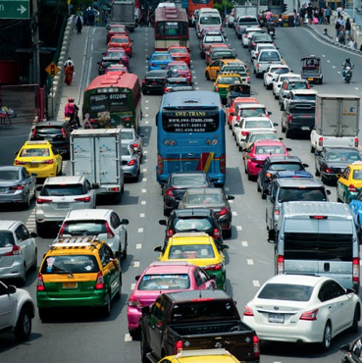
Data Collection Technique
Traffic & Pedestrian Surveys
What is Measured?
Number of pedestrians passing a given point in a given timespan
Number of vehicles passing a given point in a give timespan
Make careful note of time-of-day and weather conditions
Notes:
Images:
- Pexels.com (stock photography with a CC0 licence)

Slide 18
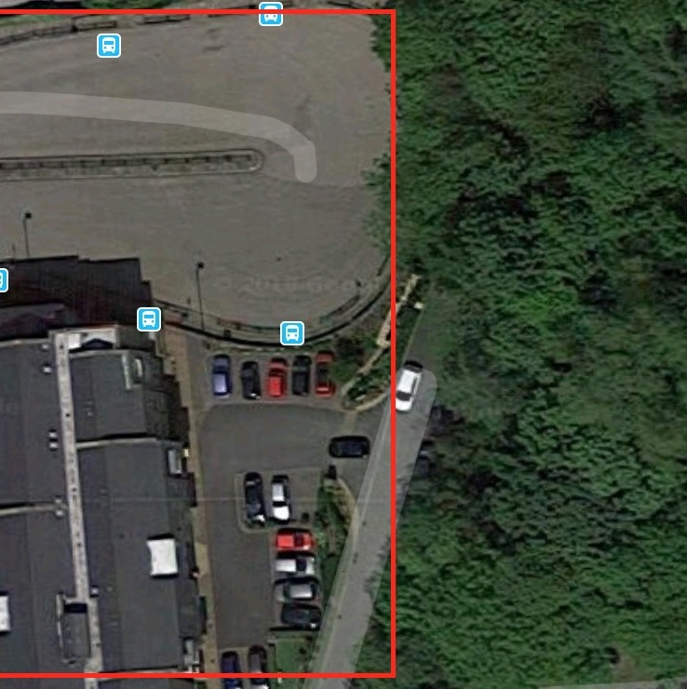
Data Collection Technique
Permeable Pavement and/or Infiltration
What is Measured?
Area of impermeable pavement
Qualitative estimate from visual observations (e.g., ‘high’, ‘medium’ ‘low’, ‘none’)
Mapped using GPS-based land mapping (of metre rules for small areas)
Estimates from aerial/satellite images (e.g., Google Maps)
Infiltration
Time taken for a given volume of water(placed in a section of drainpipe or similar) to drain into the ground
Should be measured for systematic spots within each site or gridded sub-site
Notes:
Images:
(top right) Annotated Google Maps screen grab (Uppermill)
(bottom left) Pexels.com (stock photography with a CC0 licence)

Slide 19
Data Collection Technique
Flood Risk Assessment
Site Requirements
Field sites accessible to the public, safe to access, and within proximity to a river.
Equipment & Costs
Tape measure (low cost) or GPS-enabled device (high cost) for land use mapping
Stopwatch (low cost) for infiltration measurements and traffic & pedestrian surveys
Section of drainpipe (or similar item) and stopwatch (low cost) for infiltration measurements
Notes:
Images:
Pexels.com (stock photography with a CC0 licence)

Slide 20
Data Collection Technique
Flood Risk Assessment
Data Resolution Needs
Land use inventories: for small sites or sub-sites within a gridded area, all features should be recorded (e.g., total number of houses [or area covered by residential buildings])
Infiltration: at least 3–5 measurements per sub-site, allowing for calculation of average (mean) values and associated data spread (e.g., standard deviation)
Traffic & pedestrian surveys: at least 5–10 minutes, repeated at different times of the day (at the very least, consideration of time-of-day should be made clear when presenting results)
Professional Measurement Techniques
Similar data to those collected here
Remote sensing data

Slide 21
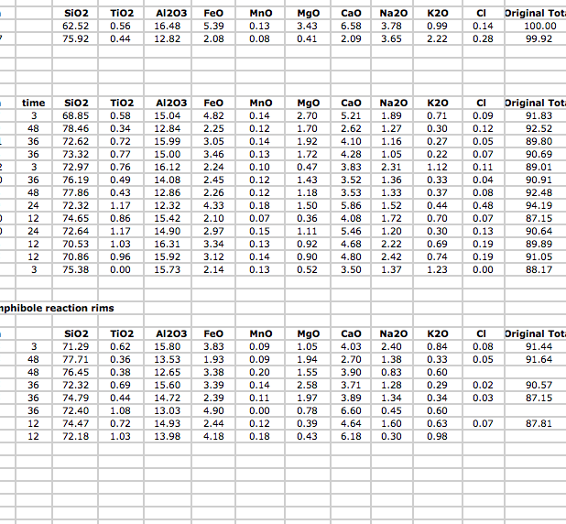
Post-Fieldwork Activities
Data Organisation & Input
For professionals, fieldwork is only the start
Post-fieldwork activities are the longest part of any project
The first step is data organisation and management
Transfer field data to computer or tablet
Consider storage options (e.g., Microsoft Excel, ArcGIS, Google Earth)
For groups, develop data management plan & sharing facilities (e.g., Google Drive, Dropbox)
Notes:
Images:
(left) Microsoft excel screen grab
(right) Screen grab of Dropbox homepage (https://www.dropbox.com/?landing=dbv2)

Slide 22
Post-Fieldwork Activities
Data Analysis & Interpretation
Appropriate use of:
Statistical techniques (e.g., data averaging, data spread, etc.)
Chart types and tables
Spatial analysis (e.g., ArcGIS, which is freely available to UK schools)
Interpretation and analysis should:
Reflect and be supported by the data
Compare and contrast different sites
Consider the results of similar studies & compare data with available secondary data sources
Return to original scientific questions and hypotheses
Consider how results would change under different conditions (e.g., changing seasons, after a storm event)
Consider how results may change in the future (e.g., impacts of climate change)
Data limitations should be considered and clearly presented

Slide 23
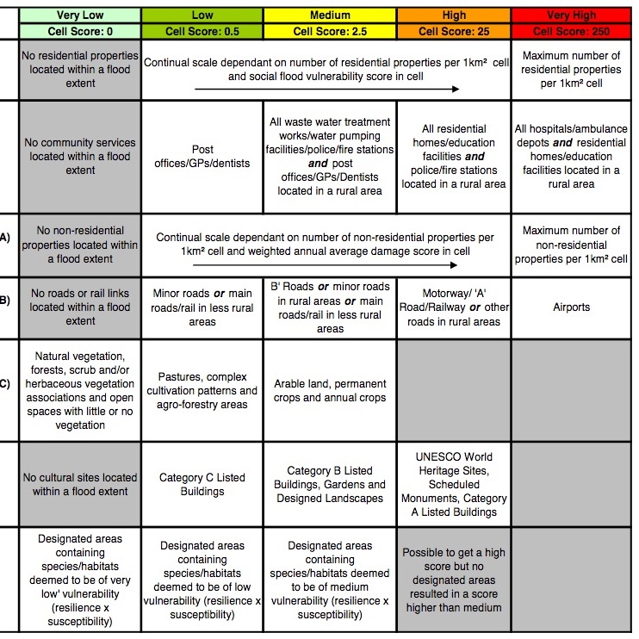
Post-Fieldwork Activities
Data Analysis: Risk Assessment Matrix
Combine different risk variables to assess total flood risk
Create a multi-parameter risk table to include each measured variable
To create table, devise a 3- or 4-point category system for each variable
For example, for residential properties, categories could be ‘none’, ‘low density’, ‘medium density’ , ‘high density’
For each category, assign a risk point score
For example, for residential properties, could be ‘none’ = 0, ‘low density’ = 1, ‘medium density’ = 2 , ‘high density’ = 3
Use table to assign a risk point score for each measured variable at each site or gridded sub-site
Notes:
Image:
- Screen grab of Multi-parameter risk from the Scottish Environment Protection Agency National Flood Risk Assessment Methodology (https://www.sepa.org.uk/media/99914/nfra_method_v2.pdf)

Slide 24
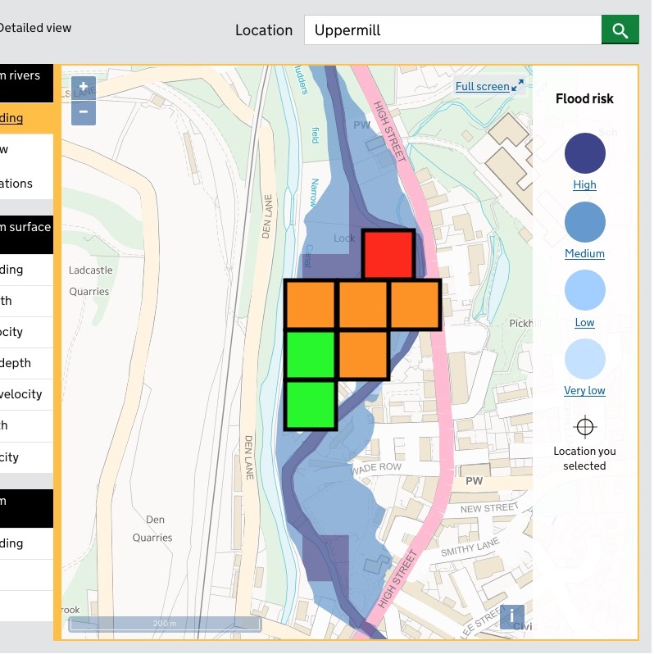
Post-Fieldwork Activities
Data Analysis: Risk Assessment Matrix
For each site or gridded sub-site, sum the scores from each variable
Assign colour codes to score ranges
For example:
0–1 = Green
2–3 = yellow
3–4 = orange
> 4 = red
Use summed scores and colour-codes to create a colour coded flood risk map
Notes:
Image:
- Annotated (gridded & colour-coded) screen grab of Environment Agency flood risk map for Uppermill (https://flood-warning-information.service.gov.uk/long-term-flood-risk/map)

Slide 25
Post-Fieldwork Activities
Data Analysis: Risk Assessment Matrix
Based on the results, students should:
Consider whether areas with the highest/lowest flood hazard match those with the highest/lowest flood risk
Think critically about the method used and consider possible improvements (e.g., should each risk variable hold equal weight? If not, should the point system be weighted?)
Develop a flood management plan for each location, including possible types of flood defence along with their benefits and pitfalls
Notes:
Image:
- Annotated (gridded & colour-coded) screen grab of Environment Agency flood risk map for Uppermill (https://flood-warning-information.service.gov.uk/long-term-flood-risk/map)

Slide 26
Post-Fieldwork Activities
Data Reporting & Sharing
Data sharing and open access is required for some professionals
For others, data sharing is restricted to paid clients
Data sharing & reporting must consider the needs of the audience
Can include written reports, oral presentations, graphical representations
Present at ‘conferences’, where different teams present concurrently using posters or talks
To reach a broader audience:
Webpage creation
Social media & blogging
Citizen science platforms
Notes:
Images:
- Pexels.com (stock photography with a CC0 licence)

Slide 27
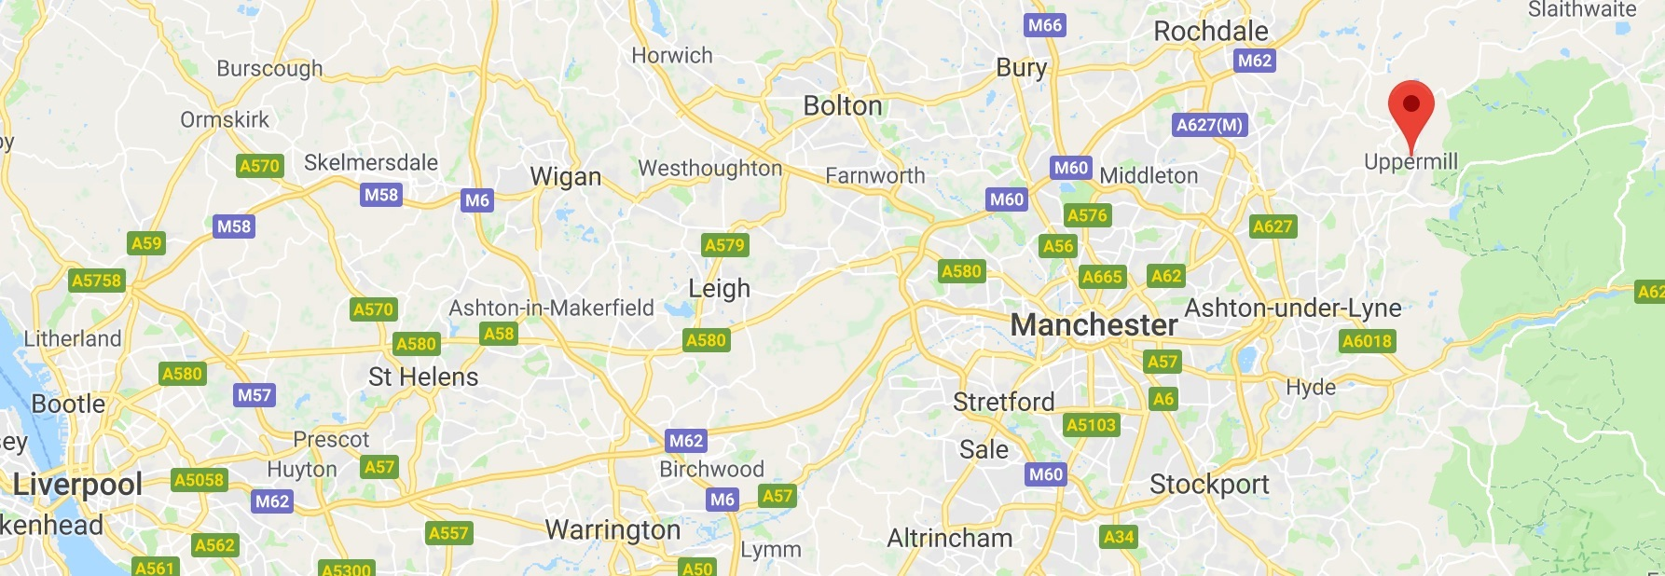
Case Study
Uppermill, Tame River Valley
Village in the Saddleworth area of Oldham (Greater Manchester & South Pennines)
Notes:
Image:
- Google Maps screen grab (North West England)

Slide 28
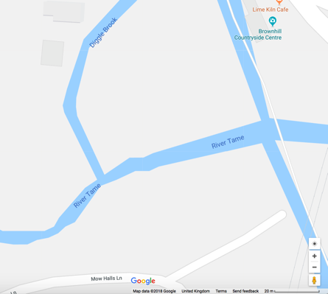
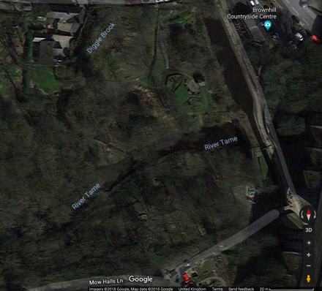
Case Study
Uppermill, Tame River Valley
Confluence of the Tame and Diggle Brook (53°33'11.4"N 2°00'33.5"W)
Confluence of the Tame River and Diggle Brook
Free flowing river course
Gentle gravel riverbank
Adjoining land-use: grass and parkland
Relatively low impact from flooding
Notes:
Images:
- (all) Google Maps screen grabs (Confluence of the Tame and Diggle Brook at 53°33'11.4"N 2°00'33.5”W)

Slide 29
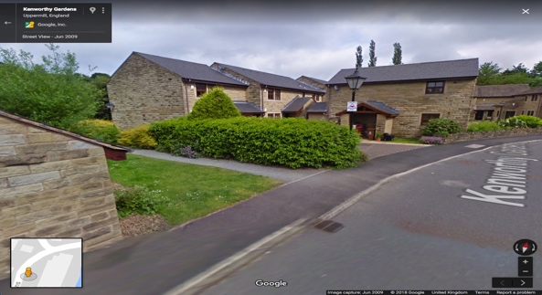
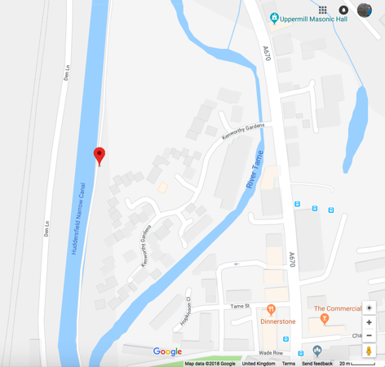
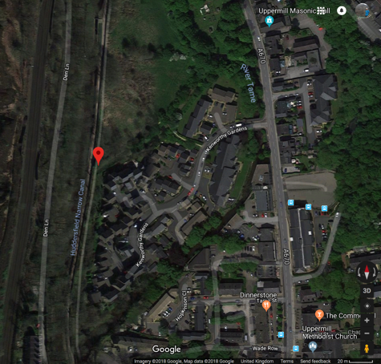
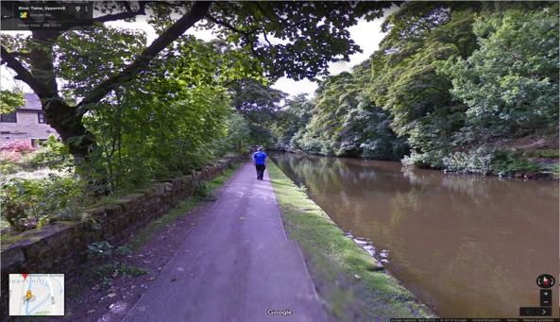
Case Study
Uppermill, Tame River Valley
Kenworthy Gardens (53°33'01.7"N 2°00'27.7"W)
Modern housing development between Huddersfield Narrow Canal and Tame River
Surrounded by a flood-protection moat
Direct access from canal towpath
Direct access from village
Notes:
Images:
(all) Google Maps screen grabs (Kenworthy Gardens (53°33'01.7"N 2°00'27.7"W)

Slide 30
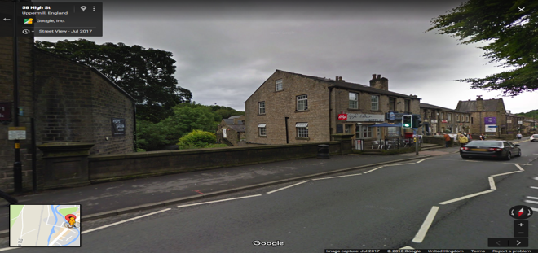
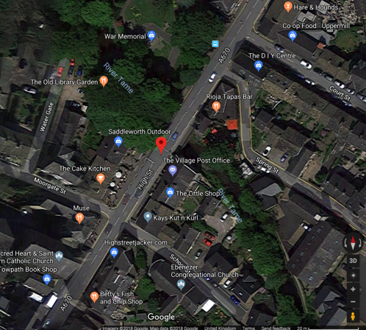
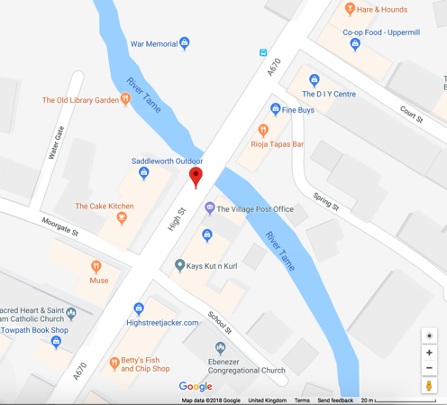
Case Study
Uppermill, Tame River Valley
Kitty’s Riverside Café Bar (53°32'50.7"N 2°00'23.5"W)
Busy urban road bridge
View down to the heavily engineered river course
River flow forced through confined space
Closer access to river below bridge
Area of past flooding
Flood protection measures in place
Notes:
Images:
- (all) Google Maps screen grabs (Kitty’s Riverside Café Bar at 53°32'50.7"N 2°00'23.5"W)

