Slide 1
3.Setting Out
Shackleton 100
Endurance 100
Geography History

Slide 2
The Story So Far…
In brief
The story so far in brief…
In 1914 the explorer Sir Ernest Shackleton set out on an ambitious expedition to cross the continent of Antarctica from one side to the other. He failed. However he achieved one of the greatest feats of turn of the century polar exploration; he returned with all his 27 men – alive, despite the loss of his ship. Shackleton’s ship, the Endurance, was crushed and sank in ice in the Weddell Sea, before his team could even begin that ill-fated attempt to cross the hostile continent of Antarctica.
Find out more here Royal Geographical Society - Geography resources for teachers (rgs.org)
In 2022, the Centenary of Shackleton’s death, Dan Snow travelled to Antarctica on board the S.A. Agulhas II, as part of the Endurance22 expedition, in a successful attempt to locate the missing wreck of Shackleton’s ship.
Find out more here Expedition Team - Endurance22

Slide 3
Proceed!
What did this one word mean to Shackleton?
Who said it and why?
How do you think Shackleton felt?

Slide 4
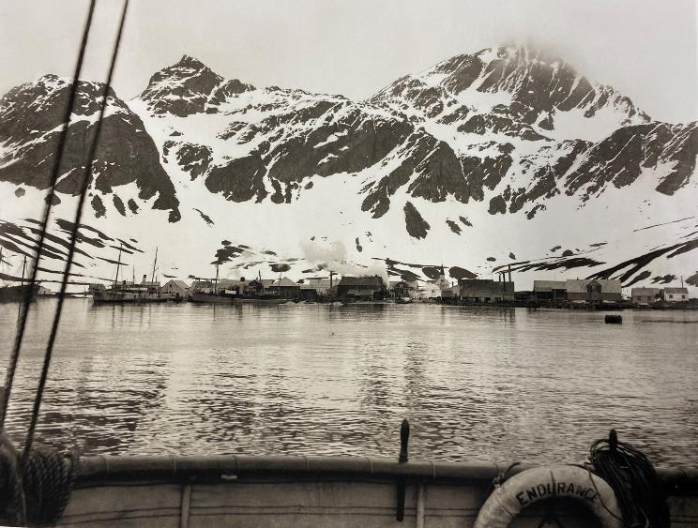
Journeying South
Shackleton joined his ship ‘Endeavor’ at Buenos Aires. They then sailed to the harbour of Grytviken, South Georgia.
Endurance sailed from South Georgia early on the morning of December 5th 1914 bound for the Weddell Sea.
Where are these places:
Buenos Aires?
South Georgia?
Grytviken?
Weddell Sea?
Grytviken Whaling Station from the Endurance November 1914

Slide 5
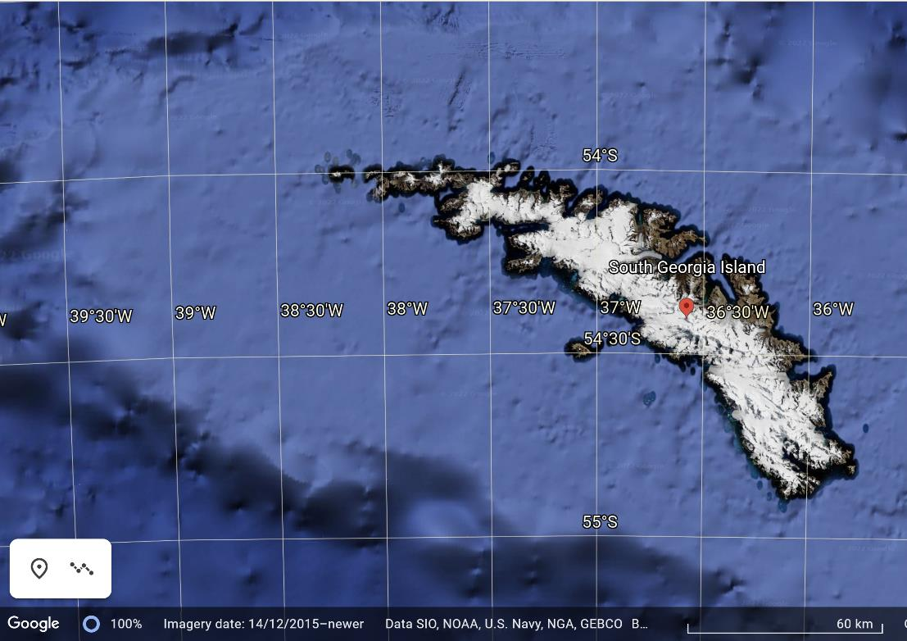
Latitude and Longitude
Describe the position of the island using latitude and longitude.
What other land can you find on the same latitude?
What land can be found south of this latitude?

Slide 6
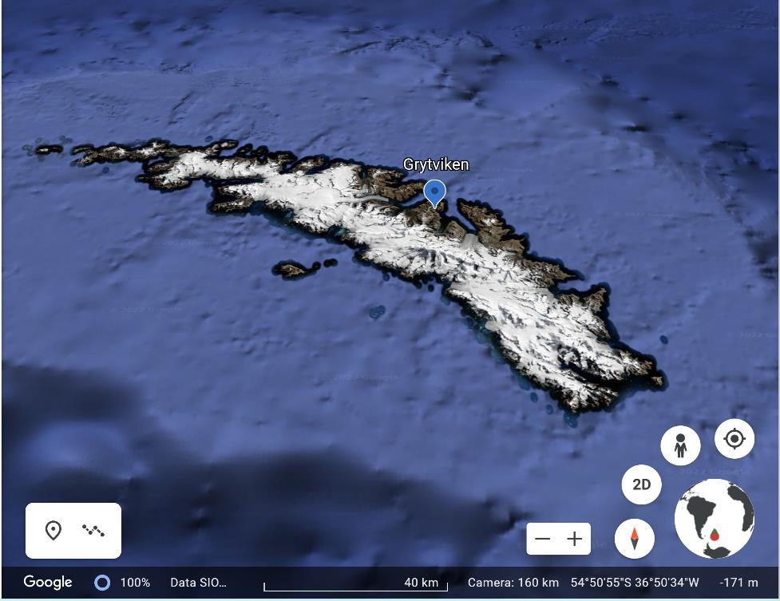
Grytviken
Use Google Earth to find and ‘zoom’ into Grytviken. Describe the landscape you find there.

Slide 7
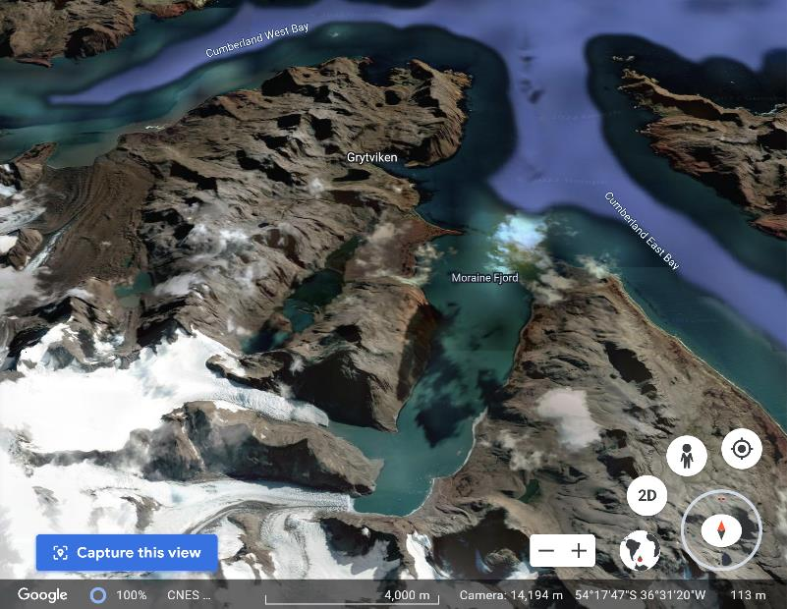
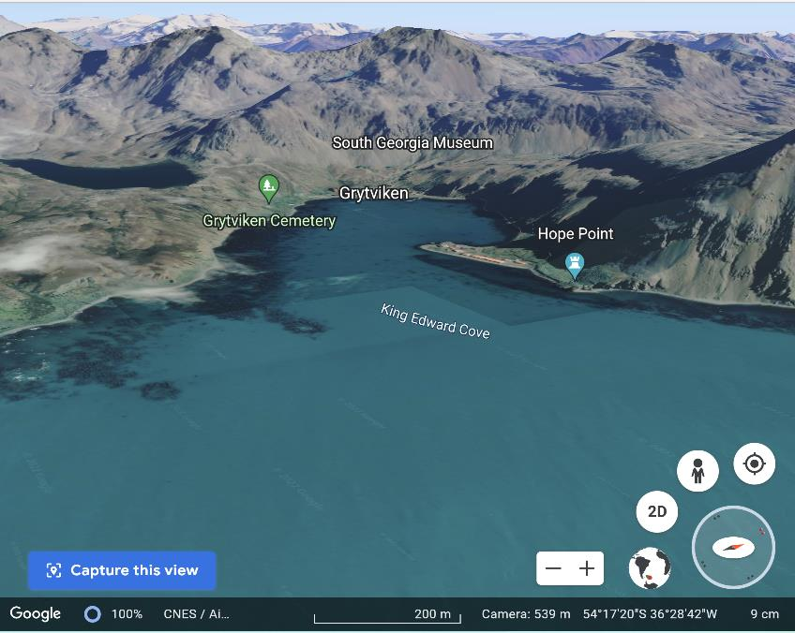
Grytviken
Use Google Earth to zoom into Grytviken. Describe the landscape there. What kind of a place is it?

Slide 8
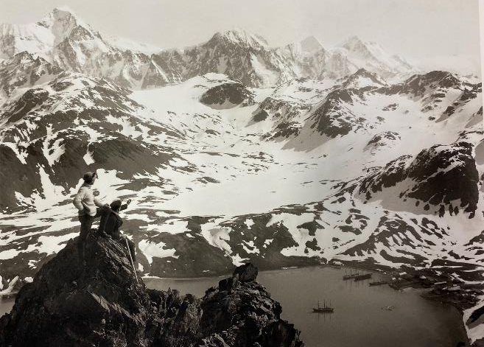
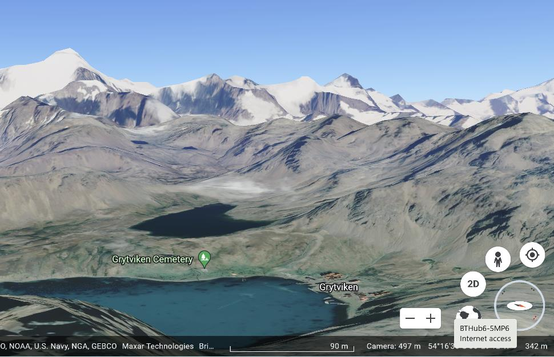
South Georgia Harbour 1914 and 2022
Worsley and Greenstreet looking over South Georgia Harbour with the Endurance and Grytviken below. 13th November 1914
Discuss any similarities and differences between the image taken by Hurley in 1914 and the recent Google imagery shown here.

Slide 9
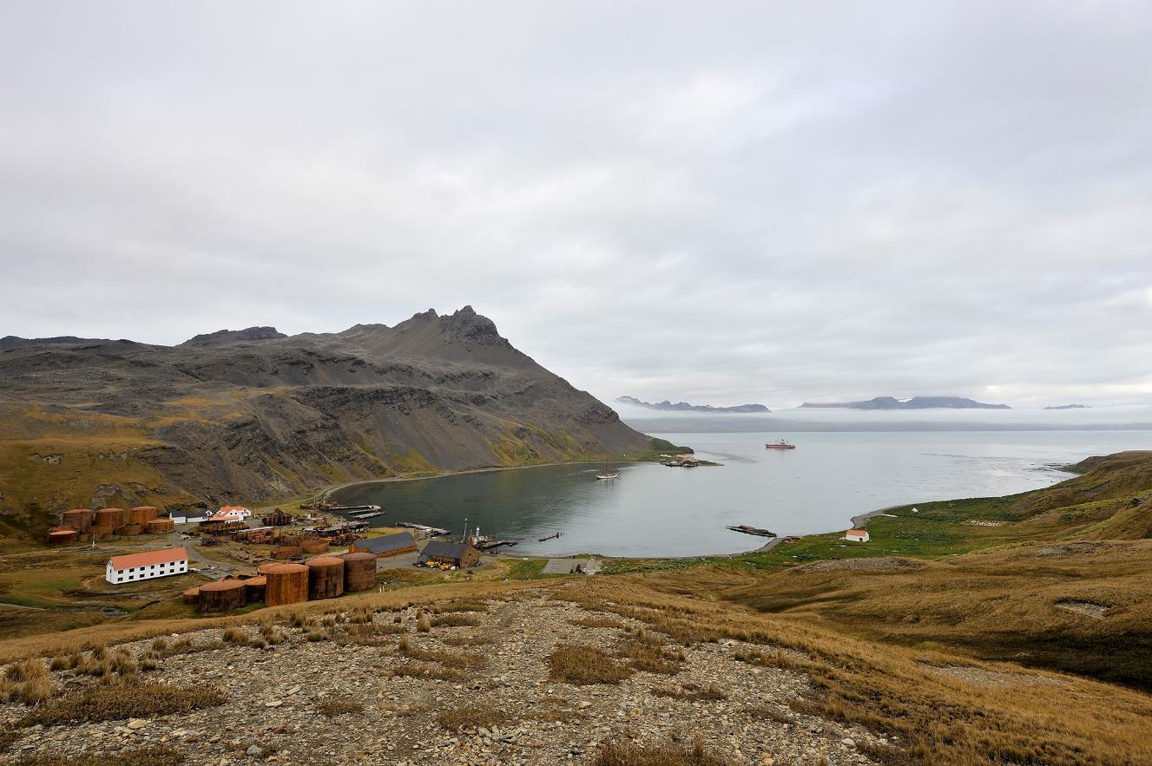
Draw your own sketch map of this scene and label the features you can see.
Can you add these features?
Use a map or Google Earth to help you.
King Edward Cove
Harbour
Old Whaling Station
Grytviken
Bay
Hope Point
King Edward Point
South Georgia Museum
Grytviken Cemetery
Grytviken, South Georgia. Photo © Frederic Bassemayousse
Endurance22 Gallery - Endurance22

Slide 10
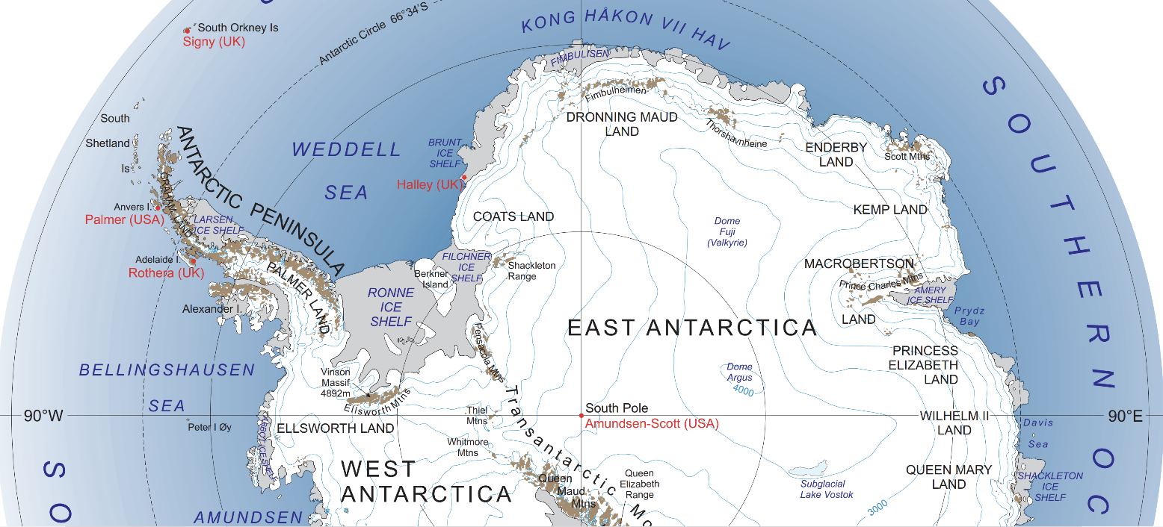
The Weddell Sea
Download the map here
https://www.rgs.org/about/the-society/what-we-do/teachers/weddell-sea-expedition/

Slide 11
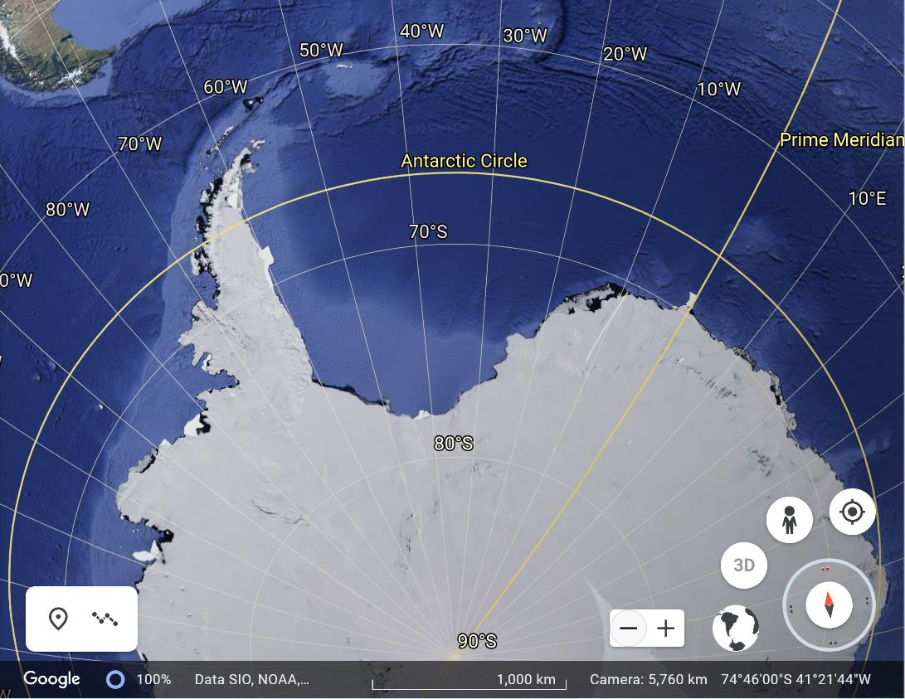
The Weddell Sea
Can you find and label the following on this image from Google Earth?
Weddell Sea
Antarctic Peninsula
Coats Land
Brunt Ice Shelf

Slide 12
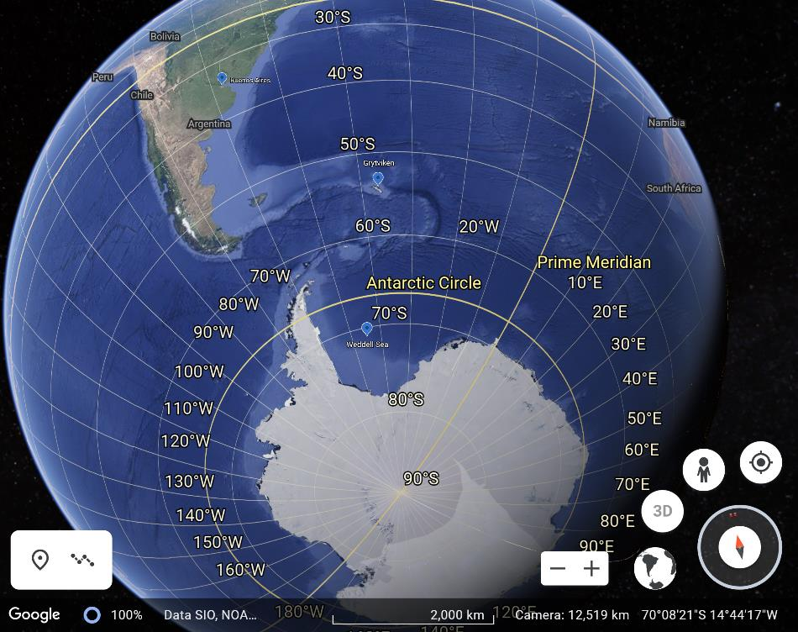
Journeying South
Describe Endurance’s journey south from Buenos Aires to the Weddell Sea using place names and referring to lines of latitude.
Antarctica Buenos Aires Grytviken
South Georgia Weddell Sea
Tropic of Capricorn Antarctic Circle

Slide 13
Will there be ice?
Leaving South Georgia 5th December 1914
The whalers had warned Shackleton that the ice was unusually far north that season but he didn’t seem worried.
World of Change: Antarctic Sea Ice (nasa.gov)
What do you notice about seasonal ice growth and shrinkage around Antarctica?

Slide 14
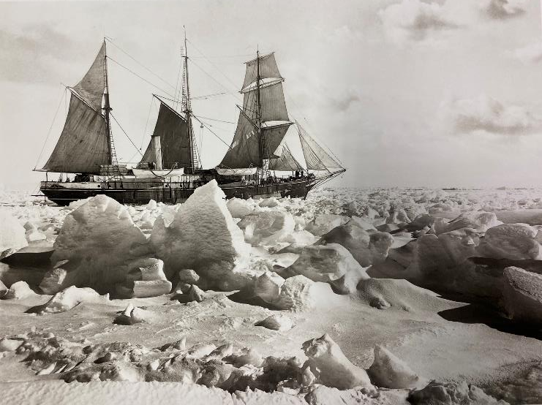
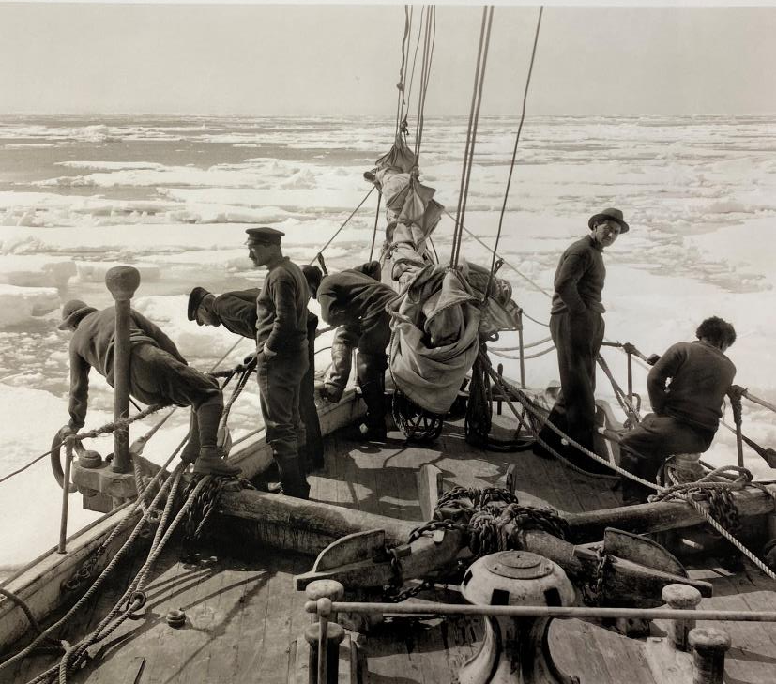
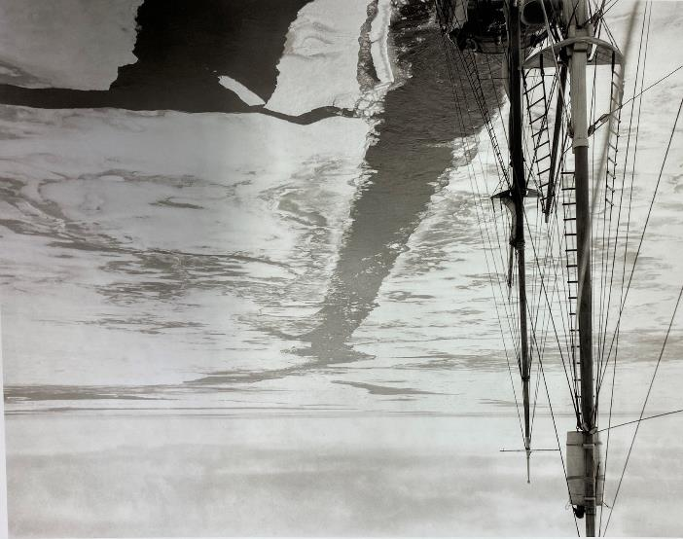
The Ice Kept Coming!
On the bow of the Endurance entering the polar sea 11th December 1914
Mast of the Endurance with the wake of the ship through a field of young ice 24th January 1915
Endurance in full sail in the ice, 25th January 1915
What story do these three images tell?
How would you be feeling if you were a crew member?

