Slide 1
2 Then and Now
Shackleton 100
Endurance 100
Geography History

Slide 2
The Story So Far…
In brief
The story so far in brief…
In 1914 the explorer Sir Ernest Shackleton set out on an ambitious expedition to cross the continent of Antarctica from one side to the other. He failed. However he achieved one of the greatest feats of turn of the century polar exploration; he returned with all his 27 men – alive, despite the loss of his ship. Shackleton’s ship, the Endurance, was crushed and sank in ice in the Weddell Sea, before his team could even begin that ill-fated attempt to cross the hostile continent of Antarctica.
Find out more here Royal Geographical Society - Geography resources for teachers (rgs.org)
In 2022, the Centenary of Shackleton’s death, Dan Snow travelled to Antarctica on board the S.A. Agulhas II, as part of the Endurance22 expedition, in a successful attempt to locate the missing wreck of Shackleton’s ship.
Find out more here Expedition Team - Endurance22

Slide 3
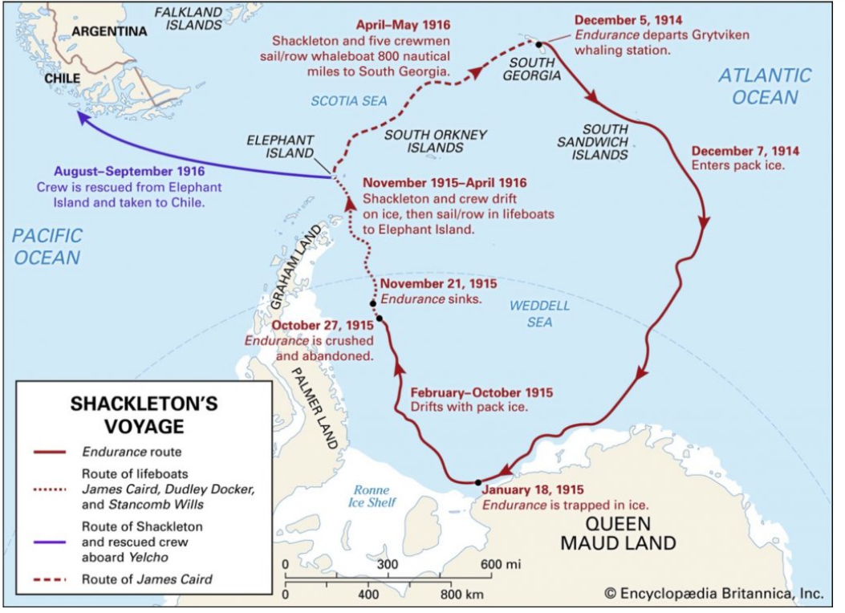
Endurance 22: where would they search?
When Endurance was crushed in the ice and sank in 1915, Captain Frank Worsley took detailed measurements of the location using a sextant and recorded it in his diary, which is now in the Scott Polar Research Institute (SPRI) archives.
The job of this expedition was to first use their own navigation experts to narrow down a likely search area. Then they would set sail and hope they did not also become trapped by ice.
Once in position, Endurance 22 expedition would use specially designed underwater surveillance equipment to search for the wreck.

Slide 4
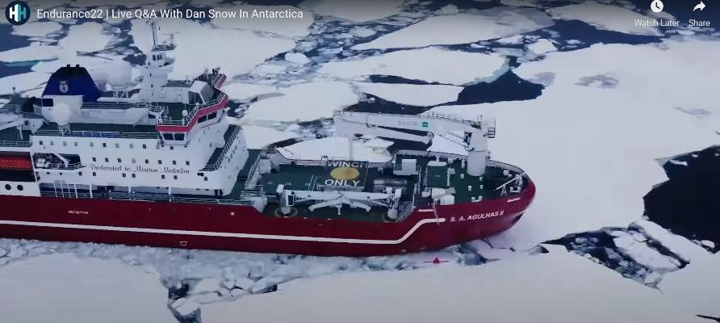
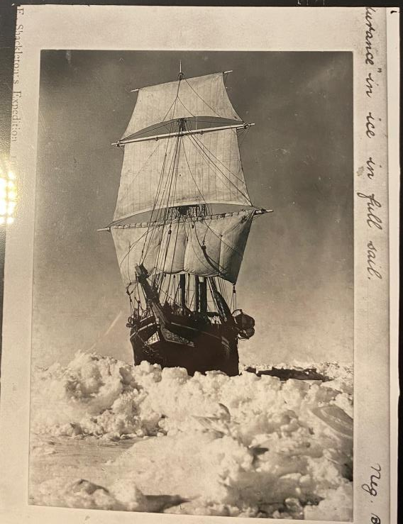
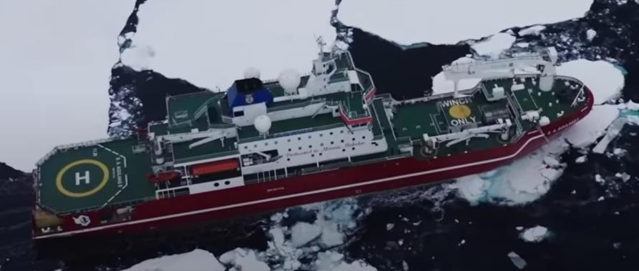
Then and Now: ships
Same and different?
Agulhas II in the ice
Endurance 22 Expedition 2022
The Endurance in the ice in full sail. Photograph Frank Hurley Imperial Trans Antarctic Expedition 1914-1916
Endurance22 | Live Q&A With Dan Snow In Antarctica - YouTube

Slide 5
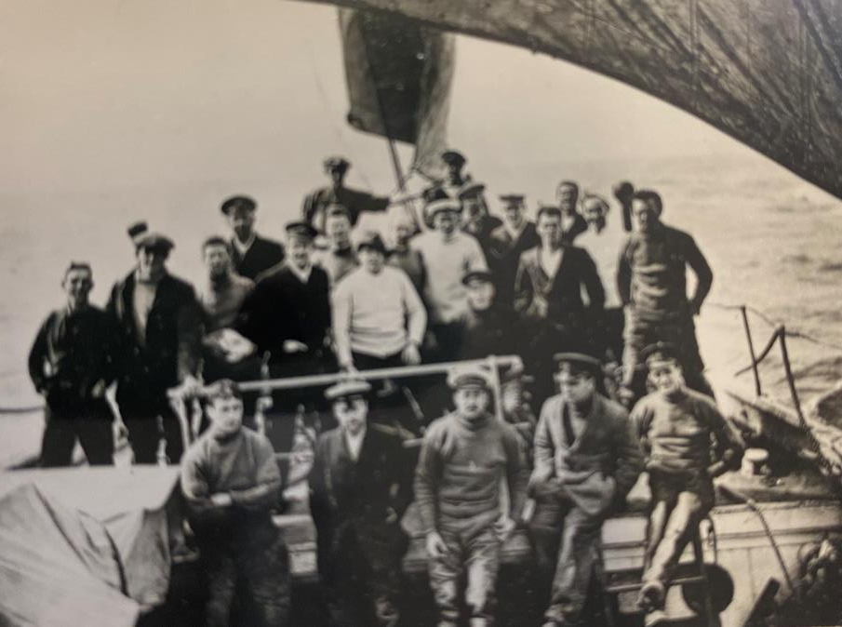
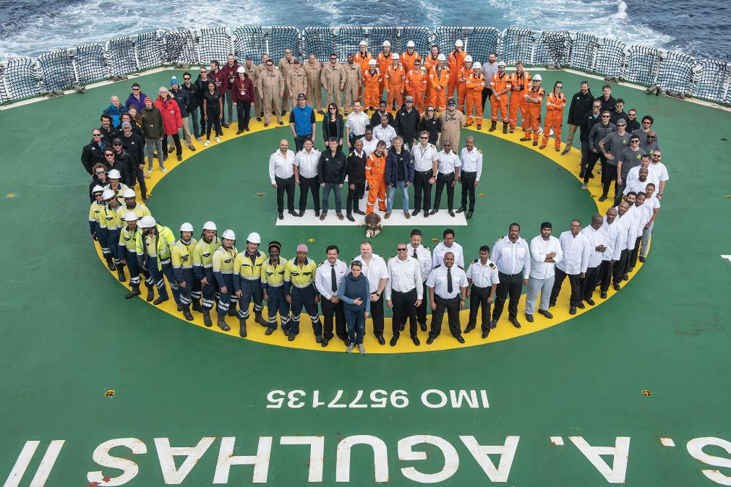
Then and Now: crew and ship
The Crew on board Endurance (Bow)
The Crew on board Agulhas II (Helipad)
Photo Frank Hurley
Endurance22 Gallery - Endurance22

Slide 6
 | Endurance | S.A. Agulhas II
Built: | 1912 | 2012
Cost | Bought by Shackleton £11,600 | More than £100 million
Length: | 44m | 134m
Speed: | 10.2Kts (11.7 mph) | 16Kts (18mph)
Expedition Team: | 56 | 65
Crew: | 28 (Endurance) 28 (Aurora) | 45
Powered | Engines using coal, sails using wind | Engines using diesel - electric

Slide 7
Built
Cost
Length
Speed
Expedition Team:
Crew:
Powered
1912
2012
16Kts (18mph)
£11,600
More than £100 million
44m
45
Engines using diesel - electric
28 Endurance 28 Aurora
Engines using coal, sails using wind
65
56
134m
10.2 Kts (11.7 mph)

Slide 8
 | Endurance | Agulhas II
Built
Cost
Length
Speed
Expedition Team:
Crew:
Powered

Slide 9
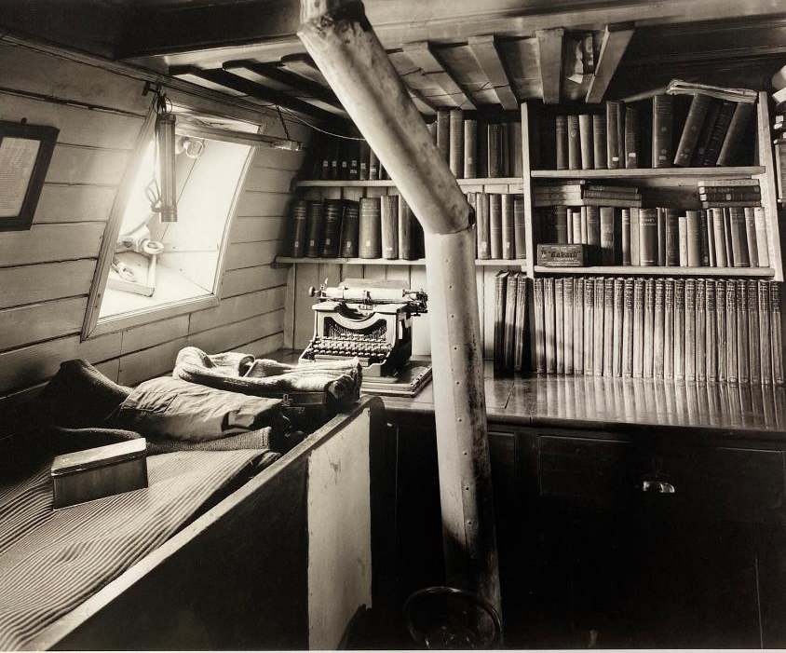
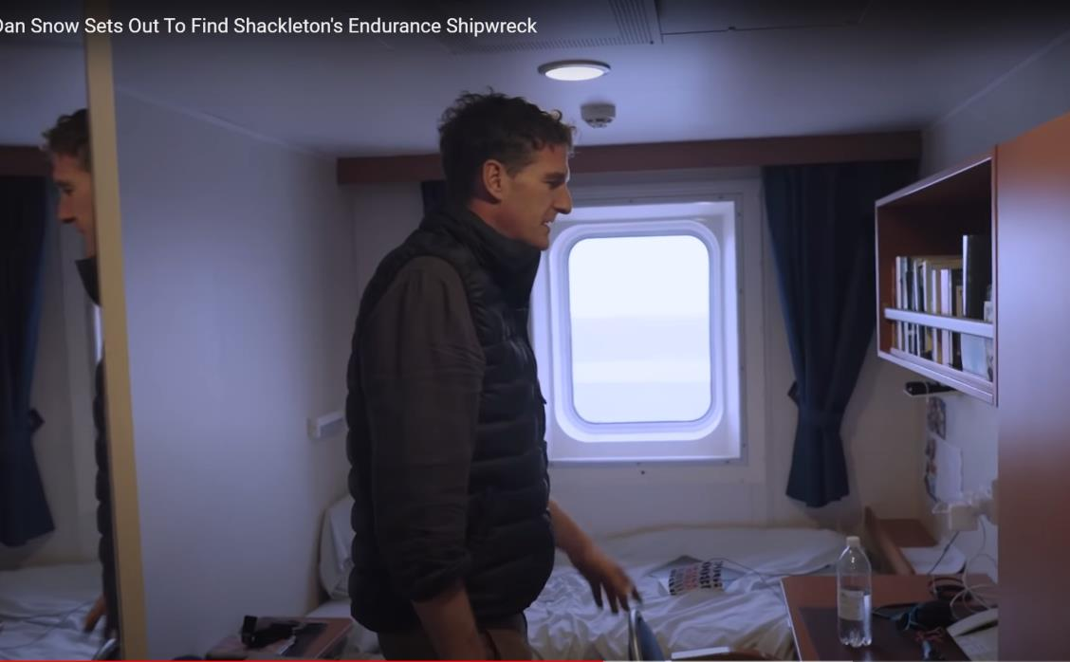
Then and Now on board
Shackleton’s cabin on the Endurance
Dan Snow’s cabin Agulhas II
Photo Frank Hurley
Dan Snow Sets Out To Find Shackleton's Endurance Shipwreck – YouTube 4:53

Slide 10
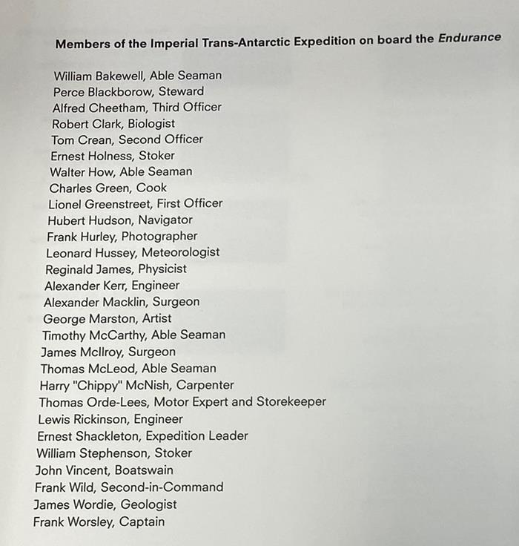
Then and Now: Crew
What do you remember about Shackleton’s crew?
Here is the list to remind you.

Slide 11



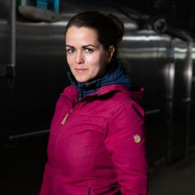

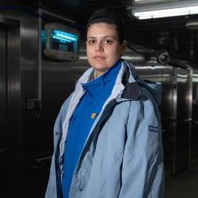



Then and Now: Crew
What do you notice about crew members of Agulhas II?
Dr Lucy Coulter
Expedition Medical Doctor
Stefanie Arndt
Sea Ice Scientist
Esther Horvath
Expedition Photographer
Maeva Onde
Senior Surveyor
Alexandra Stocker
Sea Ice Science Student
Natalie Hewit
Documentary Director
Is this the whole crew?
How do you know?
Which of these jobs would you like to do?
Mira Suhrhoff
Sea Ice Science Student
Carla-Louise Ramjukadh
Meteorologist / Oceanographer
Anriëtte Bekker
Mathematical Statistician
Expedition Team - Endurance22

Slide 12
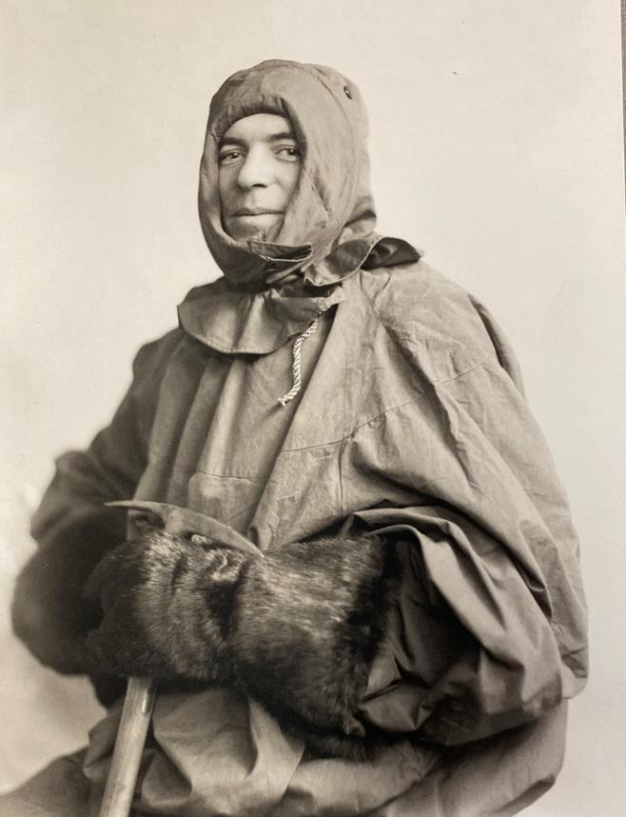
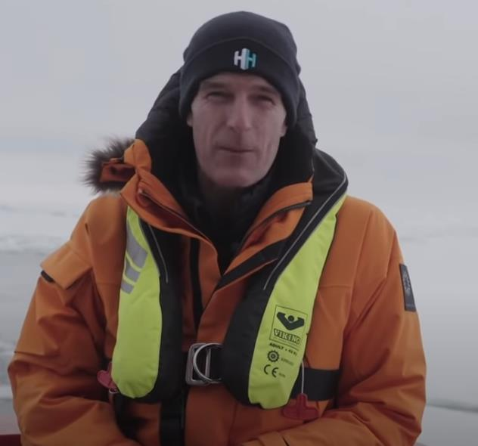
Then and Now: Crew
What are these Polar Explorers wearing? What similarities and differences can you spot?
Photo Frank Hurley

Slide 13
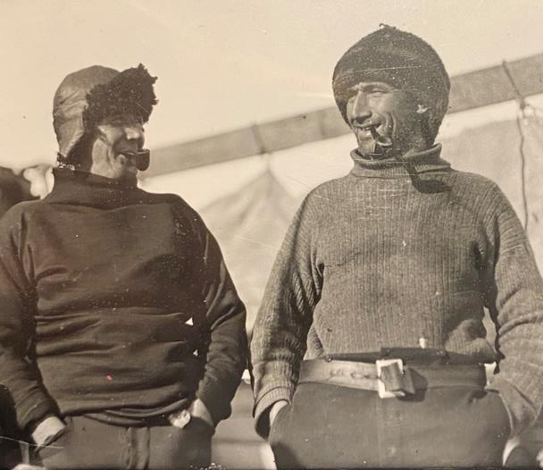
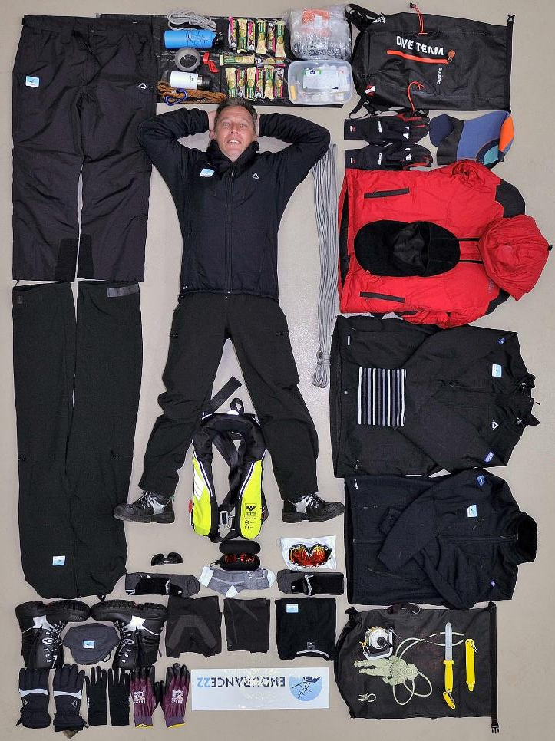
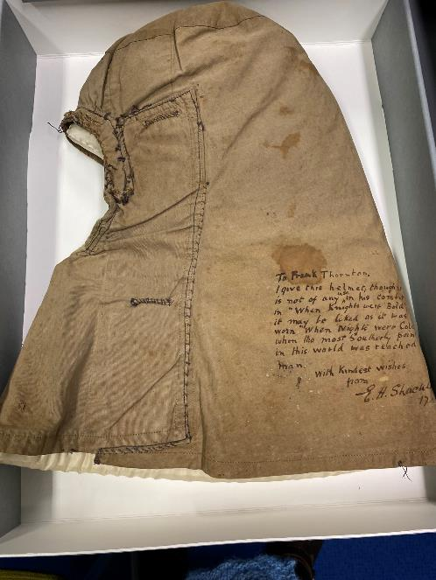
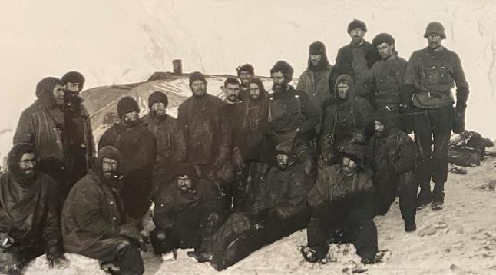
Alfred Cheatham (left) and Tom Crean, on board Endurance
Photo Frank Hurley
Endurance22 Gallery - Endurance22
Crew on Elephant Island
Photo Frank Hurley
Shackleton’s hand made hood. (RGS Archives)
Jean-Christope Caillens (Offshore Manager) shows his full Endurance22 expedition polar kit.
Photo © Frederic Bassemayousse

Slide 14
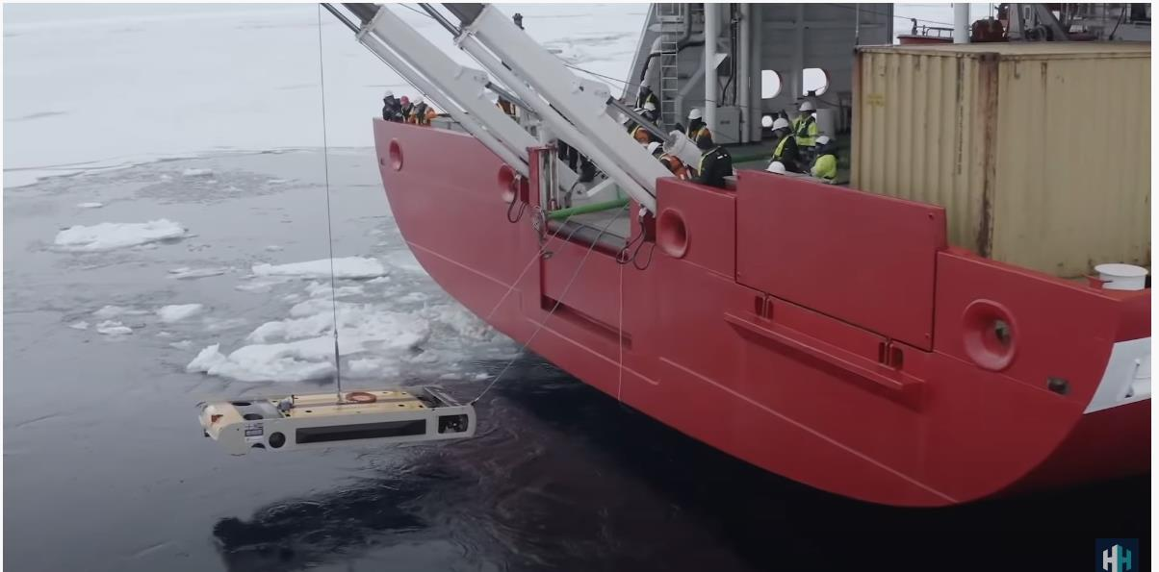
What do you think is happening here?
Describe the scene. What do you think is happening and why?
Then watch the clip showing what happened. Were you right?
Drone Launched To Find Endurance Shipwreck In Antarctica! - YouTube

Slide 15
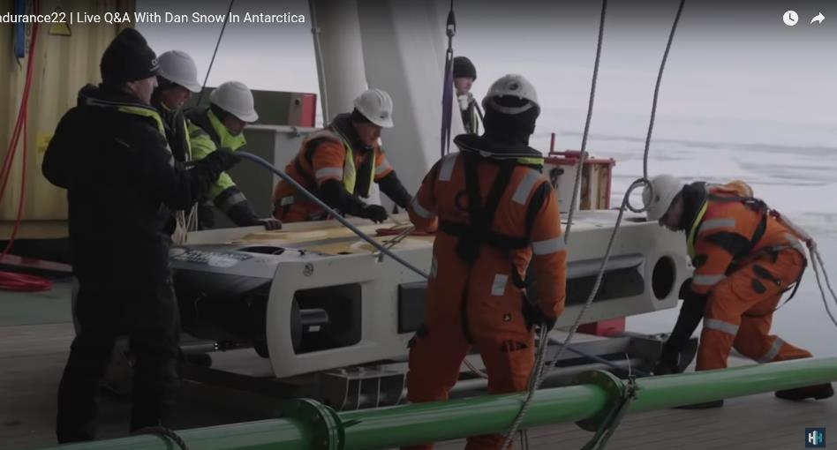
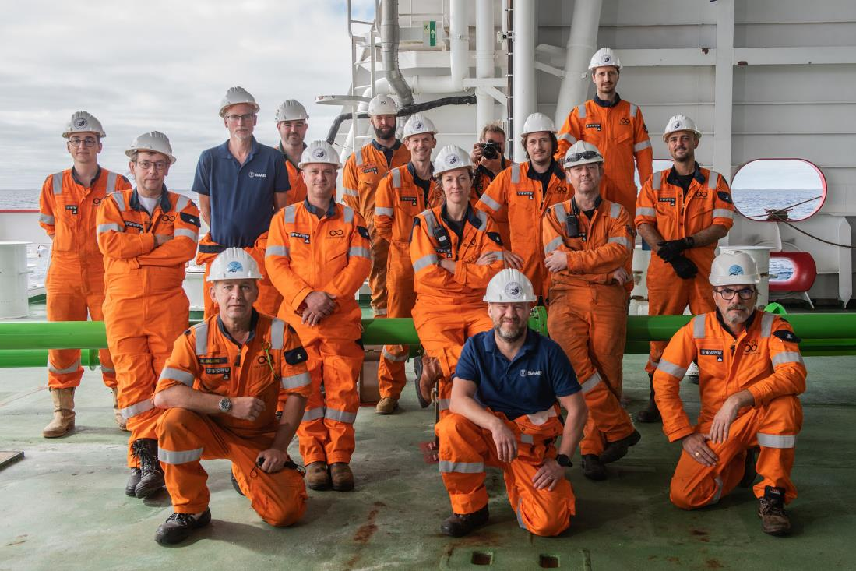
What Does a Sub-sea Team Do?
The Endurance22 Expedition was the first to deploy SAAB Sabertooth underwater vehicles to search for the wreck of Sir Ernest Shackleton’s lost ship, Endurance.
Autonomous Underwater Vehicles (AUVs) - Endurance22
Subsea Team Endurance 22

Slide 16
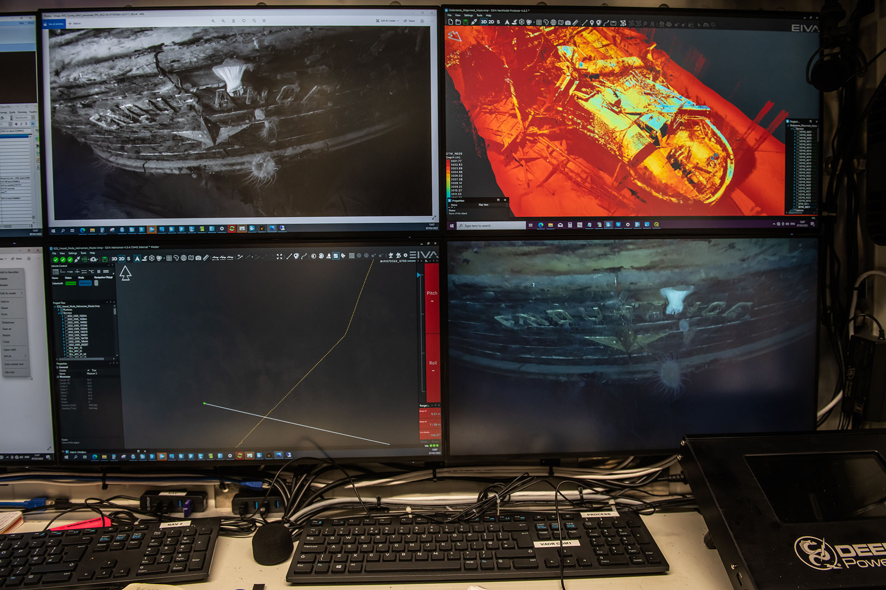
Finding Endurance
When Endurance was found, the AUV’s laser scanner was used to make a 3D model of the wreck.
Underwater cameras took amazing images of Endurance far beneath the ocean’s surface.
Here we see them being sent back and seen on the Agulhas ship’s computers.

Slide 17
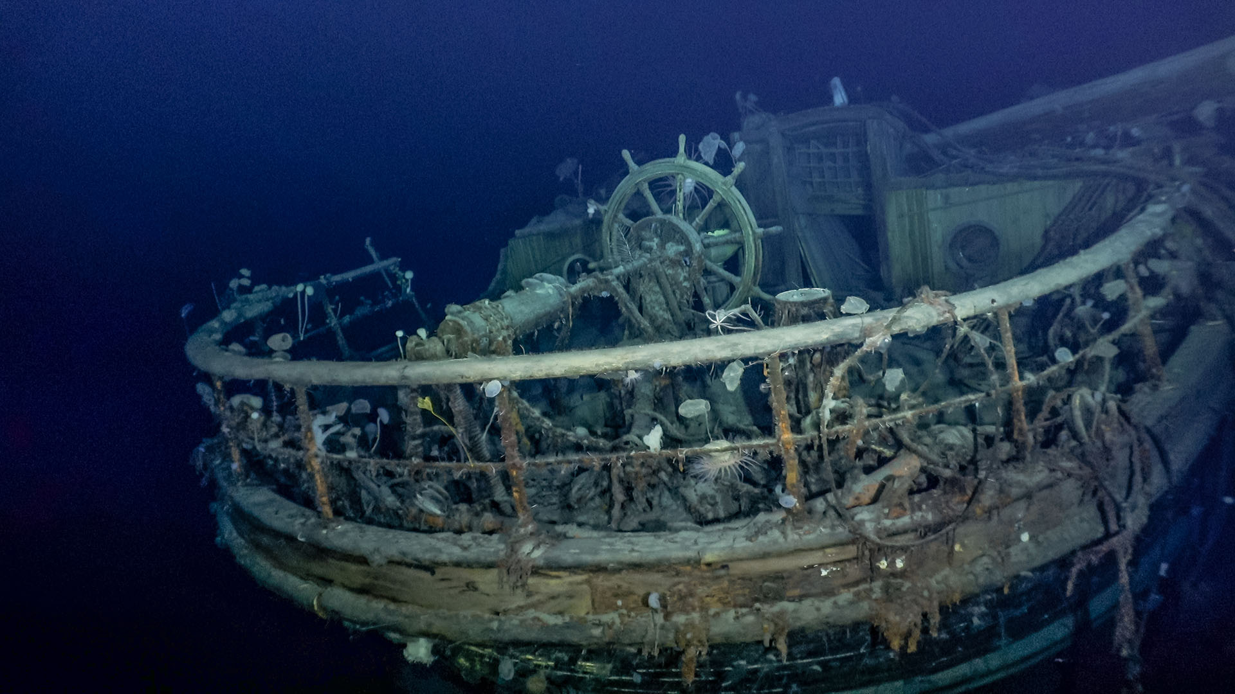
Marine Archaeology - Endurance22

Slide 18
Glossary
Autonomous Underwater Vehicle (AUV) | A specially built, controllable camera that can move and search beneath the sea and take high definition images
Celestial Navigation | Uses the sun, moon, stars and planets for navigating across the surface of the earth.
Meteorologist | Someone who studies the earth’s atmosphere and its interactions with the earth’s surface. An expert weather forecaster.
Oceanographer | A special kind of scientist who studies the ocean
Sabertooth AUV | The specially designed underwater vehicle with camera and sonar, used to search for the wreck of the Endurance
Sextant | A navigational device that measures the angle between two points such as a star and the horizon, and used to calculate latitude and longitude.
Sonar | Sonar, short for Sound Navigation and Ranging, uses sound waves to help explore and map the ocean. Sound waves travel farther in the water than do radar and light waves.
Subsea | Under the sea

Slide 19
LINKS
Royal Geographical Society - Geography resources for teachers (rgs.org) Timeline
Royal Geographical Society - Geography resources for teachers (rgs.org) Story retold
Endurance22 | Live Q&A With Dan Snow In Antarctica – YouTube
Drone Launched To Find Endurance Shipwreck In Antarctica! - YouTube
Endurance22 - The Hunt For Shackleton's Lost Ice Ship
Ernest Shackleton’s Ship Endurance Found - YouTube

