Slide 1
The Year without a Summer, 1816
How did the eruption of Tambora in 1815 affect the UK?
Investigating the Tempest Extreme Weather Database with KS2

Slide 2
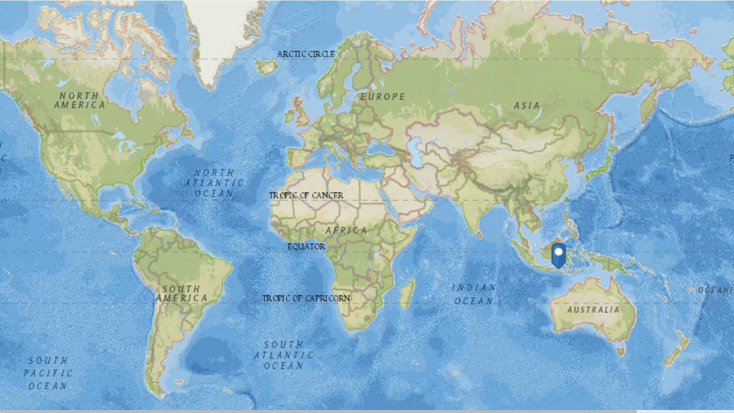
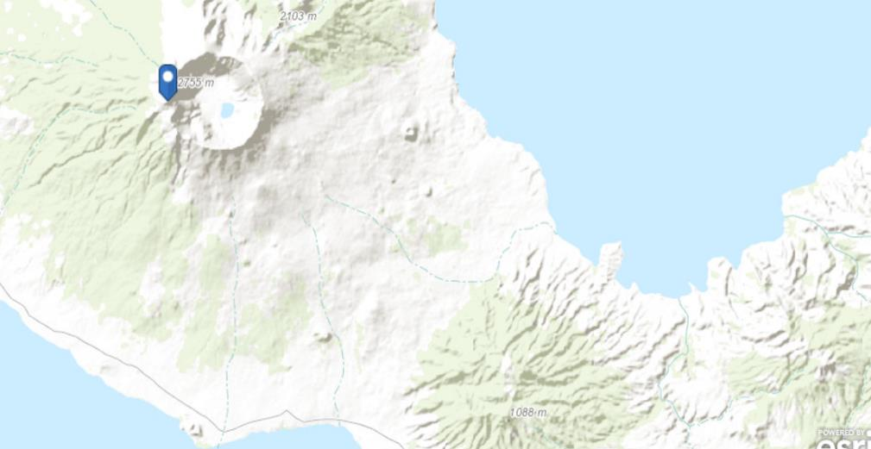
Mount Tambora
Mount Tambora is a stratovolcano on Sumbawa island, Indonesia.
The 1815 eruption of Mount Tambora was one of the most powerful in recorded history.
The ash from the eruption column dispersed around the world and lowered global temperatures to such an extent that the following year, 1816, is sometimes referred to as the ‘Year Without a Summer’.

Slide 3
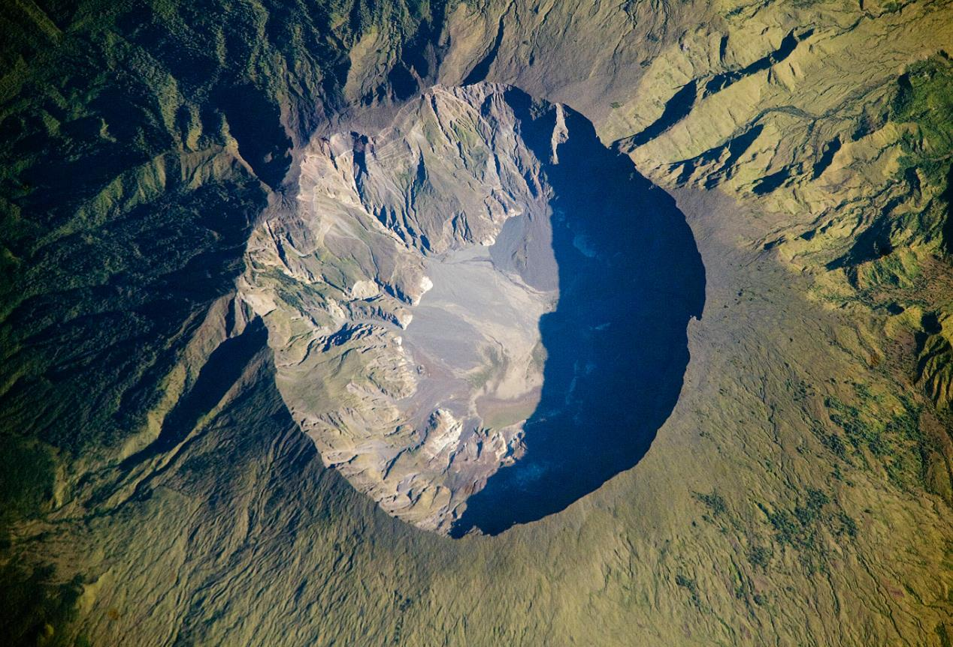
What did Tambora do in 1815?
In April 10, 1815, the Tambora Volcano produced the largest eruption in recorded history. An estimated 150 cubic kilometers (36 cubic miles) of tephra—exploded rock and ash—resulted, with ash from the eruption recognized at least 1,300 kilometres (808 miles) away to the northwest.
Enough ash was put into the atmosphere from the April 10 eruption to reduce incident sunlight on the Earth’s surface, causing global cooling, which resulted in the 1816 “year without a summer.”
https://earthobservatory.nasa.gov/IOTD/view.php?id=39412
Why might this affect long term weather patterns around the world?
What effect do you think the eruption of Tambora in 1815 had on the weather in the UK the following year, 1816?

Slide 4
A Year Without A Summer
Searching for records Summer 1816 across the UK

