Slide 1
Engaging Students with Reading in Geography
Emily Chandler
(@ChandlerGeog)

Slide 2
Why?
@ChandlerGeog
Further develop their literacy skills
Improve geographical understanding
Develop writing skills
Increase independence

Slide 3
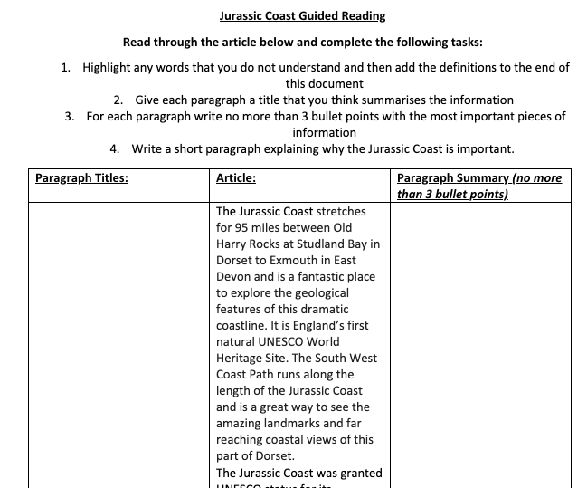
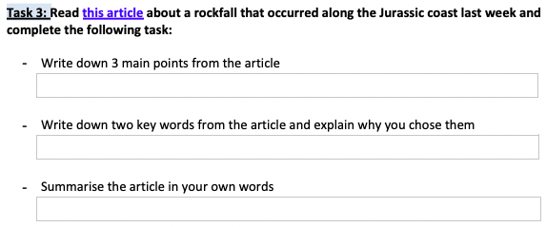
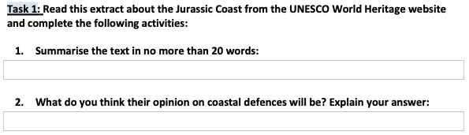
Engaging with the text and pulling out key information
@ChandlerGeog
Book: Closing the Reading Gap by Alex Quigley
3, 2, 1
Guided Reading
20 words summary

Slide 4
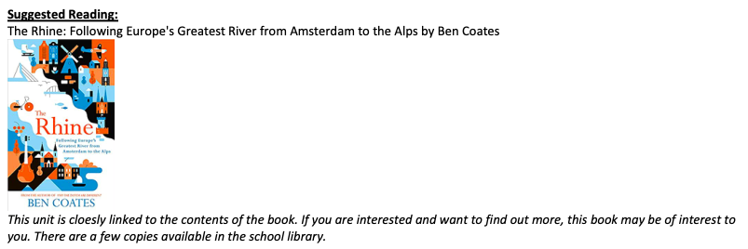
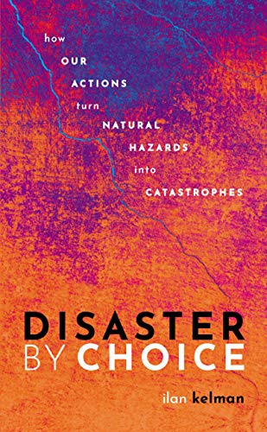
Linking Books to Topics
@ChandlerGeog
Year 7 - The Rhine
Year 9 - Risky World

Slide 5
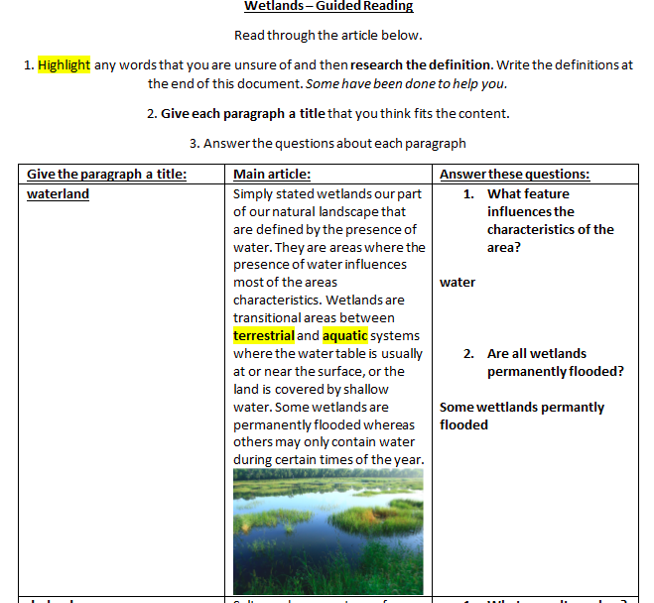
Supporting EAL/SEN learners
@ChandlerGeog

Slide 6
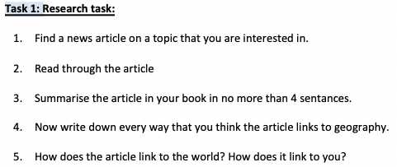
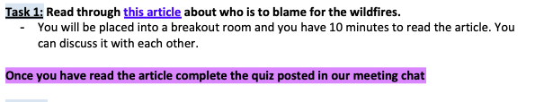
Increasing students interest in the text
@ChandlerGeog
Allowing discussion
Giving students choice
Link to interests

Slide 7
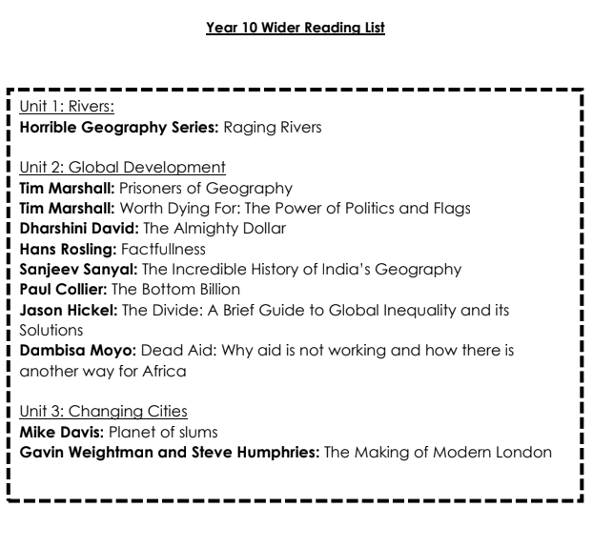
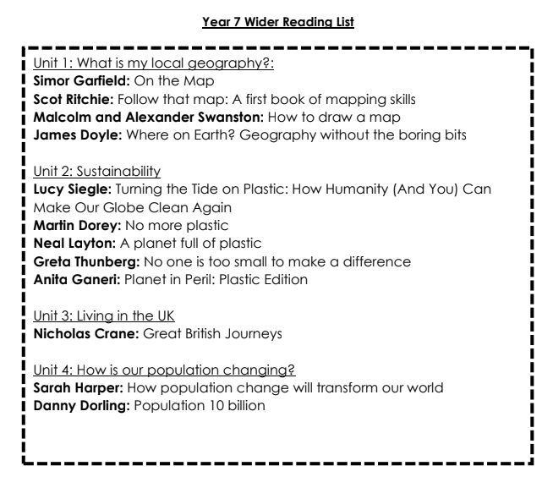
Encouraging reading beyond the classroom
@ChandlerGeog
Wider reading lists
The News

