Slide 1
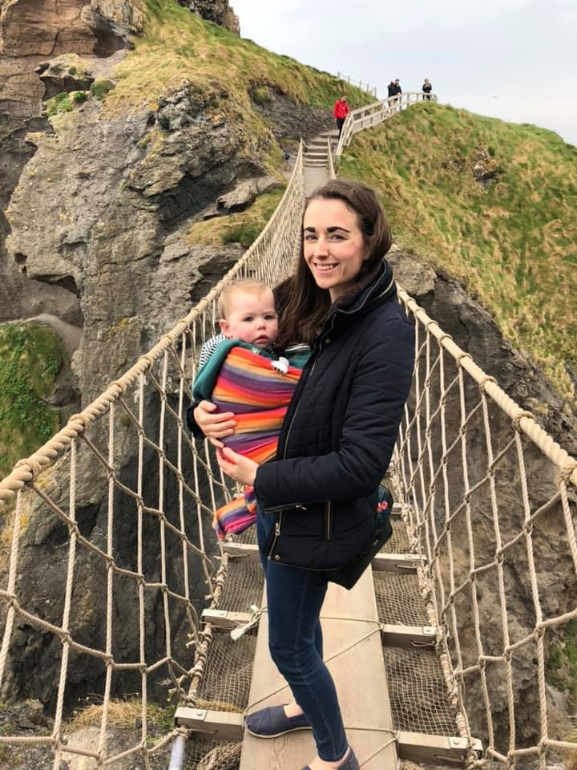
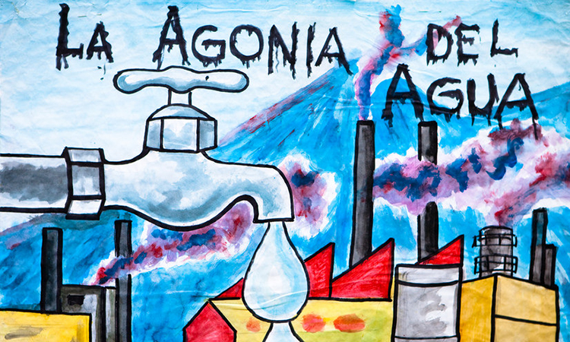
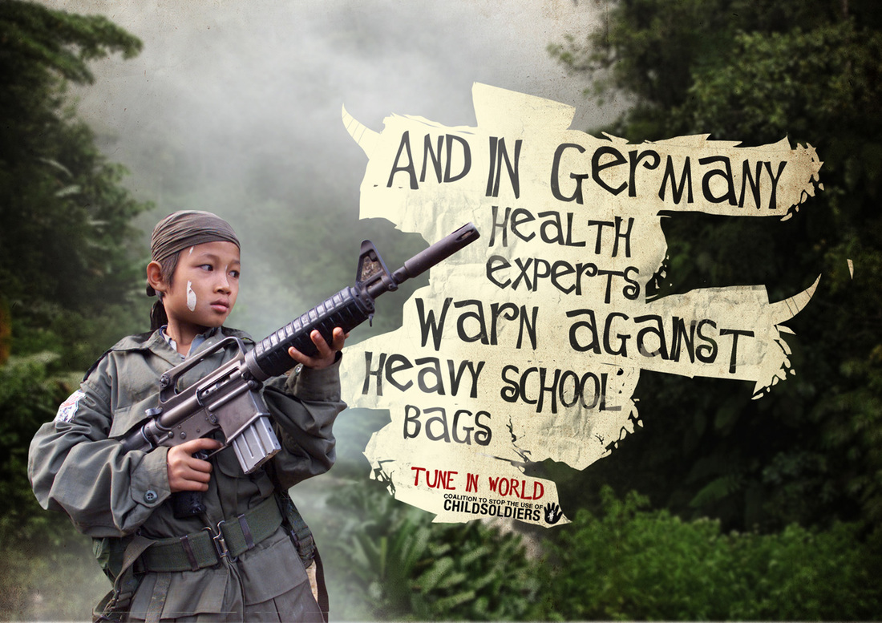

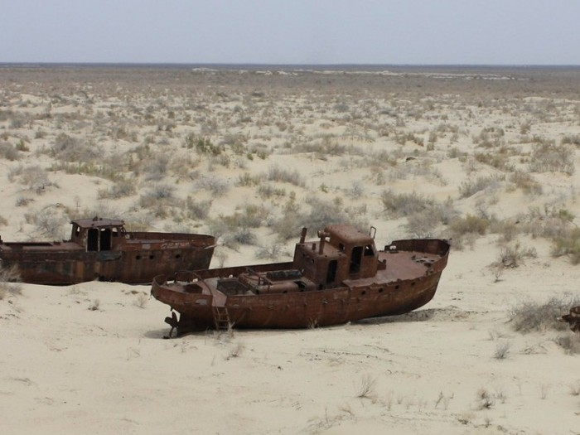

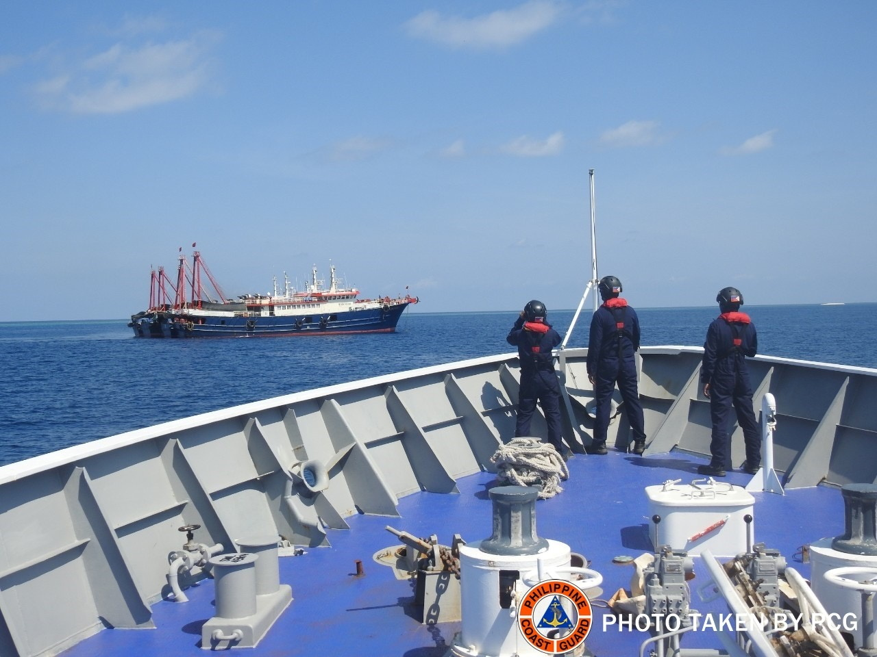
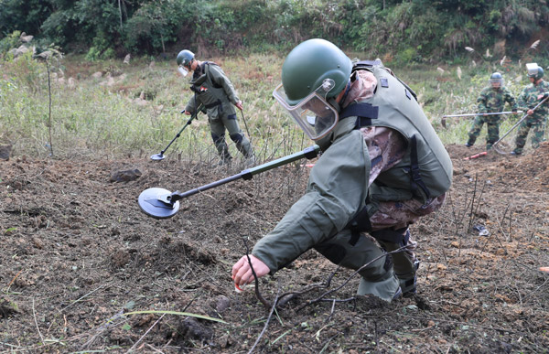


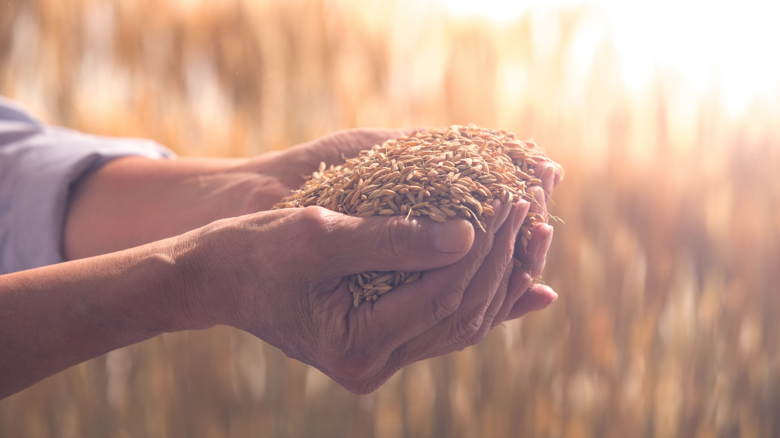
How we teach conflict at KS3
Fiona Sheriff
Head of Geography
Kingsthorpe College
@fiona_616

Slide 2

Initial thoughts
We wanted to create a unit which covers topics they see on the news – but often this news has no geographical context for students.
We also wanted to create a unit that got students engaging in debate. We wanted something thought-provoking with coverage of multiple locations.

Slide 3
What do we mean by conflict?

Slide 4







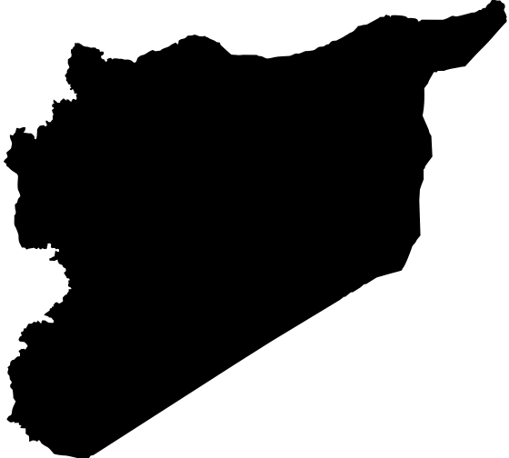


Our SOW
What is conflict?
La Guerra del agua
The Aral Sea
Blood diamonds
Child soldiers
HS2
Food security
Landmines
The South China Sea
Syria

Slide 5
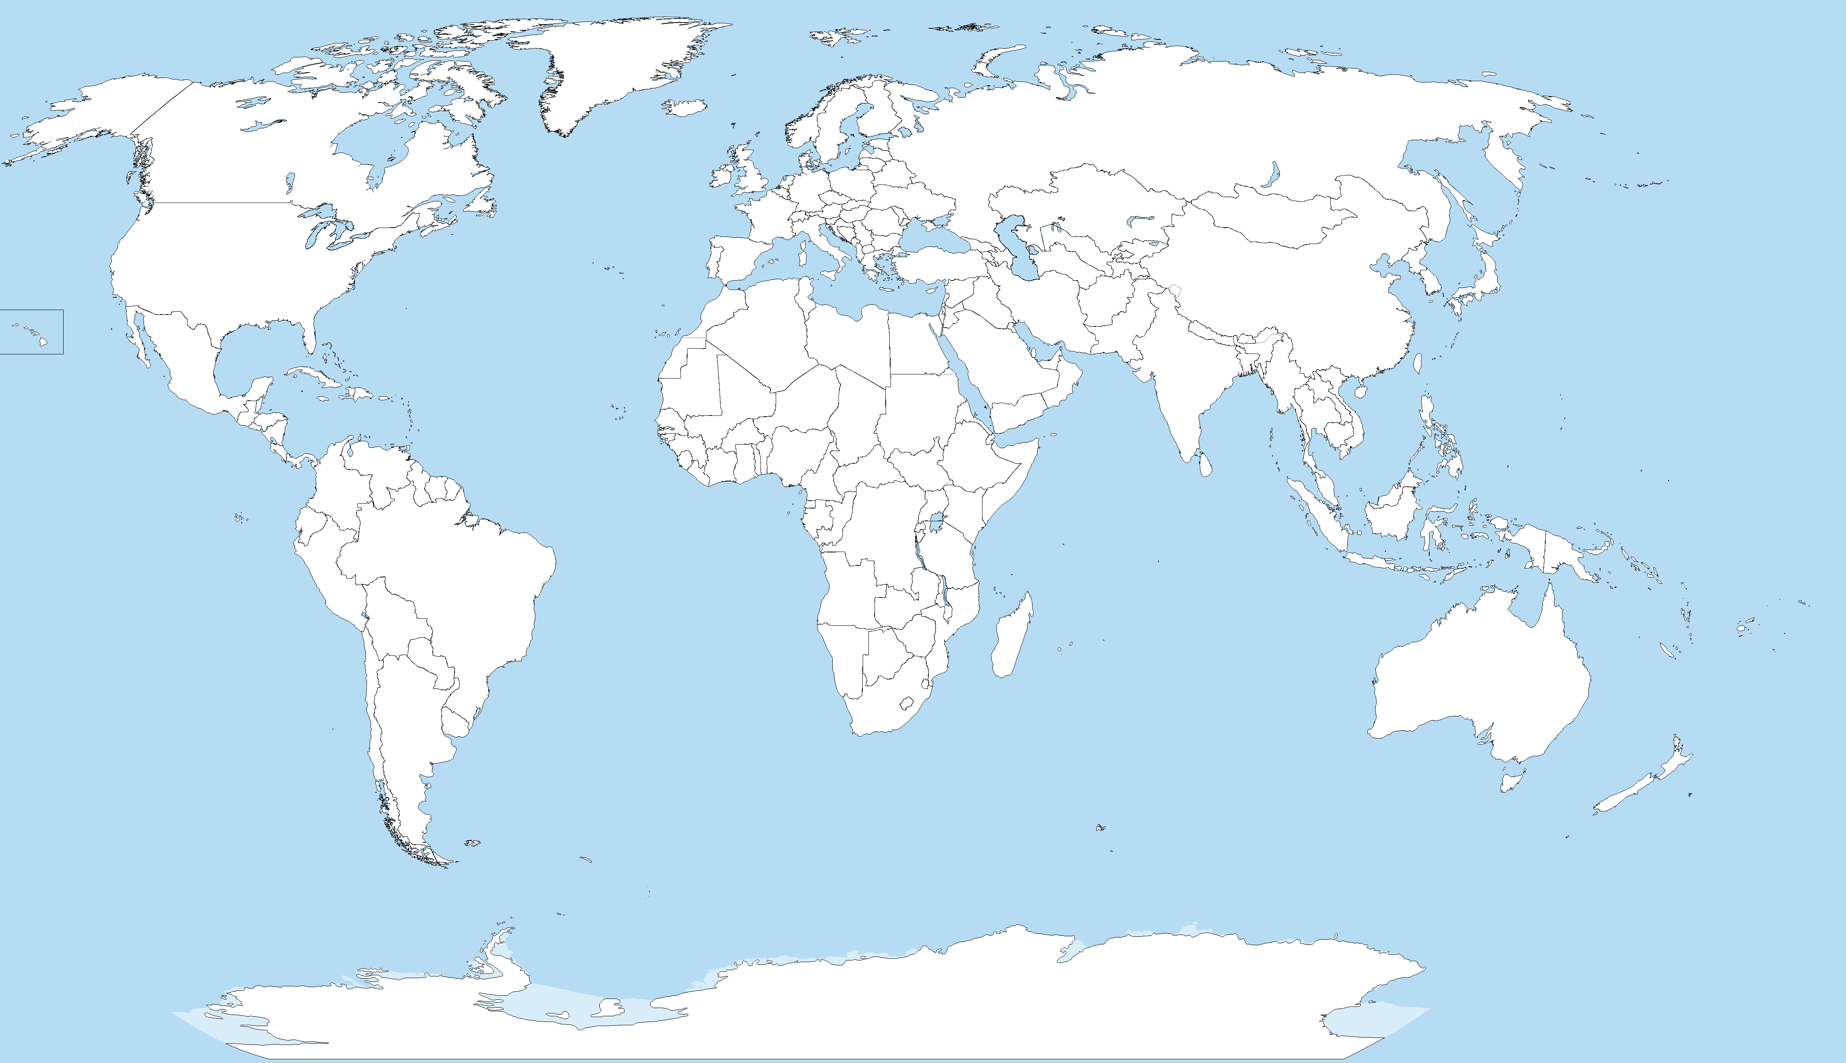

Slide 6
Stories
Campaigns
How do we bring the
topic to life?
Songs
Photographs
Decision Making
Media
Mapping

Slide 7
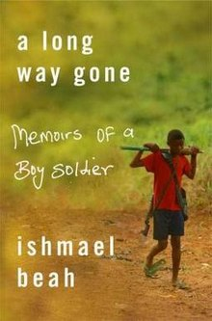

Ishmael Beah

Slide 8
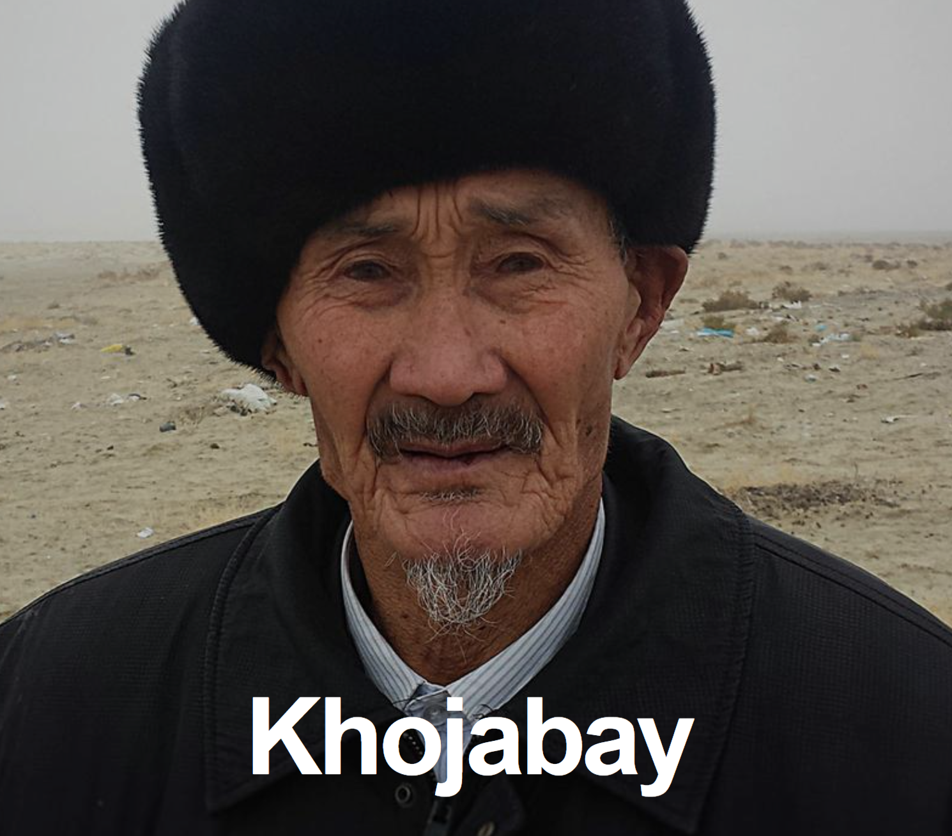
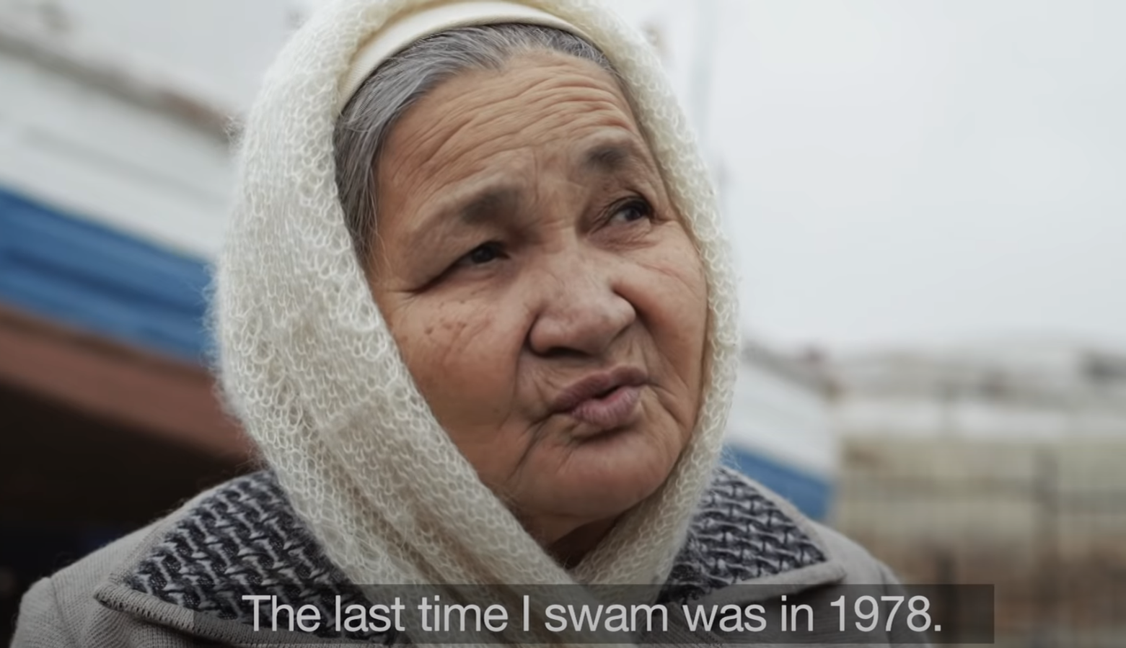
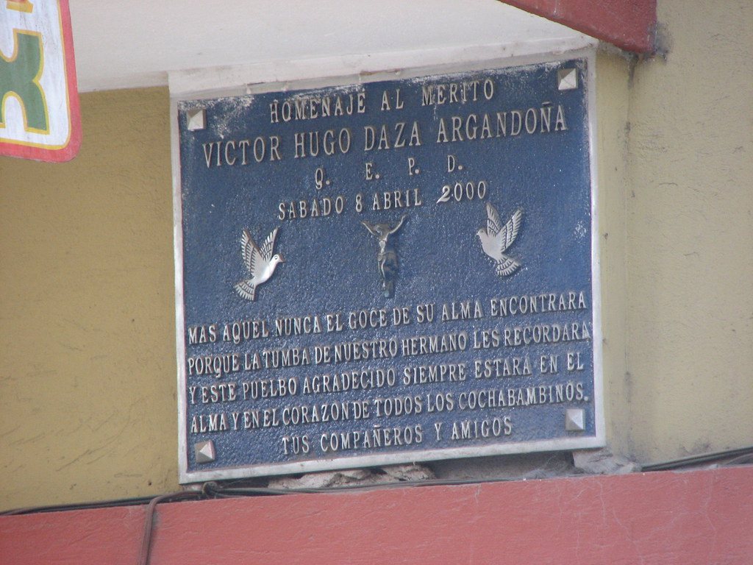


Slide 9
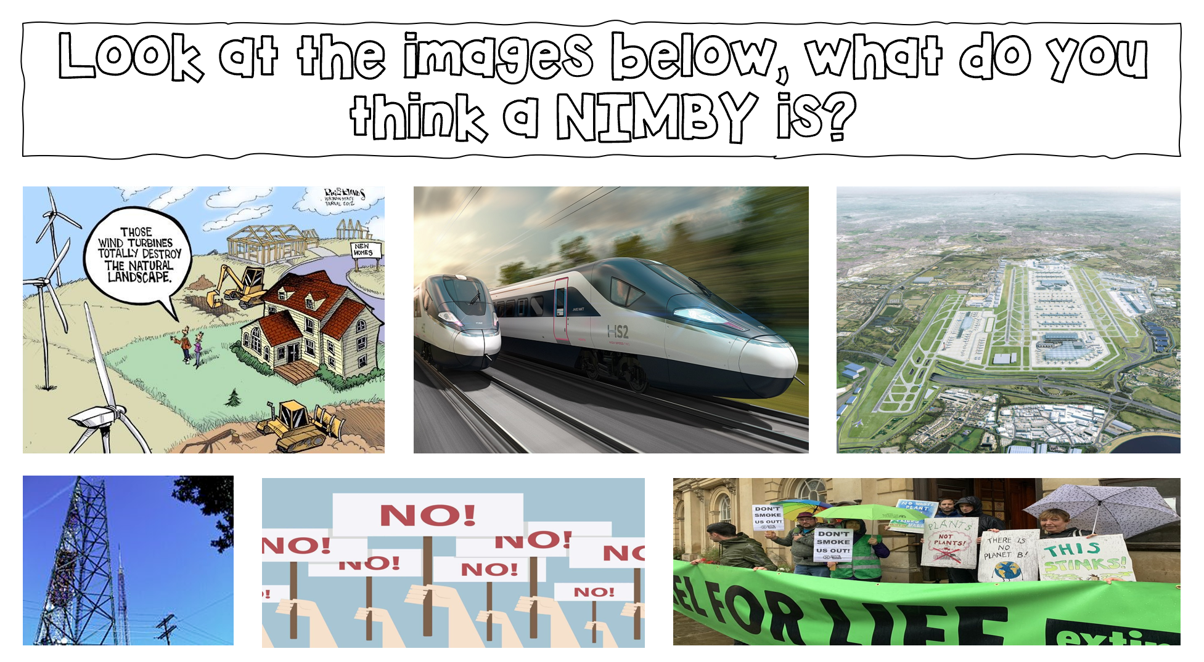
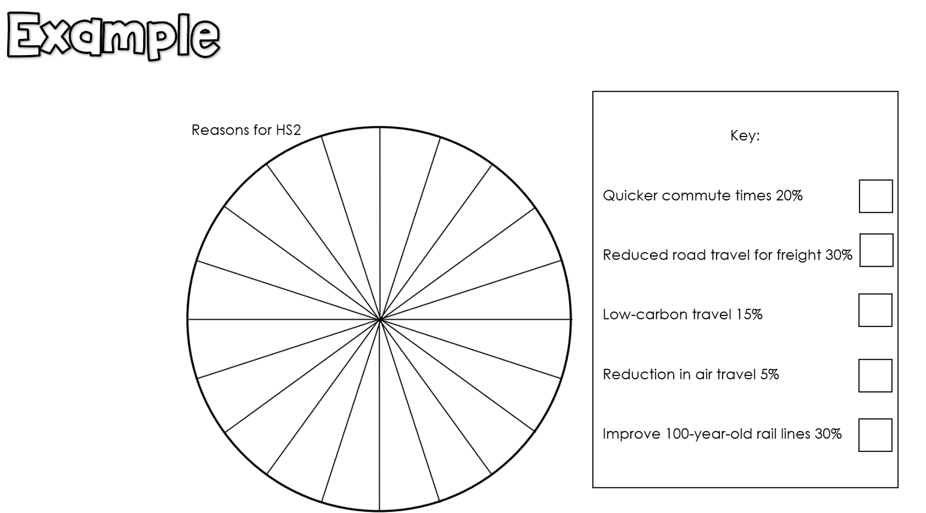
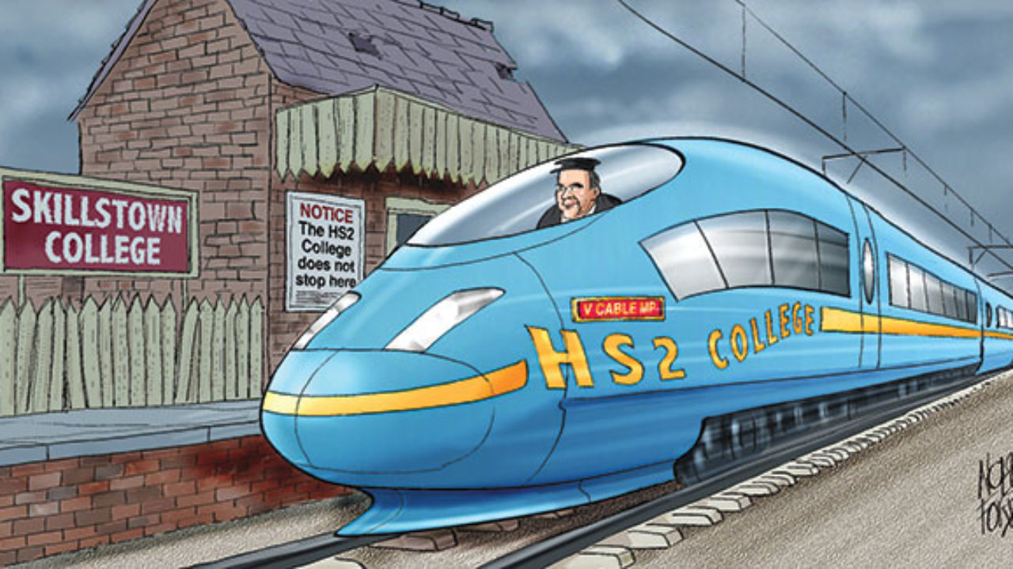
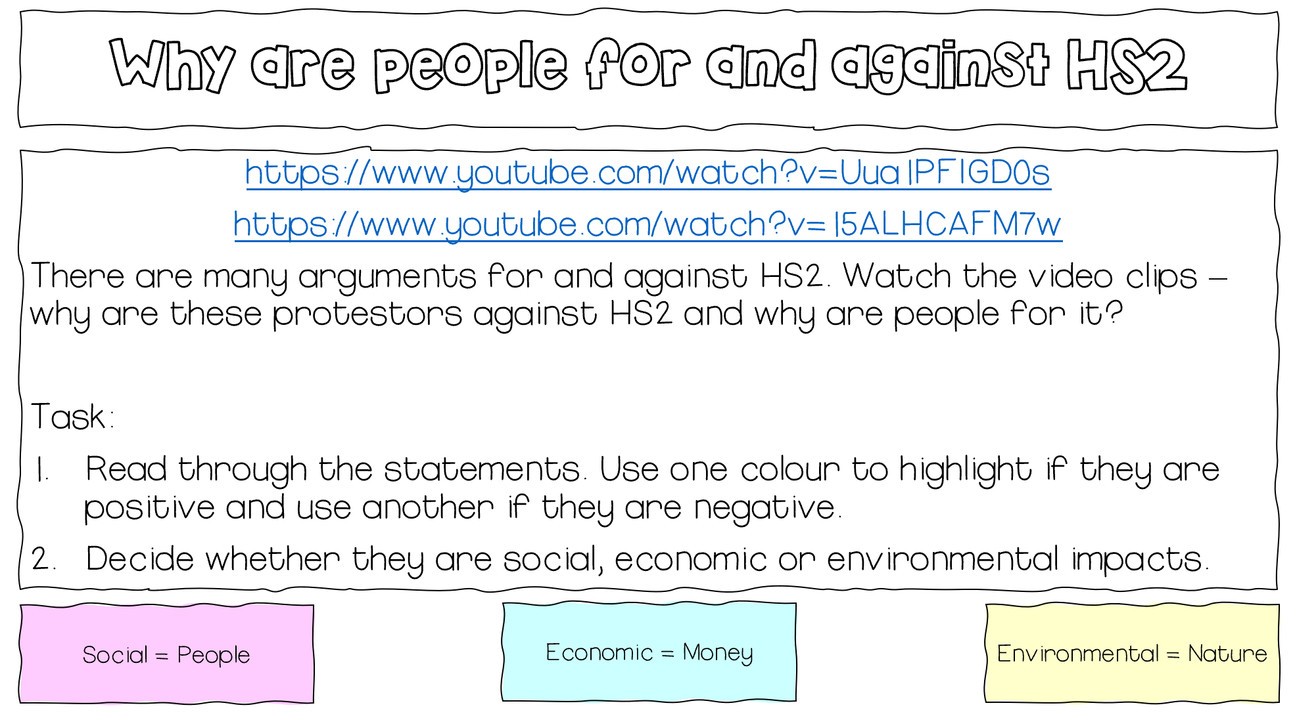
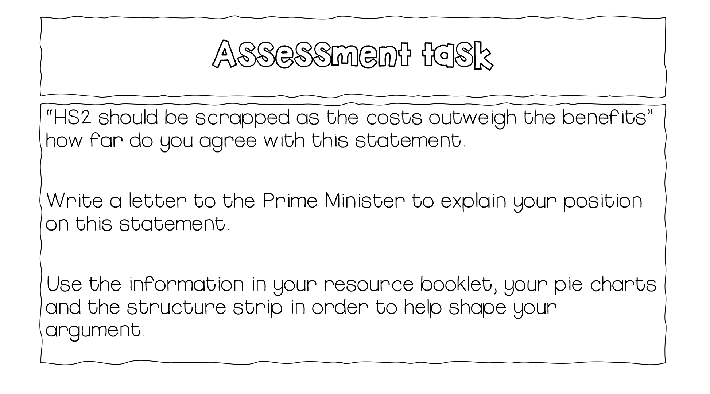
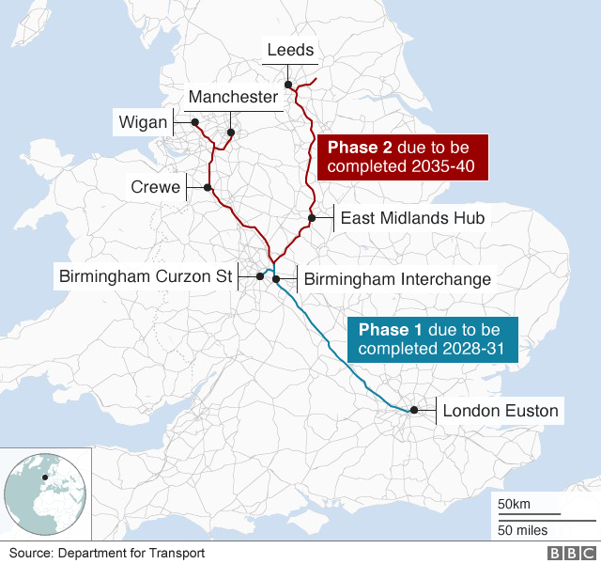
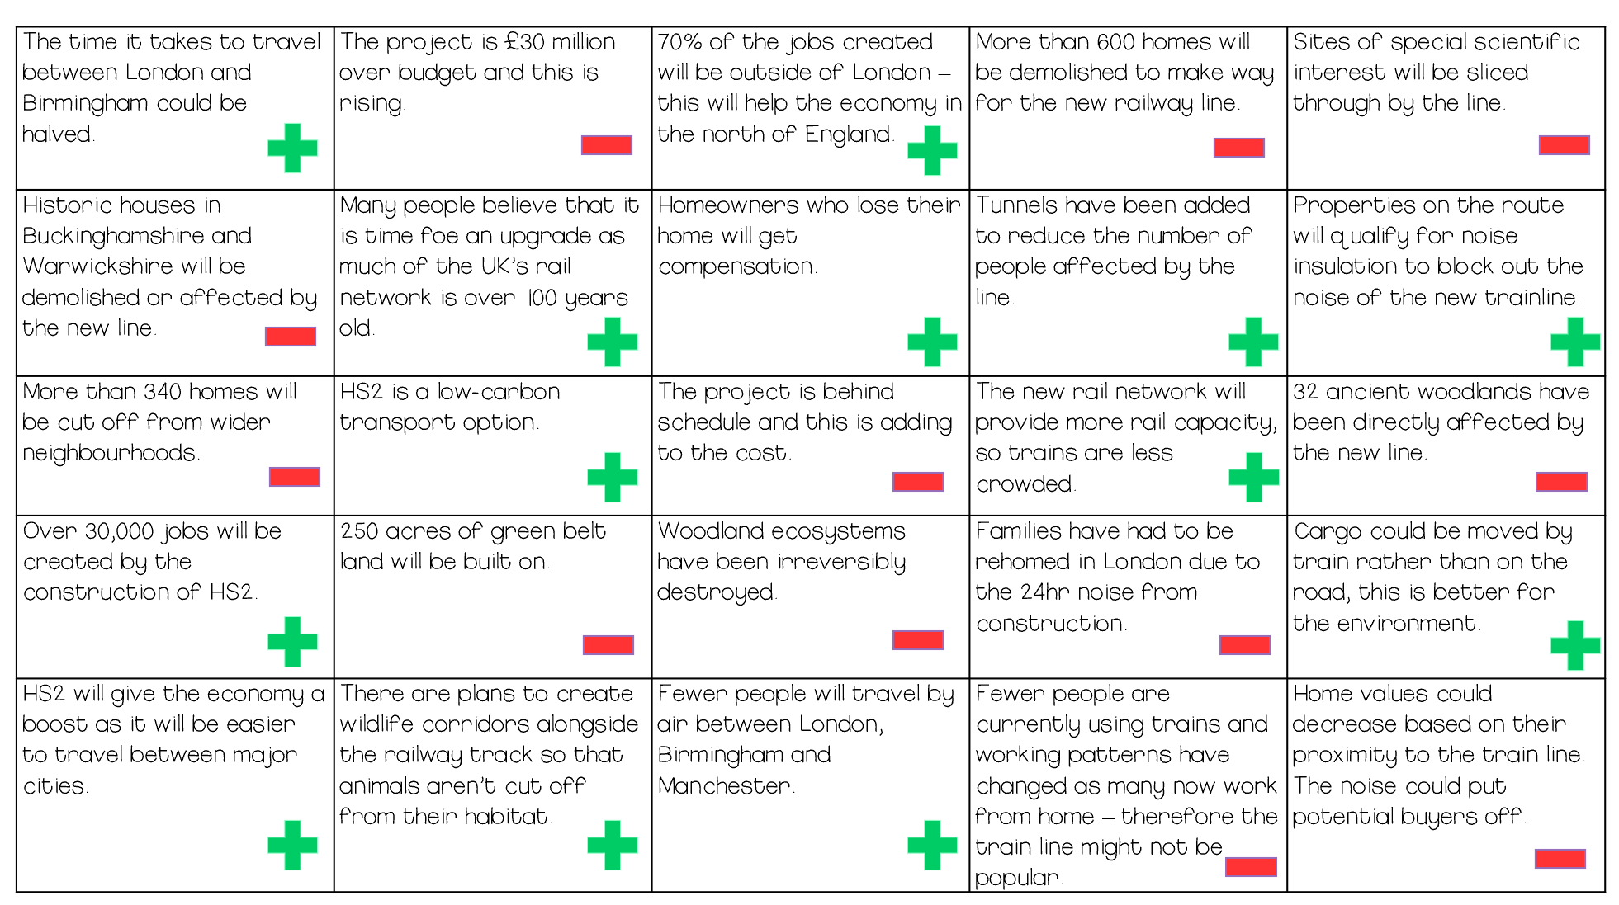
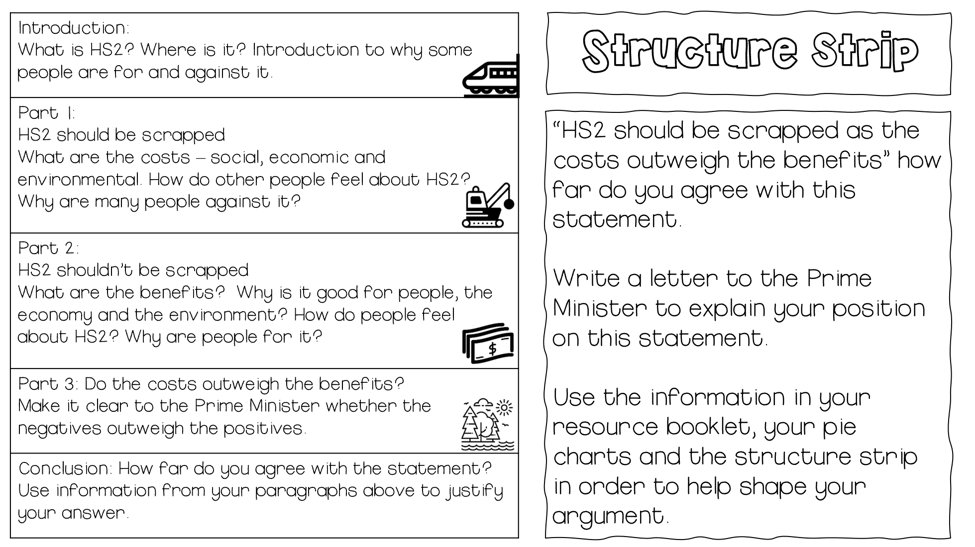

Slide 10
Why do we have to be careful?
This can be an emotive topic.
Danger of the single story.
Ensuring our views are broad and balanced.
Sticking to the geography.

Slide 11

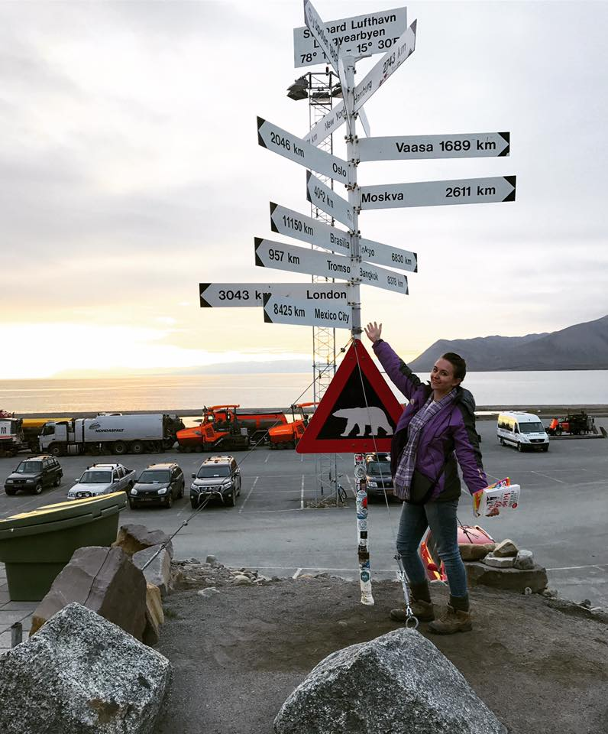
Conflict SOW
Thank you for listening!
@fiona_616

