Slide 1

Introducing globalisation
Connected people and places

Slide 2
Presentation Content
What do we think ‘globalisation’ means?
Identifying different aspects of globalisation
Globalisation and technology
Global changes over time (since 1945)
The benefits and concerns brought by globalisation
Conclusion: what we have learned

Slide 3
What is globalisation?
The growth of a global culture
More trade between countries
The internet connects people
Cheap air flights and travel
The global spread of wealth
Food and goods that cross continents
People are always using the word ‘globalisation’ but what does it mean?
Before we go any further, each student should try and write his or her own definition of the word
In groups, compare statements and look for common themes such as those shown opposite (on click)

Slide 4
Four aspects of globalisation
Economic globalisation
Social globalisation
Cultural globalisation
Political globalisation
What do the different words – economic, social, cultural and political – represent?
Can you suggest an example of each?
The next slide shows four examples. Match them with the words: economic, social, cultural and political

Slide 5
four examples of globalisation
A British Asian family visiting their relatives in India
Leaders of world nations meeting at a conference to discuss world trade
A German car manufacturer moving one of its engine factories to Brazil
A British teenager watching South Korea’s Psy sing ‘Gangnam Style’ on YouTube

Slide 6
Technology drives change
In just three years, mobile ownership has soared in Africa from two-fifths to almost two-thirds. In Europe, many people have two phones (for work and home)

Slide 7
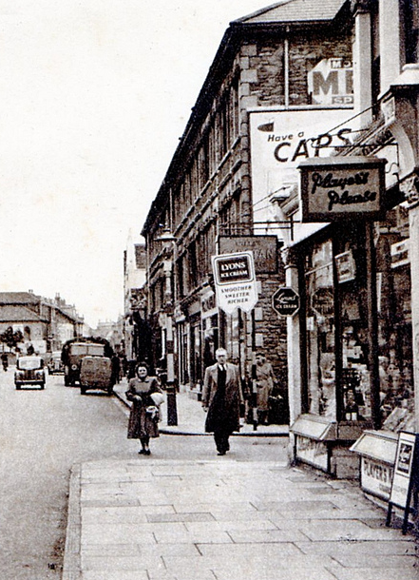
time 1
1945-1980
The ‘post-war’ era
Setting the rules for world trade

Slide 8
time 1
1945-1980
1944
World Bank is founded after World War II
1948
Jamaicans begin to move to the UK
1975
UK joins what will later be the EU
The ‘post-war’ era
Setting the rules for world trade

Slide 9
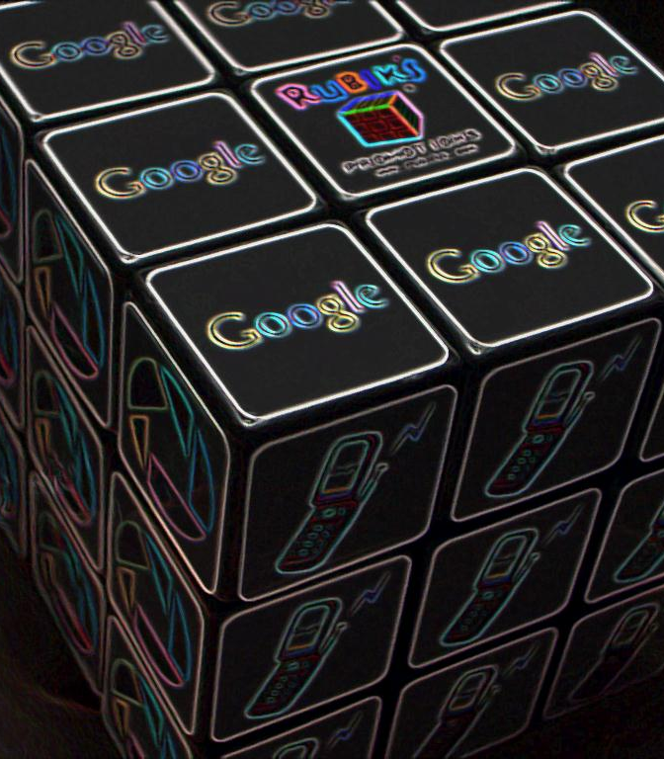
time 2
1981-1999
Big companies move overseas
Internet revolution begins

Slide 10
time 2
1981-1999
1990
First proper Windows computers
1996
Broadband available for homes
1998
Tesco opens first overseas store in Asia
Big companies move overseas
Internet revolution begins

Slide 11
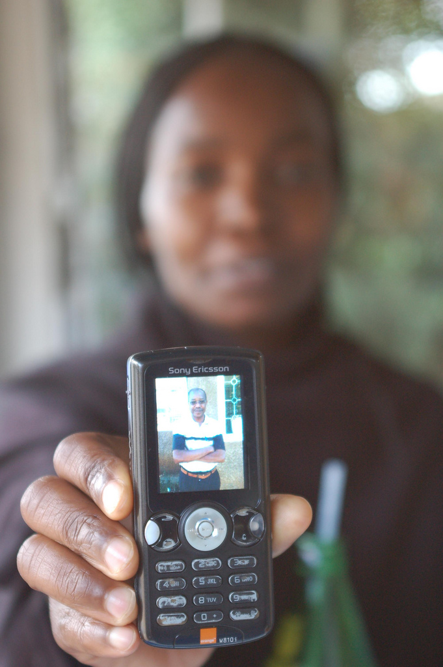
time 3
2000-now
Technology takes off
Rapid development in Asia and Africa

Slide 12
time 3
2000-now
2000
Millennium Development Goals launched
2004
Facebook is launched
2011
China becomes second largest economy
Technology takes off
Rapid development in Asia and Africa

Slide 13
benefits
Over recent decades there has been the fastest reduction in poverty in human history. This coincides with rising levels of global trade and investment
Since 1990, the population of developing countries living in extreme poverty (less than US$1.50 per day) has halved to just 21%
Life expectancy in many developing countries has risen to 70 years or higher
Globalisation has made the world a better place for many people

Slide 14
concerns
1.4 billion people still live in poverty, both in rural areas and slums of cities
Income inequality has increased in most countries
Polluting industries have moved from Europe and North America to Asia and Africa
Many factory and farm workers in Asia and Africa endure hard working conditions for low pay
Not everyone has benefited from globalisation yet. Some people may even be worse off

Slide 15
What’s your global view?
Tough work conditions for some ‘sweatshop’ and farm workers in Africa and Asia
Rising income for billions of people and increased life expectancy almost everywhere

Slide 16
What we have learned
Globalisation is a complex process that has developed over time
It has different economic, social, cultural and political dimensions
Technology has played a key role driving changes
The changes since 2000 have been especially rapid and have transformed lives in every continent
Although globalisation has benefited billions of people, concerns remain that it has changed some people’s lives for the worse

Slide 17

credits
Mobile phone growth data: http://www.itu.int/en/ITU-D/Statistics/Pages/facts/default.aspx
Google Rubik’s Cube: http://www.flickr.com/photos/ihorner/1903064070/sizes/l/in/photostream/:
1950s High Street: http://www.flickr.com/photos/brizzlebornandbred/6487384035/sizes/l/in/photostream/
Mobile phone picture: whiteafrican (Flickr Creative Commons license)

